Slide 1
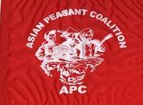

Slide 2
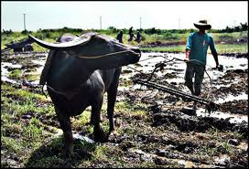
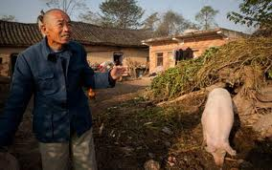
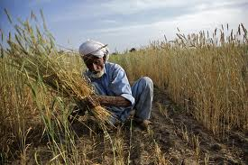
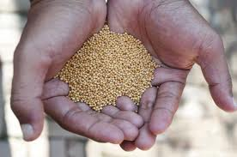
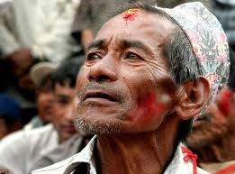
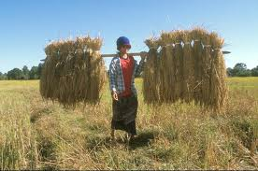
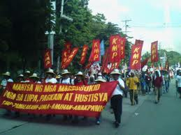
The Asian Peasant Coalition (APC)
The Asian Peasant Coalition (APC) emerged from the Asian Peasant Conference that took place on March 29-30, 2003 in the Philippines that took a very strong anti-imperialist stand and symbolized the strengthening and further consolidation of peasant movements throughout Asia.
APC is an Asia-wide peasant coalition of farmers, landless peasants, fisherfolks, agricultural workers, dalit, indigenous peoples, herders, pastoralists, peasant women and rural youth. It held its 1st general assembly (GA) in November 2004 in Bangladesh, and the 2nd GA in December 2006 in Indonesia.. It has more than 15 million members representing 33 organizations coming from 9 countries in Asia such as Bangladesh, India, Indonesia, Malaysia, Mongolia, Nepal, Pakistan, Philippines and Sri Lanka.
APC fosters close relationship with all democratic and progressive people’s movements towards gathering their support for the plight of the peasants of the region. It also support the struggles of all the toiling masses in the world.

Slide 3
Organizations (32 Organization From 9 countries with 15 million members)
Bangladesh:
Bangladesh Krishok Federation (BFK)
Bangladesh Kishani Sabha (BKS)
Bangladesh Bhumiheen Samity (BBS)
Bangladesh Agricultural Labour Union (BALU)
Bangladesh Agricultural Farm Labor Federation (BAFLF)
Nepal:
All Nepal Peasant Women Association (ANWA)
All Nepal Peasant Association (ANPA)
Monggolia:
Foundation of Agricultural Development (FAD)
India:
Andhra Pradesh Vyavasaya Vruthidarula Union (APVVU)
Tamil Nadu Women’s Force
Indian Federation of toiling Peasants (IFTOP)
South Asian Peasant Coalition (SAPC)
Alliance of Peoples’ Movement
Andra Pradesh Migrant Workers Union
Andra Pradesh Fisher Peoples’ Union
Andra Pradesh Agricultural Migrants Union

Slide 4
Organizations
Sri Lanka:
Movement for National Land and Agricultural Reform
National Farmers Assembly
Vikalpani National Women’s Federation
Sri Lankan Peasant Front
Malaysia:
TENAGANITA (Women’s Force)
PANAP
Indonesia:
Alliance of Agrarian Reform Movement (AGRA)
Pakistan: (PKMT) Peasant Movement of Pakistan
Roots for Equity
Phillippines:
Kilusang Magbubukid ng Pilipinas (KMP)
AMIHAN ( National Federation of Peaasant Women)
UMA (National Federation Of Agricultural Workers Union)
PAMALAKAYA ( National Federation of Fisherfolk Oganizations in the Philippines)
National Federation of Sugar Workers (NFSW)

Slide 5
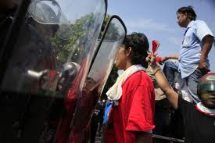
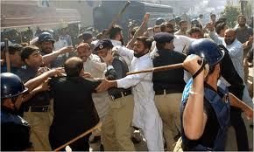
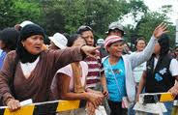
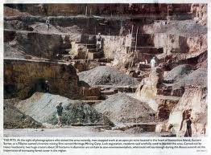
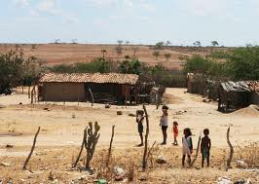
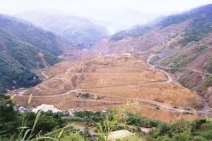
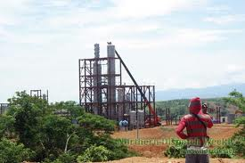
Problems of the Asian Peasants
Intensified Landlessness
“Legalized” Land Grabbing by the landlords, state and foreign agri businesses
Feudal and Semi Feudal practices
Criminalization of agrarian cases
HRV’s (human rights violation)
Agro Chemical TNC’s supported by the state
Food insecurity
Environmental destruction/climate crisis due to the imperialists corporate agenda
Oppression, displacement, discrimination including caste, and violence in all forms of peasant women due to corporate globalization, patriarchy, fundamentalism, militarization and state violence.
Large scale and destructive mining operated by MNC’s and TNC’s

Slide 6
Continuing Struggle
Asian peasants continue to educate, organize and mobilize to fight back
The agricultural workers’ movement struggle for land, living wages, security of employment and safe working conditions.
We have strengthened the peoples movement on climate change and the peoples self determination in food sovereignty and agriculture
We have strengthened our movements and unities at the regional and international levels; building alliance to other people’s movements
We integrated the peasants struggle for genuine agrarian reform and food sovereignty in the over-all struggle for freedom and democracy.
We are calling for the consolidation of people’s movements to resist imperialist globalization, feudalism and state repression.

Slide 7
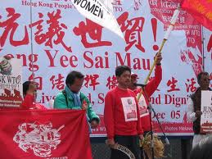
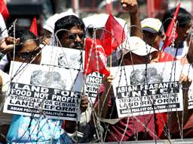
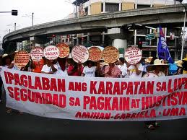
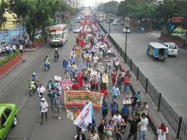
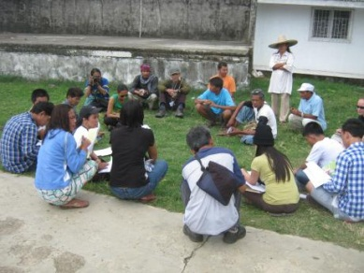
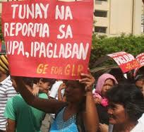
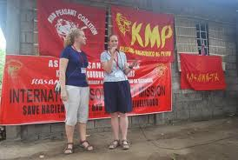
Core Strategies of APC
1. Movement building and resistance
a. Focus on realizing genuine agrarian reform and food sovereignty;
b. Resisting corporate and state aggression, including all forms of land grabbing;
c. Strengthening the resistance of people’s movement thru the realization of access and ownership to land and ecological agriculture;
d. Strengthening and developing ecological agriculture and regeneration of ecosystems; and
e. Building community resilience to realize climate justice.
2. Strengthening and expansion of the movement
a. Strengthen people’s movement and resistance thru realization of peasants rights
b. People to people exchanges; and
c. Alliance building and consolidation of struggle thru partnership with other people’s movement and organization,.
3. Strengthening governance and accountability within APC.

Slide 8
Gains and Victories
*Wage increase of agricultural workers in the Phils. and India
*Asserting Peasant’s rights to land and livelihood (Indonesia, India, Bangladesh & Philippines)
Land rent reduction (50%)
Freeing our colleagues from unjust imprisonment
Oppossing and Stoping destructive Mining operation
Nurturing of seeds and community seed banking
Strengthening peasant’s cooperation
Campaign against agrochem TNC’s/Prohibited GM crops
Gaining broad support from different sectors and abroad

Slide 9
Let us persevere in our struggle against Globalization! Fight for land and Genuine Rural Development!
Long Live International Solidarity!
Thank you!

