Slide 1
Enabling Environment and Policy Support for Agroecology
Fr. Francis B. Lucas
Chairperson Emeritus,
Asian NGO Coalition for Agrarian Reform and Rural Development (ANGOC)
Alliance Against Hunger and Malnutrition (AAHM) Regional Node

Slide 2
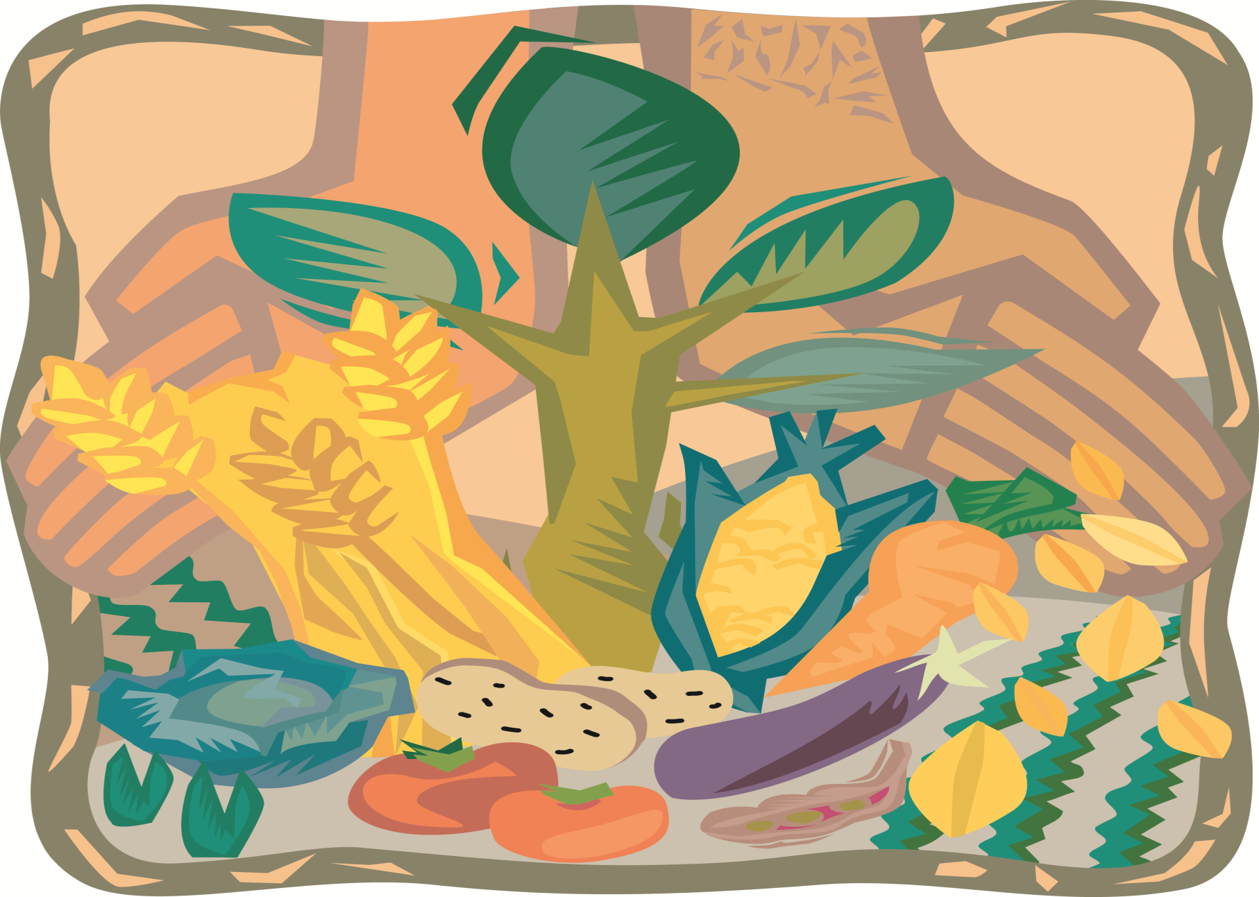
Conserving Agrobiodiversity = Survival of Life on Earth

Slide 3
Life/Survival AGRO ECOLOGY AND AGRO BIODIVERSITY
Increase of Synthetics/ Technology
Population Growth
GNP/GDP
WD Econ.Growth
Rapid Industrialization of new economies
Climate Change
Ecosystem destruction
Agricultural
Land
Agricultural
Population
INEQUITY
OBESITY
MALNOURISHED
Most vulnerable are the Poor.
Small Food Producers; most dependent eco systems and Biodiversity for Survival

Slide 4
Loss of Biodiversity (Source: FAO, 1999 www.fao.org/FOCUS/E/Women/Biodiv-e.htm)
Why?
Industrialization leading to Reductionist Science
Commercialization of food production; IPRs of PGRs
Consumerism, changing consumption patterns
75% of Plant genetic diversity in Agriculture lost since 1900s
90% of Crop varieties lost from farmers’ fields
Half of domestic animal breeds gone
Fishing grounds overfished,
Deforestation from agricultural expansion, urbanization and natural disasters
Only 12 plants and 5 animal species generate 75% of the world’s food.

Slide 5
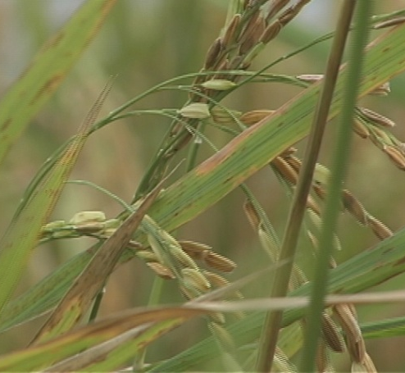
Sustainable Agriculture !
Who practices S.A.?
SA conserves the seeds of life, the genetic resources that could feed the planet, in a sustainable, equitable, ecological and healthy balance of eco systems

Slide 6
The Boon and Bane of Green Revolution

