Slide 1
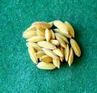
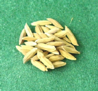
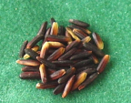
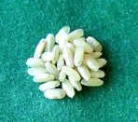
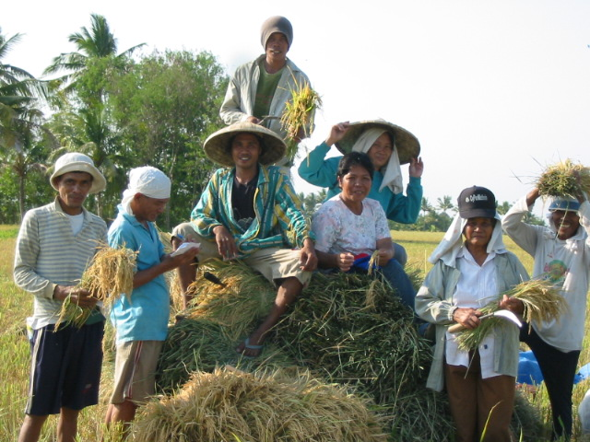
Enabling Environment and Policy Support to Sustainable Agriculture:
The experience of MASIPAG in the Philippines
Elizabeth Cruzada, MASIPAG
www.masipag.org
info@masiipag.org
CSO Meeting: Consolidating Efforts for Effective Engagement on Food and Agriculture Governance
Hanoi, March 10-11 2012

Slide 2
Rural households, who are the majority of our poor and hungry, must be able to feed themselves.
Sustainable agriculture is key to food security of rural households, food sovereignty and empowerment of peoples and communities:
REVERSE THE IMPACTS AND TRENDS OF GREEN REVOLUTION
PUT AGRICULTURE BACK INTO THE HANDS OF FARMERS, AWAY FROM CORPORATIONS AND AGRIBUSINESS.

Slide 3
MASIPAG: Farmer-Scientist Partnership for Agricultural Development

Slide 4
Locally Adapted MASIPAG Rice and Tradiotnal Rice Varieties
MASIPAG: Farmers’ control over seeds and technologies
Pangasinan – Lamyung, Bulik, Mogen, Cinamon, , Pandan, Sampaguita, Parirutong, India, Resco, Imp. Milagrosa, C22, M45, M3-4-1-2, M69-2-1, M120-4, M10-2-2-5, M44-3, M4-B1, M5-B1, M40-2-2, M44-1, M140-2, M8-3-1
Kalinga – Onay
Cagayan – Elon-elon, Ag 5, M8-3-1,
M35-1-1, M45-1, M69-4-1
518 Peoples Organizations
60 Non-Government Organizations
18 Scientist-partners
67 farmer rice breeders; 21 corn breeders
100+ farmer-trainors (volunteers)
☑ On-farm research resources
226 PO-managed trial farms +10 back-up
9 PO-managed chicken gene pools
Rice collections: more than 2000 varieties, including farmer-bred lines
☑ Practitioners in 49 provinces, and estimated to have reached 35000 smallholder households
Nueva Vizcaya – Pinili, Hinomay, Valentino, Ag 19, M11-20, M3-6, M109, M5-6, M45, M90, M11-20SG, M5-1, M30-1, M135-1, M19, 102
Zambales -, Fortuna, Pandan, Japanese 3, C21, M45, M11R
Aurora – Elon-elon, Camoros, Sampaguita, Wag-wag Aga, Palawan, Raminad, Londan-honay, Galo, Ag 5, Ag 17, Kadali, Ag 27, White Borong, Fortuna, M21, M6-11-1, M3, M4, M35
Nueva Ecija - Wag-wag Aga, Senador, AG5, AG10, Abra white, C22, M115-R, M146-1, M4-3-1, M45-1, M21-2-B2, M104-2R, M108-1R, M35-4-1, M69-2-2, M5-BD-2, M130-3, M48-1-1, M11-5-1, M86-3-1, M21, M11, M69, M5B2, M30, M45, M36-4-2, M4-3-1
Oriental Mindoro – Elon-elon, Ka Luis, AG5, GV3, M13, XO, M97, M11, M45-1
Aklan – Imp. Camoros, M45-1, M15-12-1, M11-5-1, M31-37-B4, M21-b1-1, M76-4-1, M2-1-1, M5-CS, M125-2, M140-1, M13-2-1B, M5-A1, M11-5-1, M36-2-1
Laguna – Wag-wag Aga, Sampaguita, BS Nagkarlan, Africa, M5-AS, M8-2-1, M62-1-2, M45, M5-B-2, M13-1-1, M13-1-1B, M36-4-1, M30-10-1B, M4-3-1, M3-2-1, M10-2-1
Quezon – AG17, AG5, M41, M35, M12-21
Antique – AG5, AG10, 16-70D, San Pablo, Minantika, Red Rice, M5-BD, M5-CS, M21-B3, M21-B1-1, M21-37-B4, M36-1, M36-3, M36-4-1, M62-1-1, M104-2, M139-2
Capiz – Libtong Mal, Milagrosa, Kadidit, Ag 23, M16-3, M115-1R, M114-4
Camarines Sur – AG24, Elon-elon, M5-A, M48, M70, M102, M103, M106, M107, M110, M112, M128, M131, M143
Negros Occidental – Wag-wag, AG10, AG5, Binangan, Dinorado, Fortuna, Imp. Borong, Imp. Milagrosa, Inuwak, Macan, Red Borong, Sampaguita, White Borong, Zambales, 2R-IN, 90D-42, 90D-43, 90D-44 Bugana Rice, GL1-8-1, GL4-5-5, GL4-9, M10-2-1, M104-1R, M11-20-1, M117-1R, M127-3, M13-2, M133-1, M139-1, M15-12-1, M20-1, M21-37-B4, M22-2-1, M36-1, M36-4-1, M4-4B, M5-BD, M50-1-1, M50-2, M5-AS, M62-1-1, M62-1-2, M6-6, M69-3-1, M8-2-1, M8-3-1, M90-2, M90-LG, MV4-4, Mv4-8
Agusan del Norte- Palay Damo, AG5, AG10, Sta. Maria, San pablo, Carandang, Bengawan, Jap 1, Tapol 1, India, M5-AS, M117, M11-20-1, M11-20-B2, M4-4B, M5C, MC14-2R, M87-W, M6-14-1-1
Iloilo - Kagingi, Imp. Camoros, Malido, Lubang, Inuwak, red Borong, M15-12-1R, M10-2-1
Surigao del Sur – San Pablo, M2-1-1, M5-BD, M13-2-1B, M3-4-1, M93-1
Zamboanga del Sur – White Bengawan, Red Elon-elon, Red Wag-wag, AG5, AG17, C35, M101-1-1, M112-4, M115-6, M76-3-1, M8-1-1-2, M86-4-1, M97-2-1, M35-1-4-1, M97-ES, M5-AS, M15-12
Bohol - Melobina, Maragay, Ag 5, Magsanaya, M148-1, SKK
Davao del Norte – AG5, Layong Mabilog, Cicadiz, Sampaguita, Milagrosa, Hinumay, Malagkit, Tinangi, Bogret, Camoros, San Pablo, Red Wag-wag, Wag-wag Aga, M35, 4-11-90, M21-4-1, M58, M50, M59, M75-1, M4-4-B2
Lanao del Norte – Ala, Wag-wag Aga, Sulig, Hinumay, AG5, M15-12-1, M19, M68, M91, M86-4-1, M109, M117-1-1R, M108-1R, M36-2, M86-4-1, M8-3-1
Davao del Sur – AG5, M117-3, M15-12-1, M117, M95-5, M5-AS
South Cotabato – San Pablo, AG5, M2, M3-1-1, M5-CS
North Cotabato – C21, Moguama Africa, Nagdami, Vahari, Vadani, BS Nagkarlan, Maligaya Rice, Pinitumpo, AG5, Puro-puro, San pablo, Tinagi, M35-1-2-1, M67-2-1, M5-BD, M26-4-1, M115-1A, M108-1R, M5-C3, M5-CS, M4-4B, M36-4-1, M14-1-1, M11-6-1, M123-2, M129-1, M10-2-2-5, M11-20-1, M11-6-1, M30-10-1B, M36-4, M-AS, M5-B2, M94-4-1,, M11-6-1, M126-1-2, M13-21B, M131-1, M146-1, 21-2-B2, M15-12-1
Bukidnon – Lubang, C18, Senador, Wag-wag Aga, Bengawan Puti, red Elon-elon, Red Borong, AG24, Bogret, Makagina, Mamintana, Pungko, Sologanon, SP Red, Sta. Maria, Sto. Niño, Sulig, AG5, Maligaya Rice, AG10, Puro-puro, Red Binato, M5-BD, C11-4, Dong Red, M76-1, M94, M15-12-1, M3-4-1, M35-3-1, M51-1-1, M51-2, M5-C, M70-1W, M75-1, M86-1, M90-LG, M93-1

Slide 5
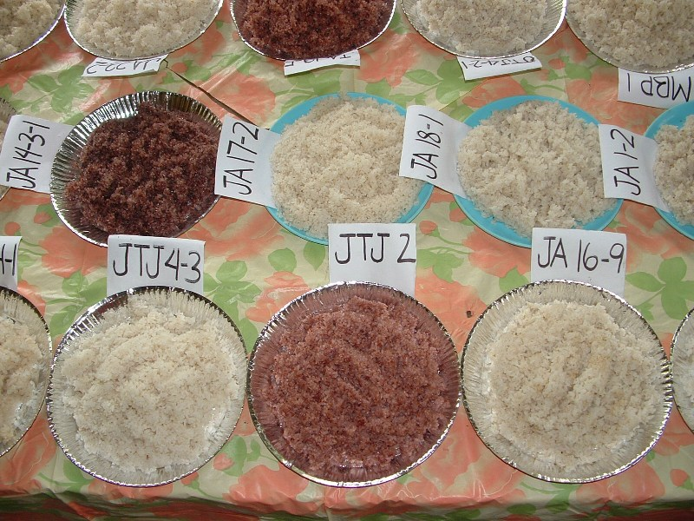
Rice Breeders and their bred-lines: Buayan, M’lang, North Cotabato
Localized rice seedbanking and breeding
Name | Code | No. of crosses | No. of selection | Filial Generation
1. Arthur B. Jurada | JA | 22 | 65 | 21-11
2. Jeannette B. Jurada | JING | 2 | 2 | 11
3. Armando Golendes | AGO | 1 | 1 | 11
4. Virginia S. Alegre | VSA | 1 | 1 | 10
5. Rosie M. Fabila | RMF | 1 | 1 | 9
6. Jose Ben Travilla | JBT | 3 | 3 | 9-6
7. Hazel B. Pedroso | HBP | 1 | 1 | 6
8. Fred Laudato | JJJ | 1 | 2 | 6
9. Marietta B. Peniero | MBP | 1 | 1 | 6
10. Ariel B. Digan | ABD | 3 | 3 | 2
11. Daniel B. Antes | DBA | 1 | 1 | 2
12. Belton D. Soriano | BDS | 1 | 1 | 2
13. John T. Jurada | JTJ | 6 | 11 | 6
14. Claive Jurada | CMJ | 1 | 2 | 6
15. Jeannar Jurada | JCJ | 2 | 2 | 6
16. Syrian Dave Espino | SDE | 1 | 1 | 6
17. Harlene Laudato | Joy | 1 | 2 | 6
Total No. of Rice Breeders: 17
Total No. of Crosses: 49
Total No. of Selection: 100
Rice Breeding Training Conducted : 7
5 trainings for adults
2 trainings for youths

Slide 6
Ranked 4th in share of total area planted in the country, 2002
Source: Adoption and Spatial Diversity of Later Generation Modern Rice
Varieties in the Philippines. C. C. Launio,* G. O. Redondo, J. C. Beltran, and Y. Morooka, Agronomy Journal • Volume 100, Issue 5 • 2008

Slide 7
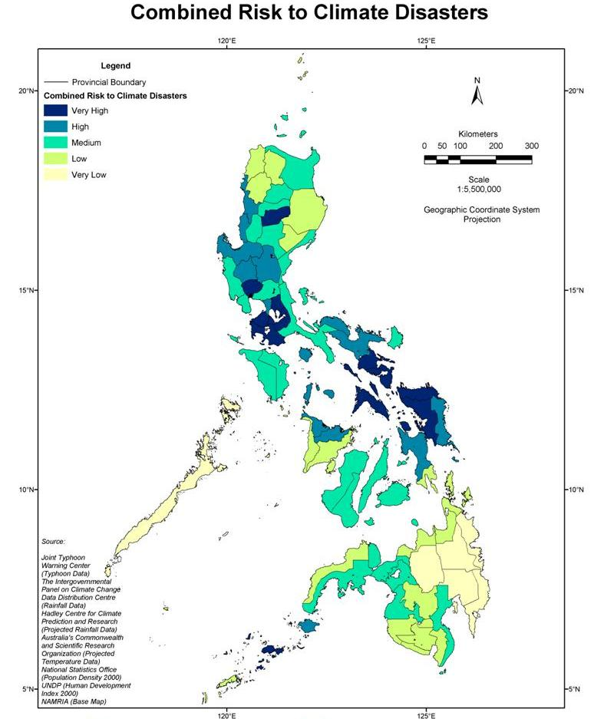
Farmers breeding rice varieties that prove to be climate resilient
Drought tolerant – Elon-elon, San Vicente, Palawan, M160-1
Solano, Nueva Vizcaya
Salt Water intrusion– Loreto, Binulungan, M115-1R, M45-1
Calabanga, Cam Sur
Bato, Cam Sur
Flood resistant – M116-2, M115-1R, M160-1, M45-1, PBB 401
Drought tolerant – M6-14-1R
Batbatngon, Leyte
Drought resistant – Senador, Hubanib
Patnongon, Antique
Alimodian, Iloilo
Libagon, Southern Leyte
Drought resistant – M148-2, M394-1, M51-2, M177-3, M74-1
Drought tolerant – Red Borong, Zambales MLD 4-1
Sta. Josefa, Agusan del Sur
Flood resistant – JDC 3 , JDC8, Dalagang Bukid
Malng, North Cotabato
Drought tolerant – M4-3-1, Hinumay
Legends:
Farmer-bred lines
Traditional rice varieties
MASIPAG Selections
Sultan Kudarat, Saranggani
Salt water intrusion – Jasmine, Kanoni, Elon-elon, Makaginga, Binulawan
Some MASIPAG rice varieties adaptive to climate disaster risks,
as tested by farmers, 2009 wet season

Slide 8
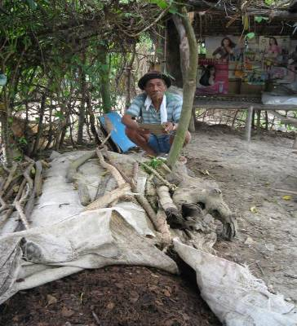
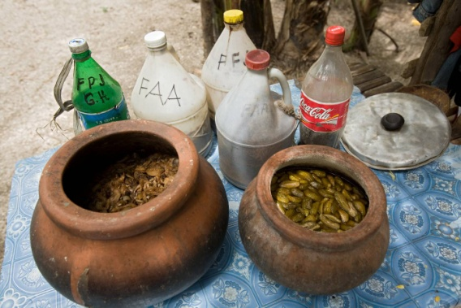
Adaptive technologies and innovations: FDAT (Farmer-developed and adapted technologies)
Decreased chemical fertiliser and pesticide use
Organic farmers have eliminated the use of chemical fertilisers and pesticides and use a variety of organic methods. In contrast 85% of conventional farmers use fertiliser and 80% continue to use pesticides.
97% of the full organic group use alternative pest management.
Ibabao Bana, Cabanatuan, Nueva Ecija

Slide 9
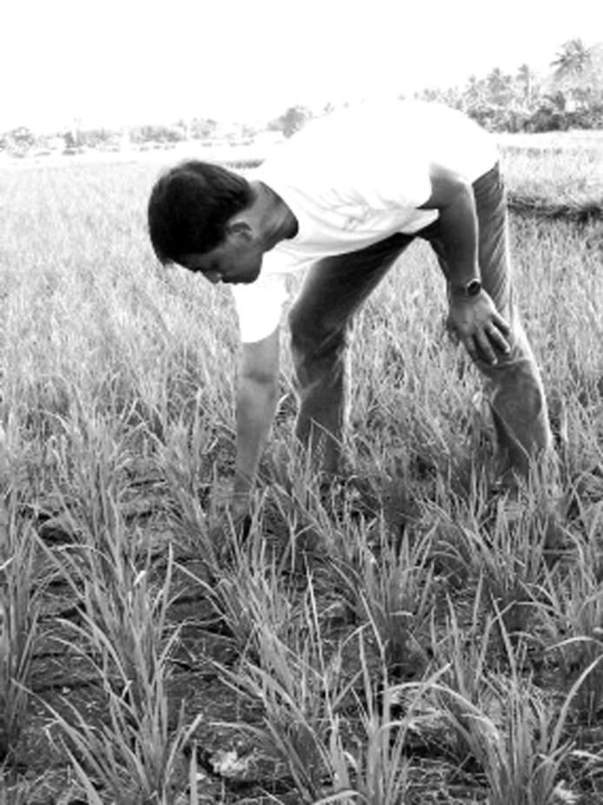
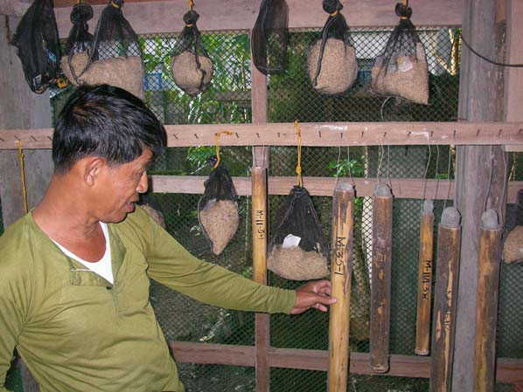
Farmers develop ability to adapt and innovate based on study of local conditions
Farmer Lucio Gurango plants a drought-resistant variety ahead of the regular planting season, hoping to determine new cropping schedules.

Slide 10
Comparable rice yields to conventional farming
Rice paddy yields 2000-2007 (kg/ha)
Average rice yields |  | Full organic farmers |  | Conversion farmers |  | Conventional farmers
 |  | 2007 | 2000 | 2007 | 2000 | 2007 | 2000
National average |  | 3,424^{ns} | 3,374^{ns} | 3,287^{ns} | 3,473^{ns} | 3,478^{ns} | 3,570^{ns}
A R E A | Mindanao average | 3,767^{ns} | 3,717^{ns} | 3,864^{ns} | 4,152^{ns} | 4,131^{ns} | 4,324^{ns}
 | Visayas average | 2,683^{ns} | 2,429^{ns} | 2,470^{ns} | 2,547^{ns} | 2,626^{ns} | 2,695^{ns}
 | Luzon average | 3,743^{ns} | 3,941^{ns} | 3,436^{ns} | 3,660^{ns} | 3,828^{ns} | 3,851^{ns}
Farmer-bred varieties grown without any chemical fertilisers or pesticides are yielding on par with chemically fertilised and pest-managed ‘expert-bred’ varieties.

Slide 11
Net agricultural incomes are significantly higher for MASIPAG farmers
Per hectare net incomes of the full organic farmers are one and a half times higher than those of conventional farmers.
 |  | Full organic farmers | Conversion farmers | Conventional farmers
Net agricultural income
National average per farm |  | 36,093 ^{ns} | 37,216 ^{ns} | 30,819 ^{ns}
Net agricultural income per hectare (cultivated)
National average |  | 23,599*** | 17,457*** | 15,643***
By area | Mindanao average | 23,715 ^{ns} | 17,362 ^{ns} | 19,588 ^{ns}
 | Visayas average | 22,868** | 16,039** | 13,728**
 | Luzon average | 24,412** | 18,991** | 13,403**

Slide 12
Average annual agricultural expenses are significantly lower for MASIPAG farmers
Production expenses | Full organic farmers | Conversion farmers | Conventional farmers
Inputs, seed, fertiliser, pesticides all crops or livestock | 1,119*** | 6,029*** | 10,453***
Irrigation fee | 252 | 431 | 455
Land rental/shared payments in kind | 981 | 1,423 | 1,529
Land amortization | 3 | 0 | 4
Hire labour or services | 5,291 ^{ns} | 5,609 ^{ns} | 5,861 ^{ns}
Repay long term loans | 2,567 | 4,055 | 2,982
Other expenses | 1,650 | 1,811 | 1,618
Total | 11,863 | 19,358 | 22,902

Slide 13
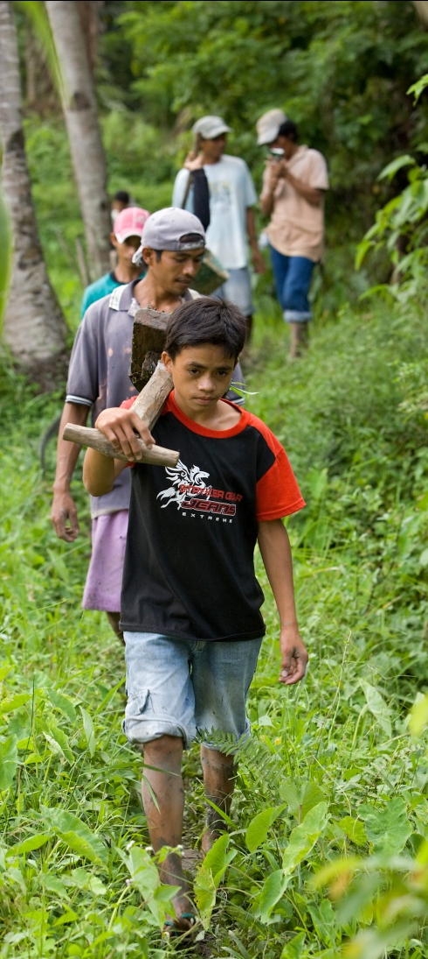
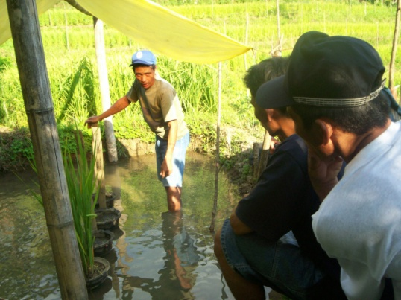
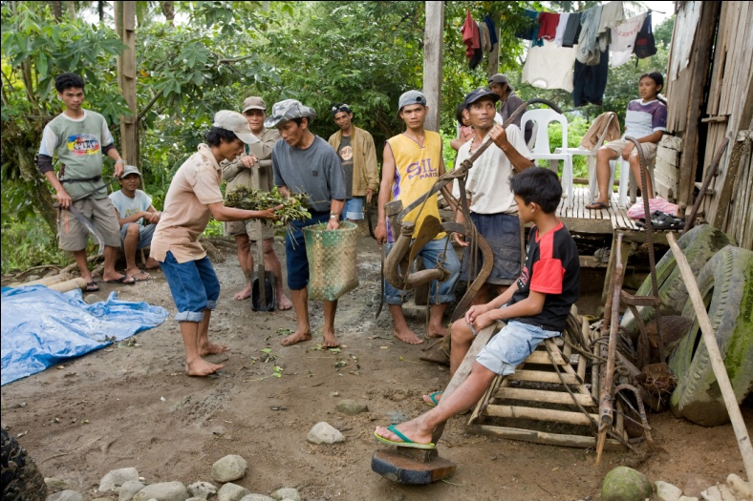
Total reduction of production expenses through Bayanihan (shared labor)
Bayanihan carried out by 2 sub-groups, committee headed by vice-chair
Bayanihan activities done weekly 8am-4pm, helping each member with DIFS plan implementation: land prep, planting, construction of dikes, fishponds, contour bunds
Farmers without carabaos benefit from using carabaos of other members
Members bring their own rice, host prepares viand
Regular meetings to attend to problems, planning and assessments
TSAFO, Malitbog, Bukidnon
Tumigbong Sustainable Farmers Association (TSAFO), Bukidnon (org 2003, 22 members, upland farmers)

Slide 14
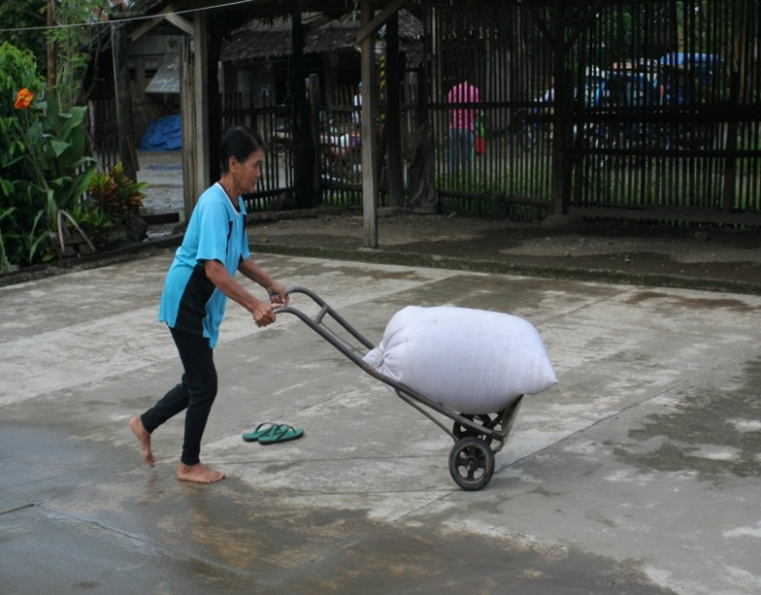
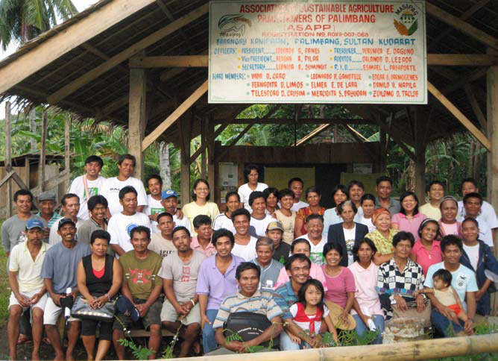
Collective marketing of organic products: Masipag Farmer Guarantee System in ASAPP
Group collects palay from members: 40% of surplus of tenant-members, 60% from land-owning members; does milling and selling
Bayanihan done in 4 groups, regular schedules
Collects CBU, and P50/sack goes to general fund
Sells 4 – 10 varieties of rice in General Santos on consignment basis
Association of Sustainable Agriculture Practitioners in Palimbang (ASAPP), Sultan Kudarat, 56 members

Slide 15
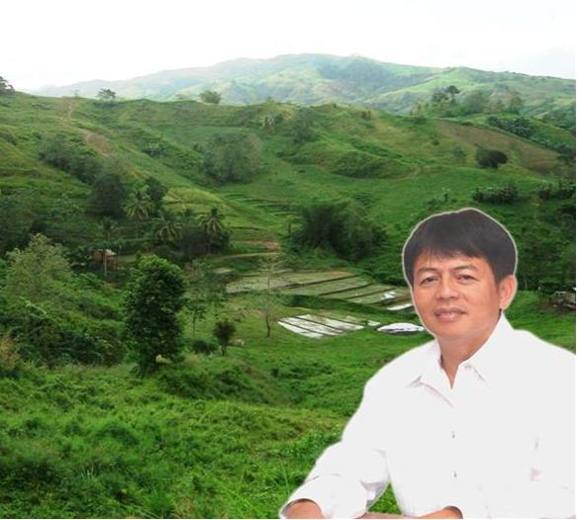
Farmers influencing local governments
Resource allocations for small farmers
Moratorium on GM crops
Training local farmers and government staff on organic agriculture
Setting up local seedbanks
Adopting organic agriculture as main agriculture program, lobbying for local laws on OA.
Planning and managing local agricultural programs as members of organic agriculture commitees under the Organic Agriculture Act.
Sustainable Organic Agriculture DUMINGAG EXPERIENCE
NACIANCENO M. PACALIOGA, JR.
Municipal Mayor

Slide 16
Developments in government regulations
Organic Agriculture Act
RA 10068
Establishment of a comprehensive organic agriculture program:
promotion and commercialization of organic farming practices;
cultivation and adoption of production and processing methods;
continuing research and upgrading
capacity building of farmers
education of consumers
extension assistance to LGUs, POs, NGOs, and other stakeholders;
documentation and evaluation
Agri-Pinoy Rice program:
removal of subsidies on hybrid rice seeds and chemical inputs

Slide 17
An enabling environment for small farmers’ practice of sustainable agriculture is one that recognizes and promotes farmers’ rights, especially regarding control over land, genetic resources, technology and knowledge.

Slide 18
An enabling environment recognizes and develops the different dimensions of sustainable agriculture with collective farmer empowerment and food sovereignty as the central goals. The modern agriculture paradigm, with its technological fixes and market orientation, favors agribusiness corporations and fails small farmers.
SOCIAL
ORGANIZING and participation in local decision-making and policy change
GENDER equity in ownership, access and control of resources
REVIVING LOCAL CULTURES AND TRADITIONS esp indigenous knowledge and bayanihan systems
FOOD AND LIVELIHOOD SECURITY
SOCIAL ORGANIZATION and promotion of farmers’ rights
FARMER EMPOWERMENT and FOOD SOVEREIGNTY
DIVERSIFIED and integrated farming systems
SOIL FERTILITY
WATER AVAILABILITY
SECURING ACCESS TO LAND and productive resources
BIODIVERSITY CONSERVATION, utilization and improvement
ENVIRONMENTAL REGENERATION
REVIVING LOCAL ECONOMIES thru processing and local marketing
ECONOMIC
RESILIENCE to CLIMATE CHANGE
ENVIRONMENTAL
GOALS AND ELEMENTS OF SUSTAINABLE AGRICULTURE

Slide 19
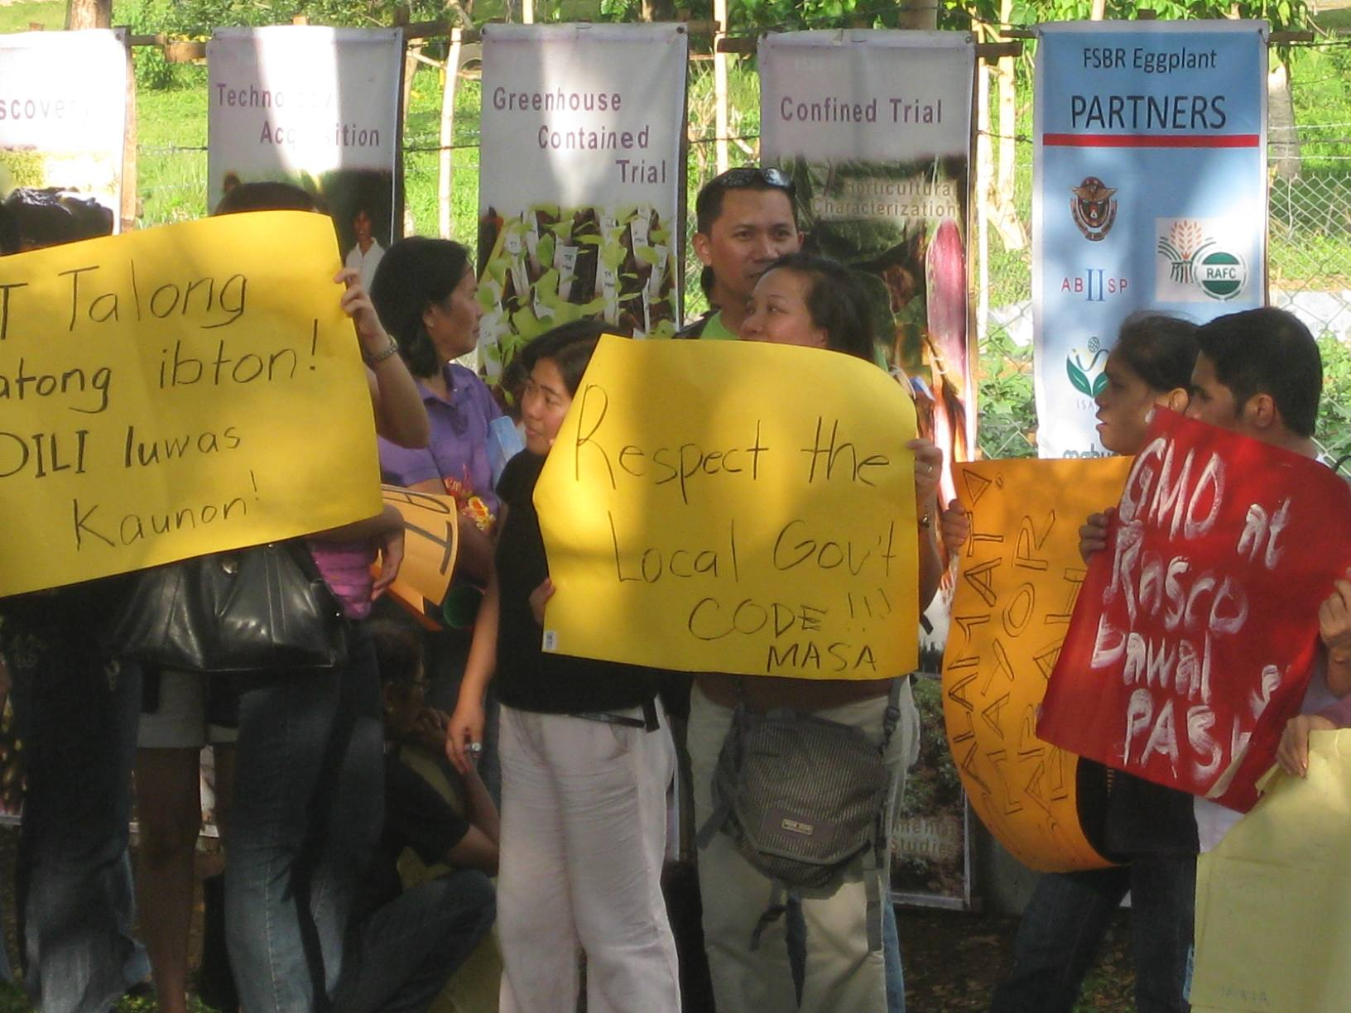
Farmers’ organizations themselves must develop strength and lead in creating this enabling environment, and primarily in their own communities first.

