Slide 1
OBJECTIVES and FLOW Regional Learning Session Sustainable and Inclusive Marketing Arrangements towards Increasing Farmers’ Market Power
Name of Presentor

Slide 2
Main Program
May 9-11 Regional Learning Session on Sustainable and Inclusive Marketing Arrangements
May 12-13 AFA ExeCom meeting
May 14 AFA-Agriterra evaluators’ Meeting
Notes:
This is the first regional event of AFA this year. We are happy tp hold it here in Manila. As this gives many of the AFA ExeCom members, who are mostly new , to see the AFA office and meet all the AFA staff.
As usual, because we want to maximize our face-to-face meetings, we dovetail several events in one trip – so for this trip, we have three main events.
Now we discuss the objectives and flow of the first event.

Slide 3
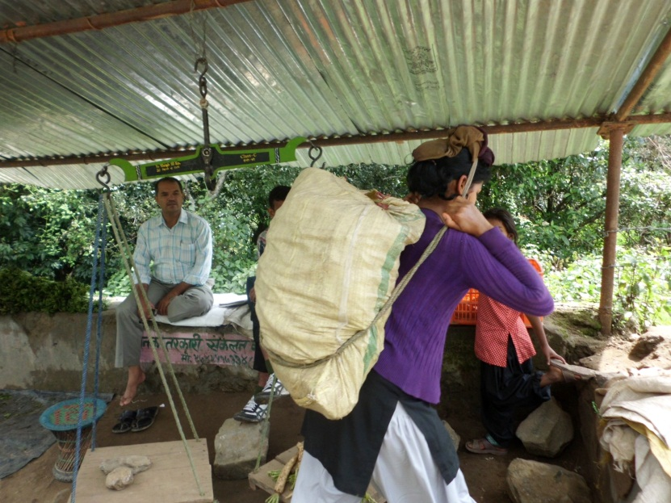
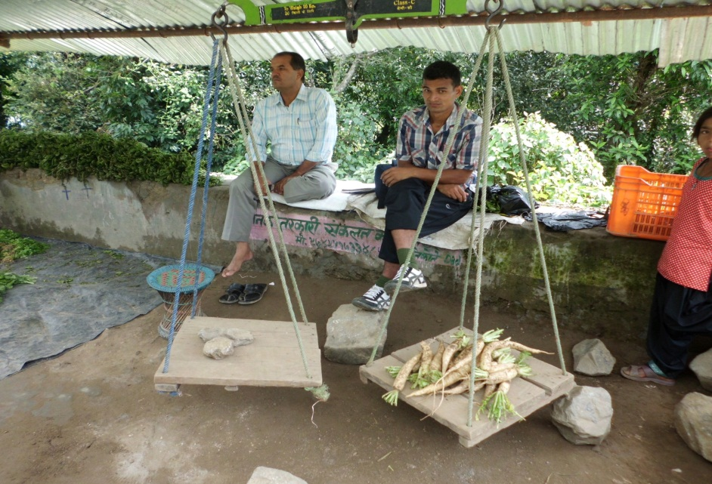
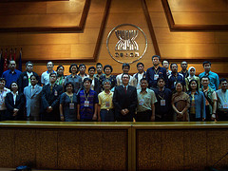
Context
Land Investments
PPP
-VG on Responsible Tenure
Of Land, Fisheries, Forests
-Responsible Agro Investments
Notes:
This is a picture of a young woman farmer from Nepal who has walked one hour from her home to reach this local market station alongside the road .

Slide 4
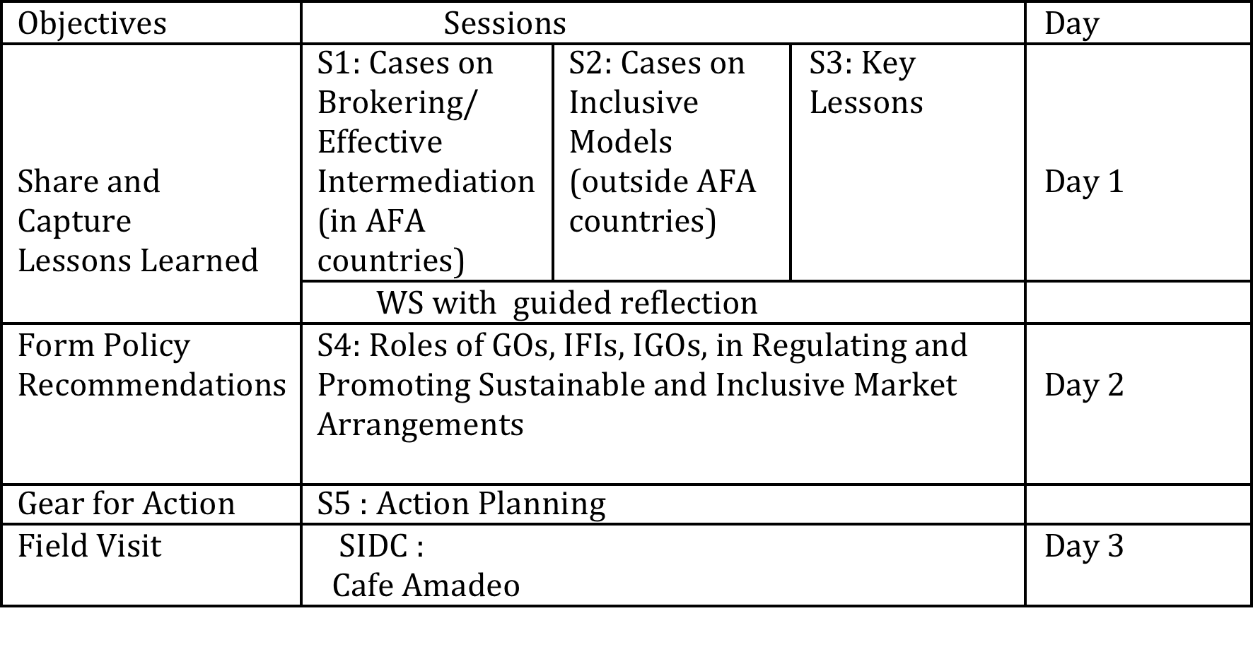
Objectives and Flow

Slide 5
Bring home
*New learnings
*New friends
*Action plan
*Policy recommendations

Slide 6
Guides for Effective Learning
Brief but to the point
Respect time allocations
Be open to new ideas
Ask , share and reflect
Pause for translation
Further exchange during breaks
Make friends

Slide 7
Host Teams
Keepers of time, alertness, orderliness
Day 1 AM | AINOUKAI (
Day 1 PM
Solidarity Night
Day 2 AM
Day 2 PM
Day 3 Field Visit | PAKISAMA

Slide 8
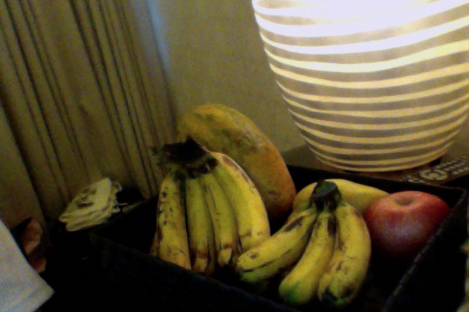
☺ have a fruitful workshop ☺

