Slide 1
Case of Successful Marketing Arrangements in Cambodia (Rice, Pig and Vegetable)
Prepared by:FNN
April 22, 2013

Slide 2
1. The case of rice marketing arrangement
CEDAC Enterprise and farmers living in Sdok Development Community located in Tropangsdok village, Tangyap commune, Preykabas district, Takeo province, are in the marketing arrangement.
By the end of 2008, the initiative was processed by CEDAC Enterprise itself to market farmers’ products directly, particularly organic fragrant rice.
In operational mechanism, those farmers supply organic fragrant rice to CEDAC Enterprise after milling by their own rice mill cooperative. The enterprise provides farmers only with Rice Intensification System Training (SRI). By following the techniques as a whole, certified by CEDAC Internal Control System (ICS), the products have been purchased by CEDAC Enterprise. The Enterprise provides them a better price compared to middlemen. The price is 2,950 Riel per kg (about US$ 0.74), while the middlemen offered 2,500 Riel per kg (about US$ 0.63). However, 450 Riel per kg (about US$ 0.11) higher from CEDAC Enterprise is included the price of product transportation. It means that farmers are responsible to directly send the product to the enterprise in Phnom Penh.

Slide 3
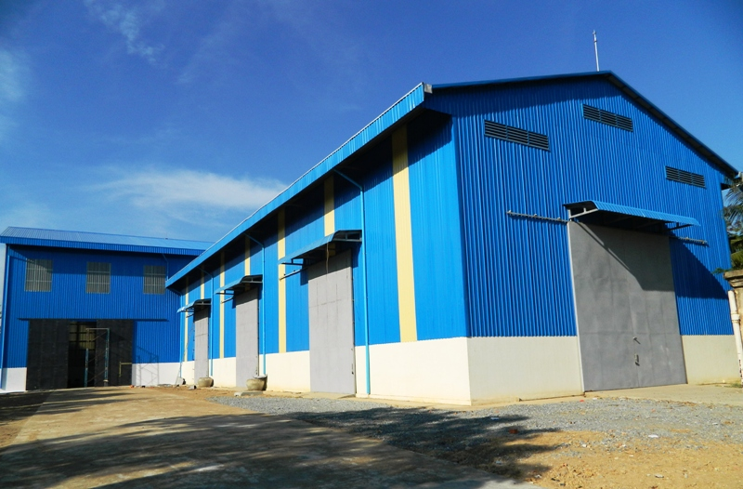
The objectives of the marketing arrangement are: - Link or engage farmers to the markets - Enhance farmers to adapt and adopt the new innovation system - Keep farmers with value add of their products - Gain profit from this work to CEDAC Enterprise As a result, after over 4 year process, farmer access to believable market with CEDAC Enterprise. Value added of their product is prevented as a whole. And CEDAC Enterprise keeps playing as a domestic enterprise with its acceptable profits. Interestingly, as it is observed, there this still have a limitation of new innovation adoption among farmers, while the adaptation is regularly seen.

Slide 4
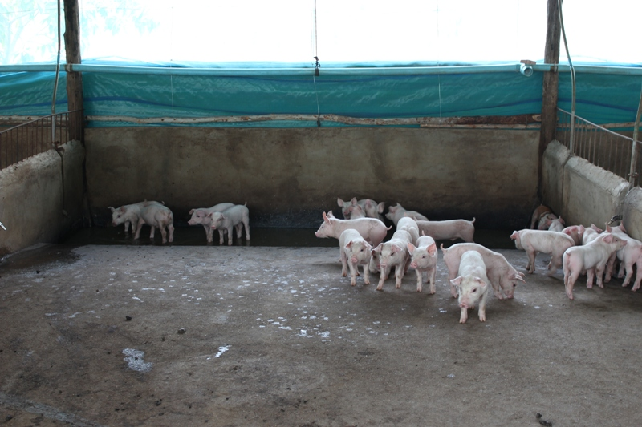
2. The case of pig marketing arrangement 2-1 Between CP Enterprise and Individual Farmers
C.P. Cambodia Co. Ltd, located at 25 kilometers on National Road No. 4, Chak village, Baek Chan commune, Ang Snuol district, Kandal province, does the marketing arrangement with farmers living in Krang Thnal village, Mohasaing commune, Phnomsruoch district, Kompong Speu province.
From year 2008, the initiative has been processed by CP Enterprise along with individual farmers.
The enterprise provides piglets, vaccination and foods to individual farmers. Individual farmers are responsible for proper farm, irrigation and nurture.
CP Enterprise has two objectives of the marketing arrangement:
- Link or engage farmers to market
- Gain profit from the arrangement to the enterprises
As a result, farmer can access to believable market with CP Enterprise. There is no price trick anymore to farmers. CP Enterprise itself can get suitable profits.

Slide 5
2-2 Between CEDAC Enterprise and Farmer Groups
CEDAC Enterprise and farmers living in Chorkchey Development Community located in Trapaing Thmor village, Trapaing Kor commune, Cheung Prey district, Kampong Cham province do the arrangement.
From year 2005, the initiative has been processed by CEDAC Enterprise to market farmers’ products.
In operational mechanism, those farmers supply organic pigs to CEDAC Enterprise. The enterprise provides farmers only with organic raising technique training. Following the technique as a whole, the products have been bought by CEDAC Enterprise. With such kind of products, CEDAC Enterprise provides them with a better price compared to middlemen’s. The price is 8,500 Riel per kg (about US$ 2.13), while the middlemen only offered 7,900 to 8,000 Riel per kg (about US$ 1.98 – 2). However, 500-600 Riel per kg higher from CEDAC Enterprise is included the price of product transportation. Farmers are responsible to directly send the products to CEDAC Enterprise.

Slide 6
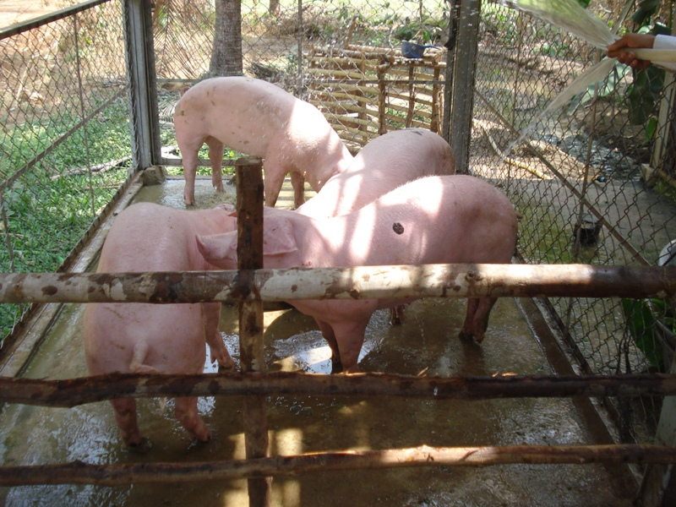
CEDAC Enterprise has two main objectives of the marketing arrangement:
- Link or engage farmers to the market
- Gain profit from the arrangement to the enterprises
As a result, farmer can access to believable market with CEDAC Enterprise. There is no price trick anymore to farmers. CEDAC Enterprise itself can get suitable profits.

Slide 7
3. The case of vegetable marketing arrangement
There is a case in arrangement between enterprise and farmers on organic vegetables with individual contract. CEDAC enterprise and farmers living in Thmor Reap Vegetable Community located in Thmor Reap village, Pongror commune, Rolea Ph’Ear district, Kampong Chhnang province, done the arrangement.
From year 2005, the initiative has been processed by CEDAC Enterprise to market farmers’ products.
In operational mechanism, signing farmers supply organic vegetables to CEDAC Enterprise. The enterprise provides farmers only with organic growing technique training. Following the technique as a whole, the products have been bought by CEDAC Enterprise. With such kind of products, CEDAC Enterprise provides them with a better price compared to middlemen. Generally, the price is 400-500 Riel (about US$ 0.10-0.13) per kg higher than middlemen. It is included the price of product transportation. Farmers are responsible to directly send the products to CEDAC Enterprise.

Slide 8
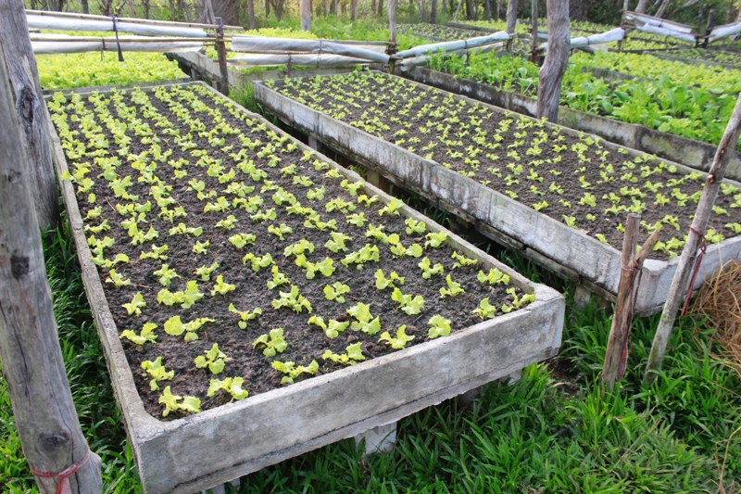
The objectives of the marketing arrangement are:
- Link or engage farmers to market
- Gain profits from the arrangement to the Enterprise
As a result, farmer can access to believable market with CEDAC Enterprise. There is no price trick anymore to farmers. CEDAC Enterprise itself can get suitable profits.

Slide 9
It is a good opportunity for farmers if they form in group and do farming together. The successful marketing arrangement is prepared in group or cooperative. But all farmers are asked to sign in farming contract individually. The ability of farming in group guarantees the production capacity. Besides getting high price from their products individually, farmers can get more benefit from shares of group. Along with the process, technical problem needs to be solved in order to improve the process of the arrangement. So far, to market their products, farmers seem to be in the dream. There is no certainty in selling their products to. The market from middlemen sets low price for their products. Farmers do not trust in such kind of market. Now farmers likely trust in market from the arrangement. The high price factor and market factor seem to be the same, but the word “High Price” to the products is the only word which farmers interestingly want to listen at the first time. There is the link between these four factors contribute to the successful marking arrangement. Each factor should be performed and ensured well at the same time in order to increase the level of success in marketing arrangement.
Findings
Technical enhancement
High price
Market
Working in group
Success

