Slide 1
Enhancing Milled Rice Production Project (EMRIP)
Inclusive businesses & investment plans
Farmer Production Groups (producer networks)
Policy dialogue
Significant rise in income (>60%) jump in crop yields
(+30-50%); and
better prices (+10%) for improved quality of paddy
Actual throughput rising from 12,400 tons (2009) to 36,523 tons (2011 projected) a 300% rise
SNV 2013
Notes:
EMRIP was successful in connecting a large number of smallholder rice farmers and rice millers to establish fair and equitable trading relations. Smallholder rice farmers significantly increased their production and income from improved input and extension support from partner millers. Around 300 farmer groups were established in six provinces during the project. These groups require additional on-going support to improve their operational efficiency. SNV envisages the establishment of more groups that will require capacity building support for start-up and management.
The Building Income, Independence and Empowerment for Farmers (BIIE) project supports capacity building for existing and new farmer groups in Khammouane and Savannakhet provinces. Rural farmers are empowered to access information which will afford them economic leverage opportunities, and assist them to better negotiate trading conditions, resulting in increased income potential and decreased risk.
The BIIE project aims to increase income for 2,500 smallholder rice farmers by 20% by 2015.
The BIIE project supports selected rice mills and farmer groups to build their capacity in the following areas: forming and strengthening producer groups and associations; gaining access to input, extension and credit; and leadership and management skills. The project also supports farmers, miller groups, and associations to organise policy dialogue with relevant government agencies to improve framework conditions for the rice sector in Laos.
Source: http://www.snvworld.org/en/countries/laos/our-work/projects/rice-building-income-independence-and-empowerment-for-farmers-biie

Slide 2
10 producer groups in eight villages of Luang Prabang
Cold storage facility
Buy back scheme if unsold
Demand-based or performance driven (standards)
Modern supply chain (cold storage etc…).
Better understanding of the organic concept and improved market opportunities for organic products
Notes:
The project provided a cold storage facility for farmers so they can store their unsold produce. It also buys back these produce at cost so no loss is incurred by the farmers. The project is also demand-based or performance driven as farmers has to adhere to certain standards that must be met to enhance sale-ability of produce.

Slide 3
60 organic farmers of Sangthong District
Fair price
(1) increased confidence in export markets among farmer groups;
(2) increased willingness to grow according to the export market (i.e. non-sticky), not just for the local market (i.e. sticky rice);
(3) improved organic production skills and higher productivity and efficiency within the organic group
(4) higher export prices translate into better farm gate prices for farmers;
Khamphone Syvongxay, Jan 2011, VT
Notes:
AgroAsie loans the seed, provides training and basic extension service and buys the product at a fair price for sale to ASEAN markets.
AgroAsie intends to profitably sell quality organic long-grain brown rice from Lao farmers into niche organic or health food shops throughout the ASEAN community
By selling quality organic brown rice from Laos into ASEAN community, AgroAsie will be showcasing natural products from Laos and helping Lao farmers to begin to adjust to the future ASEAN economic community

Slide 4
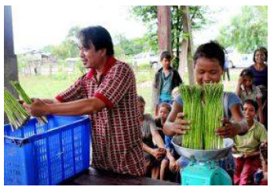
Organic Asparagus Producers Group of Sanxay District, Attapeu Province
Input for organic compost
Packaging factory
Infrastructure has improved
Improved organic production skills and higher productivity and efficiency within the organic group
Higher export prices translate into better farm gate prices for farmers;
PROCASUR Corporation, March 2013
Notes:
To limit farmers’ expenses, SWIFT provides farmers with components necessary to create organic compost that are not available in nature (e.g. sugar, dried fish oil, soy beans).
Moreover, to facilitate the export of fresh vegetable, asparagus as well as other crops, SWIFT is planning to open a packaging factory in Attapeu which would also provide a new source of employment for local people.
Infrastructure has improved, a new school has been built and a bridge is also being constructed to facilitate transportation during the raining season. The forest area has now been replaced by the fields, where asparagus and other crops are cultivated.
Asparagus production takes 3.3 ha. on an overall surface of 5 ha. cultivated by the 21 families.

Slide 5
Organic Coffee Producers Group, Attapeu Province
Improvement of infrastructure and equipment
Capacity building on coffee cultivation practices
Stable partnership between a Lao coffee company and the producers
Stable price
PROCASUR Corporation, March 2013
Notes:
Improvement of infrastructure and equipment for the extension of the organic coffee production as well as capacity building on coffee cultivation practices through various training programmes. Most importantly, the establishment of a stable partnership between a Laotian coffee company and the producers by RLIP ensures market access and alternative sources of income for the villagers.
The PPP established between the village and the Lao Coffee Company allows producers to sell their products at a fixed price, protecting them from potential market price fluctuations.

Slide 6
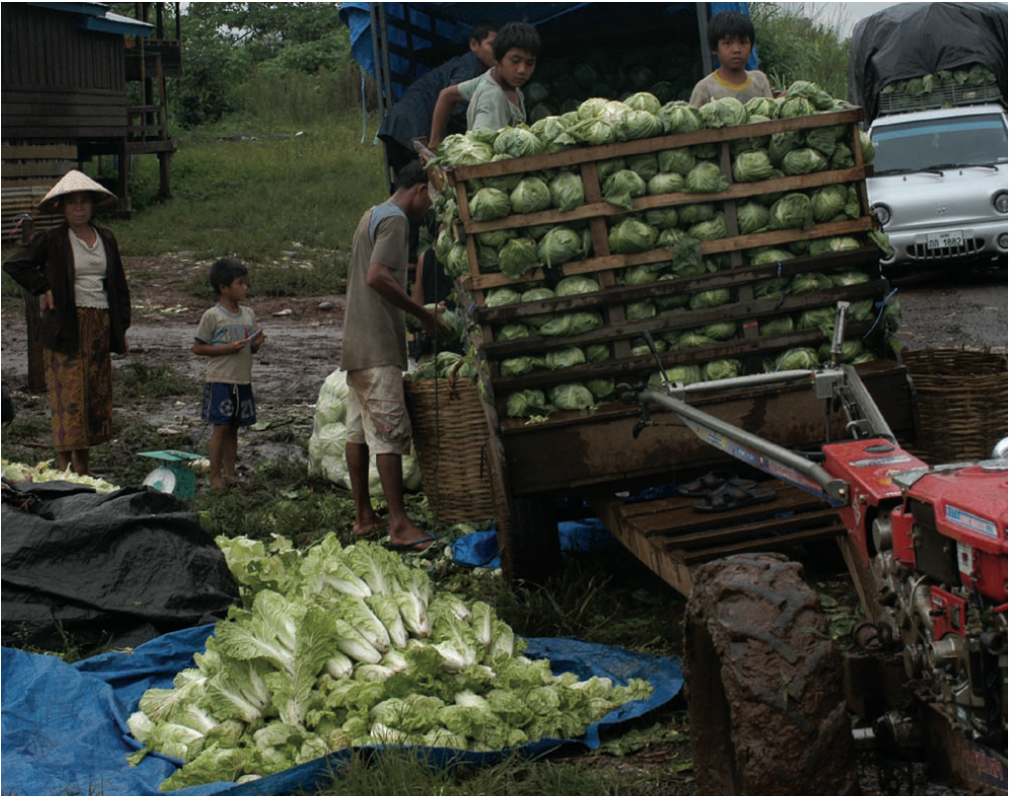
Pakxong Development Enterprise Export-Import Co. Ltd.
Encourage farmers to form groups to produce crops to match orders from traders
Fee-based market facilitation
Production loans
Secure income
Fulbrook, October 2007
Notes:
Individual producers purchase their own vegetable seeds and farm inputs, and organize their own production schedules as they see fit. In cases in which producers need credit to produce enough to fulfill their individual quotas, they apply for loans for this purpose from the provincial agricultural bank. These loans in turn are guaranteed by the field representatives operating in the area where the farmers are located. To ensure that the provincial agricultural banks have sufficient cash on hand to satisfy producers’ demand for credit, the company deposits ThB 10 million with the provincial banks. Producers then pay interest to the bank on their loans, these interest payments being used by the banks to cover their administrative and overhead costs.
Boonpon and other officials [of the provincial trade department] encourage farmers to form groups for producing crops to match orders from traders, usually Laotians, who in turn are exporting to customers in Thailand.
Meanwhile he tries to find companies to place orders and helps find groups to match the needs of companies that come into the district seeking supplies.
“I introduce buyers to production groups and farmers, if the farmers want to see the company representative I will arrange a meeting. For example if the company wants to export 200 tons of vegetables, the company has to work with the trade unit. I will go to see the farmers to find who wants to grow these vegetables and collect data about their production. The unit tells the farmers to produce 200 tons with a guaranteed minimum price,” says Boonpon.
Boonpon’s unit has good reason to match farmers and companies: its budget increasingly depends on charges levied on production for helping to manage the production process.
Buying produce under this managed contract system incurs a tax of 1.25 kip per kilogram, another 5 kip is levied per kilo for extension services, and 7.75 kip for the units running costs, including salaries; a total of 14 kip per kilo.
Energetic Boonpon’s involvement does not stop with such production agreements. “I monitor the implementation of the contract between the company and the farmers. I try to resolve disputes, for example if the company does not pay the minimum price.” Thai Baht
Cross-border contract farming provides small farmers with a secure income. It guarantees sales, at daily market price. Farmers benefit as the market price may be higher than the agreed minimum price. Farmers can either sell the cabbage to the company in the town or they can take their produce to the Thai buyers at the border themselves. If farmers request inputs or other services, such as fertilizer and seed, the company provides them. The company deducts the cost of the inputs from the sale, with the farmers receiving the balance.
[Before] the farmers could only make profits in two months a year. Now they can make profits in seven months out of the eight month the cabbage season.”. . The consequences are striking: Hyundai light trucks are now common, parked in fields beside salas or being loaded high with cabbage along the roads weaving between the verdant fields. Farmers reckon a Hyundai, which costs 57,000,000 kip ($5,876) in Pakse, is a good investment because each season they can save 20,000 baht ($571) that would otherwise be spent on hiring transport to take cabbages to the Thai border.

Slide 7
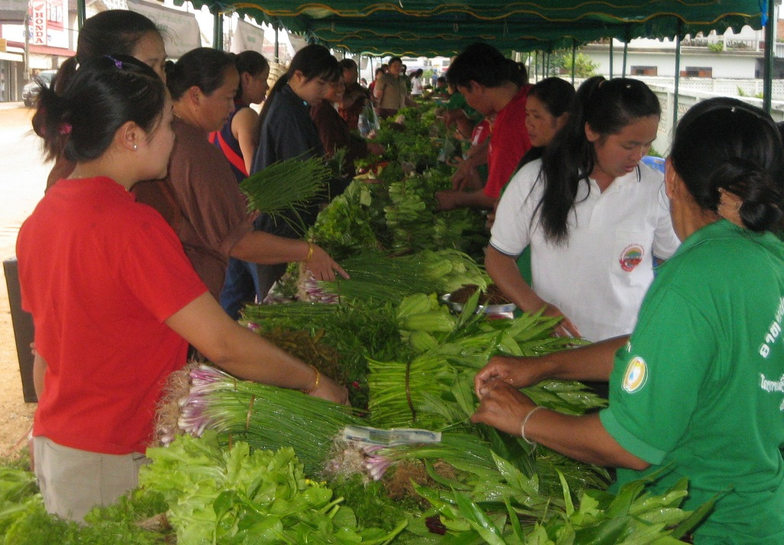
Organic Farmers Association (OFA)
Market facilitation
Better price
Notes:
Every Wednesday and Saturday morning, the bulk of organic vegetable product is sold through the organic market supplied by 40 target members in 5 villages of Pek District. After the establishment of Organic Farmers Association (OFA), market management was fused into its organizational structure. Three OFA committee leaders were elected by farmer members to manage and to take care of the money of market operation.
SAMADP provided a template to every member of the producer group to record their income from sales of organic vegetables. The SAMADP team is also giving advice on accounting and management as well as in monitoring and supporting the operation of the organic market.
In 2012, market data showed that farmers sold around 145 million Kip of vegetables from a land area of 18,358 m².
As organic vegetable production is more labour intensive than conventional farming, it involves the whole family. This shows that organic vegetable production is well suited for smallholder farmers.
The OFA takes a crucial role in marketing and sales of organic vegetables for its members. The management of the OFA has developed ideas where to take their farmer organization in the future. The association also provides active and competent support to its members by providing technical advice and managing their internal control system and organic input supply. It is currently working on a production plan to match the demand of the market.
The organic market has benefitted 40 vegetable farmers.
Recently, the Pek district governor gave assurance that the organic market will stay in its present location.

Slide 8
Shared lessons
Linking farmers to markets: a viable pathway for poverty reduction
“Previously, traders cheated us but now we are working in a group, we get the prices as agreed with traders. Now we produce more and we aren’t afraid that we won’t be able to sell our products. We are more organised now.” Vegetable group member, Xieng Khouang
Improved organisational development of smallholder producer groups and associations resulted in organised sales and increased negotiating power.
Access to market information enabled farmers to make informed production decisions.
By adding more value such as processing, packaging etc., farmers were able to capture a greater portion of product end value
Notes:
Experiences confirm market access to be a more sustained pathway through which rural smallholder farmers can increase agricultural production, profit from market opportunities and emerge from poverty.
Collective action is essential to furthering the integration of smallholders into commercial agriculture. When acting alone, farmers in Laos have virtually no bargaining power. Small farmers cannot produce the volumes necessary to satisfy the needs of buyers that want to reduce transaction costs, increase economies of scale and obtain a reliable supply.
Producer groups and cooperatives increase farmers’ bargaining power and improve their ability to organise themselves around market issues. When acting collectively, smallholders may be in a better position to reduce transaction costs, obtain market information, access bulk inputs at a reduced cost, secure access to new technologies, add value (processing, packaging, branding etc) and tap into high value markets.

