Slide 1
CSO review of GAFSP PrSW: PRAN Bangladesh
Regional Workshop on Enhancing Market Power
May, 09-11 2013
Quezon City, Philippines

Slide 2
Background of the study
Global Agriculture and Food Security Programme Grant of USD 50 million received Bangladesh in 2010 for the IAPP
Objective of the IAPP - to sustainably enhance productivity of agriculture (crop, livestock and fisheries) in two agro-ecologically constrained and economically depressed areas --Rangpur and Barisal.
IFC, a member of the World Bank Group, is providing a $15 million loan to PRAN, from GAFSP fund to expand production capacity, create 1,800 rural jobs and integrate small farmers into retail supply chains.

Slide 3
Roll of Actionaid
GAFSP Steering Committee includes, among others, three non-voting members who represent civil society groups: Ruchi Tripathi from AA-UK for Northern , Djibo Bagna from ROPPA for African , Dr. Yang Saing Koma from AFA for Asian CSOs
Commissioned by ActionAid Bangladesh and conducted by a group of journalists from a reputed media house of Bangladesh

Slide 4
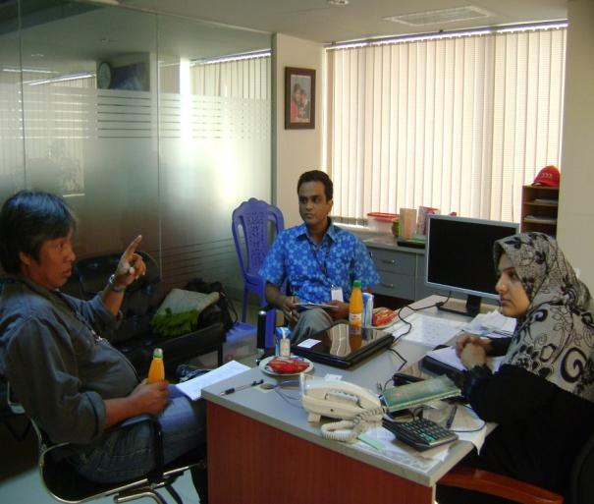
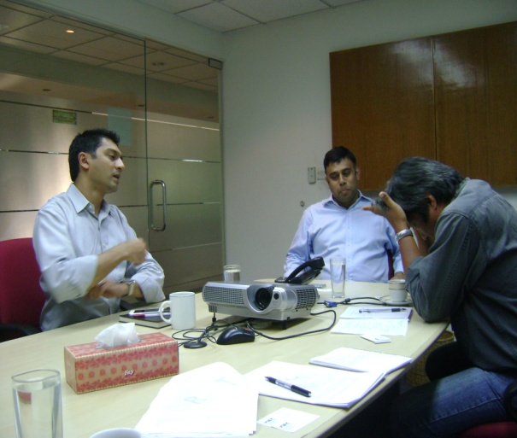
Study method
Open-ended questions were used to collect data from the interviewees
Focus Group Discussion (FGD) was held with a group of 30 farmers
20 contracted farmers were interviewed personally
Top PRAN authorities- Director, General manager and chief operating officer
IFC official was also interviewed.

Slide 5
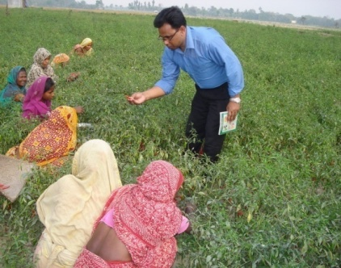
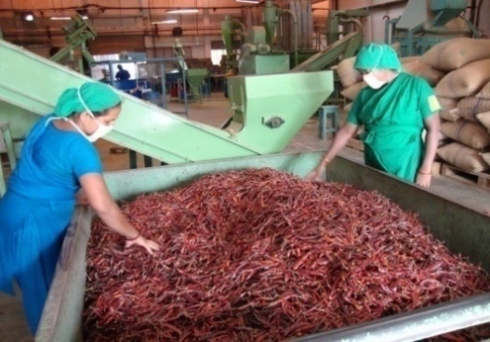
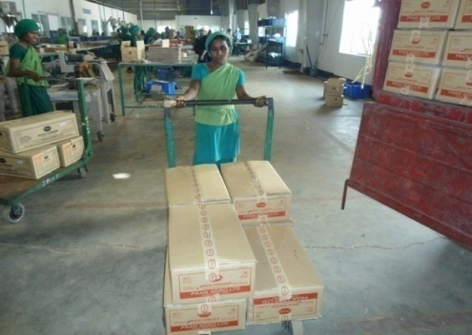
About PRAN
According to PRAN:
Launched in 1985 as an agro business venture in Bangladesh and objectives :
To serve the small farmers
Organizing contract farmers to grow specific crops
Selling of farm produce for profit
Adding value & increase shelf life of agricultural products
--------Farming---------------------Processing------------------Marketing----------

Slide 6
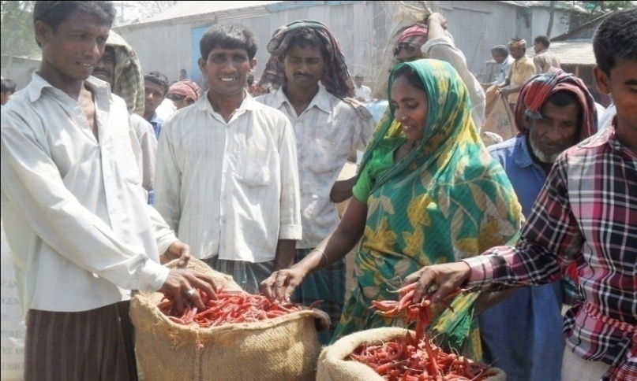
Contract Farming Approach
Feasibility study with each product
Land selection
Meeting with farmers
Organizing farmers
Training
Seed distribution
Regular field visit
Technical help
Procurement
Contract Farmers 75000
Lead Farmers
100
18,000 workers

Slide 7
Model of PRAN Krishi Hub
Facilitation seed & pesticide
Training, Field visit & Technical support
PABL
Private company
Contract Farmers
Green & semi process raw materials
Seed, Fertilizer, pesticide and Agriculture equipment
Information
1500-3000 Farmers/Hub
All kinds technical information provide to CF
HUB
ISC
CP
IC
Collection green raw material from CF
PABL=PRAN Agro Business Ltd.
ISC=Inputs Sale Center
CP=Collection Points
IC= Information Center
CF= Contract Farmer

Slide 8
Impact of PRAN activities
Contact farmers are involving formal supply chain which helps them sell their produces at fair prices.
Farmers are getting better yields due to quality seed supply and timely irrigation.
Increased farm activities in PRAN- Project areas have generated jobs both for men and women
Farmers are engaged round the year due to diversification of farming

Slide 9
Missing Ling
IFC loaned to PRAN without sharing goal and objectives of GAFSP fund (according to PRAN)
There is absence the GAFSP project campaign among the farmers
Monitoring system is yet to be introduced
PuSW and PrSW are unknown each other
PRAN is using IFC fund as usual loan
Not considering here is sustainable agricultural practices

Slide 10
Recommendations
IFC and PRAN should be consider the GASFP objectives on their loan agreement.
PRAN should detailed how it will achieve the targets in line with the agreement.
IFC team to monitor PRAN activities at the filed level after a reasonable time gap.
PRAN activities need to be monitored as well be regulated so that the contact farmers are not deprived for product and input price
Bangladesh is one of the worst affected among the countries that are facing the early impacts of climate change. Therefore, support for climate-resilient sustainable agriculture is crucial to enable the farmers to increase food security and adapt. And this issue should be a priority agenda both for the IFC and PRAN.
The overuse of chemical fertilizers in farming and the use of formalin in crops posing a great threat to public health. So, there should need a regular campaign where PRAN can play a vital role in this regard ase it has already got a network of 75,000 farmers.

Slide 11
Thank You
Amirul Islam
Manager – Food Rights and Sustainable Livelihoods
ActionAid Bnagladesh
amirul.islam@actionaid.org

