Slide 1
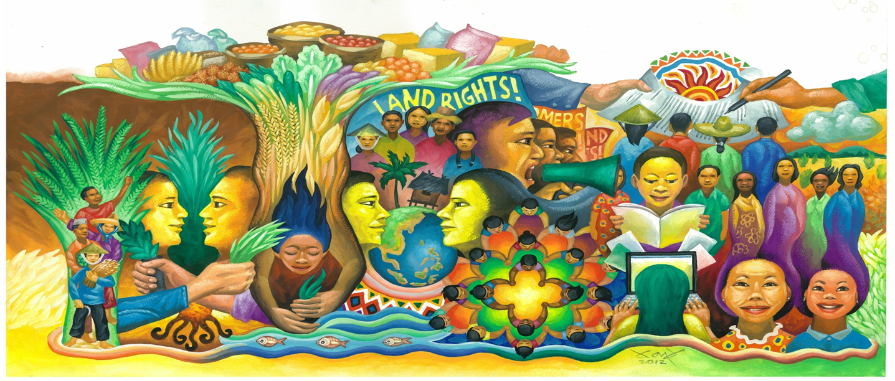
Attracting Youth to Agriculture in Asia
By Ana Sibayan
PAKISAMA - AFA
Asian Farmers Association (AFA)
Notes:
Good afternoon to everyone. We thank SEARCA and all the sponsors of this event for giving us the opportunity to share with you some of the efforts of our organizations to attract the youth in agriculture.
I am Ana Sibayan, a young farmer from Mindoro Philippines. A member of Pakisama, which is a national federation of farmers organizations in the country. Pakisama is a member of the Asian Farmers Association ( AFA) , a regional organization of national farmers organizations, currently with 17 member organizations in 13 countries, representing 12 million small scale women and men farmers and producers.

Slide 2
Outline
Introduction
Findings
Issues
Initiatives
Proposal
III. Concluding Remarks
Notes:
This is the outline of my presentation.

Slide 3
Introduction : IYFF 2014
2014 is declared by the UN as International Year of Family Farming
A recognition of the significant contribution of small-scale farmers in feeding the world and caring for the earth
Small scale family farmers feed 70% of the world’s population (majority of them are in Asia and Pacific)
Sixty (60%) of the poor and hungry people are in Asia
The IYFF is an opportunity to tell the world to invest in smallholder agriculture, invest in women in agriculture and invest in the rural youth

Slide 4
Introduction : AFA Policy Research on Youth in Agriculture
FACT process
(Farmers Advocacy Consultation Tool )
Why the Focus on Youth ?
---observation that the young do not want to farm; they migrate to cities and other countries
---no farmer , no food
Notes:
FACT process :
AFA is implementing a lobby and advocacy process on attracting the youth to agriculture through the Farmers Advocacy Consultation Tool (FACT), which is one of the priority issues this IYFF. It has 4 pillars: (1) consultation to members, (2) participatory research, (3) SMART proposal writing, and (4) lobby mapping and stakeholder analysis. It ensures that proposals are based on the needs, opinions and situations of farmers and are complemented by expert knowledge
AFA members in 9 countries conducted consultations, participatory researches and policy proposal writing , participated by ( jun, how many people ) . The initial results were presented during the regional consultation on youth issues in Bali last May 2014. A
AFA is now in the process of consolidating the results of these consultations, researches and proposals, and combining them with desk study at the regional level in order to come up with a regional policy proposal that can be lobbied with decision makers in the context of the IYFF
Why the Focus on Youth ?
Afa members have observed that the young do not want to go into farming and opt to migrate to cities. We know that the farming population is ageing. In Philippines, average age is 55. In Japan, it is 70! . If there is no one to farm in the near future, where will we get our food ? No farmer , no food. So we have to make ways to attract the youth to agriculture. But how ? What enabling policies are needed to do so?

Slide 5
Findings : Where are the Rural Youth
60% world population are youth
Unemployed or in informal labor
Not interested in agri courses
Migrating to cities inside or outside their countries for better jobs
Notes:
Sixty percent (60%) of the world’s rural population is made up of young men and women.
Unemployed or in informal labor :
Rural youth is often unemployed or work informally in unpaid, low skilled, insecure and hazardous jobs, leading to massive migration to cities
Not interested in agri courses :
For example, in University of Philippines Los Banos enrolment in agriculture courses has declined over the past 30 years from 51% of total students in 1980 to 4.7% of the total in 2012
According to a SEARCA study , outdated curricula and outmoded research and academic facilities are among the challenges on agricultural human resources in Asia .
Migrating to cities :
in Vietnam, increasing industrialization and modernization has resulted in fast pace of youth migration to cities from 40.7% of youth in 2009 to 56.4% in 2012

Slide 6
Findings : Why Agri is not Attractive to the Youth
No money from farming / low income / unstable work / high risk / no prospects
No pride and dignity in farming , low self esteem
Rural life is boring, no “entertainment”
Exclusion in agricultural policy formation and decision- making processes
Lack of rural youth organizations focusing on agriculture
Notes:
No money from farming :
Their parents were poor farmers, they will be poor farmers
In Vietnam, rural youth expressed wish to farm if farming “makes them rich and feel confident”
In Mongolia, young farmers expressed need to earn at least “subsistence wage”
No pride and dignity in farming:
Agriculture is not seen as a respected occupation or prestigious work it is a lowly job; no pride and dignity in farming.
This low regard for farming is reinforced in society through disparaging remarks about farming
e.g. In Philippines, farming seen as fit only for school drop-outs (Go back to the farm and plant camote)
As form of punishment:
Diyan ka na lang sa bukid (You are only fit to stay in the farm)
Farmers tell their children:
Huwag kang tumulad sa akin na isang magsasaka lang
(Do not be like me, just a lowly farmer)
Rural life is boring, no entertainment :
In Cambodia, youth want to adopt “modern lifestyle”
Lack of socio-cultural activities esp. for youth / no rural youth orgs
Exclusion in agricultural policy formation and decision- making processes:
Thus their issues and concerns are not usually taken into consideration or are not prioritized
Lack of rural youth organizations focusing on agriculture
Thus there are no solidarity groups for exchange of information, ideas and supporting each others’ endeavors.

Slide 7
Findings: Problems of Youth Who Farm
Access to land
Access to credit
E.g. Legacy of chemical farming
Lack of support services targetting young farmers ( research, extension. Affordable seeds, markets)
Farm mechanization
Notes:
However, there are still some youth who have decided, or mainly compelled or forced to farm.
I can tell you my story first. ( jun , help Anna write in one paragraph her story and tell it here).
I am not alone. Many of us face the same problem and challenges, even more :
Access to land
Many young farmers do not own land that they can cultivate. Under some land laws (e.g. Philippines), young people can apply as beneficiaries but they must first be considered as an independent household unit and not dependents of their parents
Access to credit:
in Vietnam, youth lacks capital and credit loans because young people are not the heads of their families hence hard for them to access loans and they do not have collateral needed by banks and financial organizations
Legacy of Chemical Farming :
Many young people know the harm of chemical farming, especially those who have been trained on sustainable agriculture, but they worry about expected low yields during initial stages of “conversion” or shift to organic/sustainable agriculture
Lack of support services targetting young farmers:
What support services are lacking or inadequate : ---Lack of exposure, knowledge and technical know-how : As this is inadequate or if offered, does not prioritize the young farmers
-- lack of support in terms of inputs, fertilizers, local seeds, access to capital, lack of information on price/market, access to market
Large Farm Mechanization that Displaces Agri Labor
Although machines make farming less laborious to attract more young people, young farmers worry that inappropriate machines will result in loss of jobs, as in case of huge tractors that can displace the labor of many farmworkers.
Lack of programs especially for young farmers :

Slide 8
Findings : BUT, young people are interested in farming
Youth will farm if :
Agri will provide decent livelihoods
Agri can be a “wealth multiplier”
Support for capital investments in family farm is available
Notes:
Contrary to widely-held perception about the rural youth, award-winning research of PhilRice in 2012 found that farmers’ children express the desire to stay connected to agriculture if only these options were available:
--- Agri will provide decent livelihoods that support their family
--Agri can be a wealth multiplier
-- Young farmers will be seen as investors andwill be given support for capital investments in family farms

Slide 9
FINDINGS Some Initiatives of Young Farmers from AFA Members
Notes:
Let me share with you some initiatives of our young farmers members in AFA, from which we draw inspiration from.

Slide 10
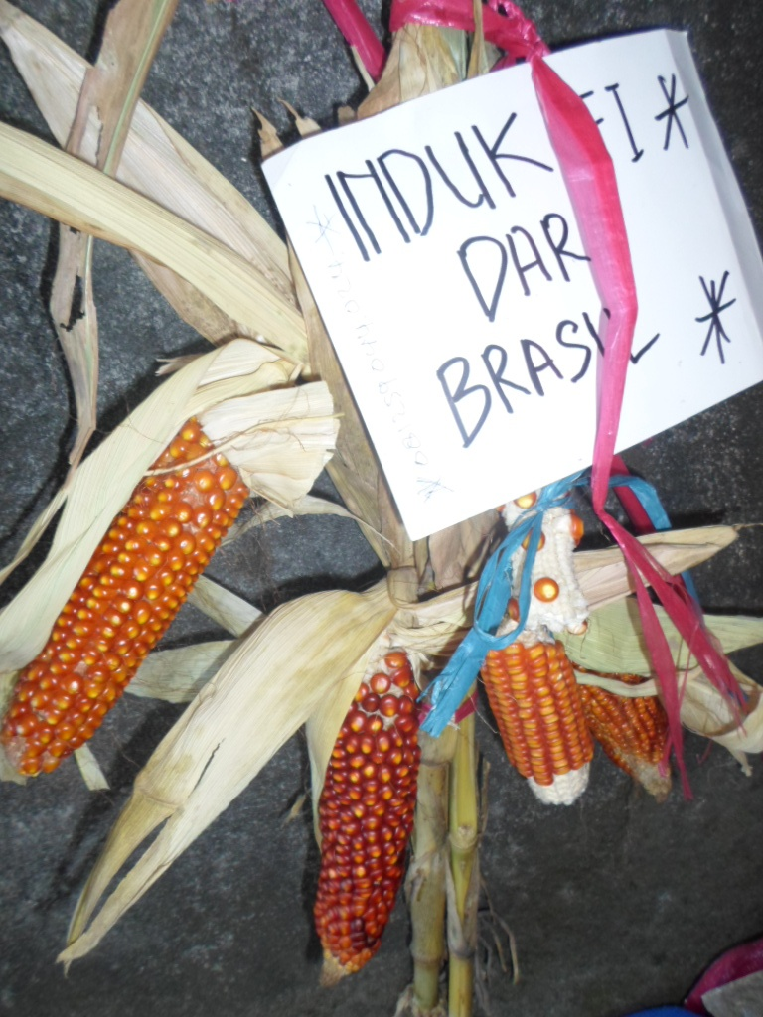
The Story of Rifai – API/Indonesia
Notes:
Muhammad Rifai (31 yrs) is a young farmer entrepreneur developing quality corn seeds since 2009, working with Indonesia Peasant Alliance (Aliansi Petani Indonesia or API) . He developed quality local seeds from cross breeding in his hometown Brasilian, Mexican and Indonesian corn, seeds which were exchanged to him during an international conference he attended.
Rifai has been sharing this knowledge among young and elder farmers through “musyawarah” or popular discussion. He has also been gaining customers by selling his locally-developed seeds which is of same quality but is 70% cheaper than private company seeds.

Slide 11
The Story of Jon – PAKISAMA/Philippines
Notes:
Jon Sarmiento (40 yrs old ) is a farmer-technician-extensionist practicing Integrated, Diversified, Organic Farming System (IDOFS) with Farm Planning.
One training activity which Jon organizes is Y.E.S. camp (Youth. Ecology. Sustainable Agriculture) for young farmers. His learning farm is accredited by Agriculture Department, and the core thrust of PAKISAMA’s Sustainable Agriculture Program is IDOFS.

Slide 12
My story – PAKISAMA/Phils
Notes:
One of Jon’s trainees is myself (21 yrs). I am a daughter of a farmer couple who finished a commercial cooking course. But I love farming and I dreamed to have my own farm and manage my own farm business. After IDOFS training, I started vermi composting, building a fishpond, making a vegetable garden, and raising free range chicken in a 2,500 sqm farm. I am now training other young farmers in our neighborhood on IDOFS.

Slide 13
VNFU/Vietnam
A youth committee with representation in leadership structure
“green summer” program
Training and capacity building
Encourage young farmers to stay in their land instead of moving to cities to look for jobs
Provide avenues for self -reflection
Notes:
Vietnam Farmer’s Union has a youth committee that is represented in leadership structure
Government program : “green summer” where young people are invited to go to rural areas to help poor farmers through labor and other activities
Training on: knowledge and appreciation of agri; new agri technologies, environment and food security issues
Encourage young farmers to stay in their land instead of moving to cities to look for jobs
Provide avenues for self -reflection

Slide 14
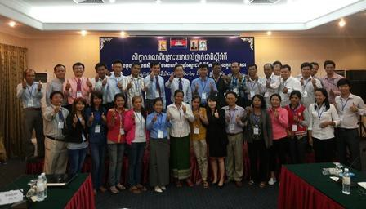
FNN/Cambodia
Notes:
Farmer and Nature Net (FNN) in Cambodia established youth committee within its organization. The committee has 1 seat in the Board. More than 100 young farmers already trained to be leaders and farmer entrepreneurs, and provide human resources that can help FNN in future

Slide 15
WAFF-KAFF / KOREA
Financial support
For the purpose of revitalizing young farmers, the government provides the loan with only 1% of interest rate, which is very low.
Developed
Countries
Lowering
Interest rate
Down to 1%
KAFF is negotiating with the central government
to decrease from current3% to 1%
Through adopting credential recognition system, more financial support to be possible on young farmers
Extra progressive financial support system
Notes:
In developed countries, for the purpose of revitalizing young farmers, the government provides the loan with only 1% of interest rate, which is very low. In Korea, KAFF members negotiating with the central government to decrease interest rate from current3% to 1%. Through adopting credential recognition system, more financial support is made possible to young farmers and there is some hope for the youth to be attracted to agriculture.

Slide 16
Taiwan
3 categories of young farmers
-parents are doing farming
-young farmers without any experience
-professionals who want to go into agriculture
New Farmer Program
Notes:
There are 3 categories of young farmers
in Taiwan. The first category is the second
generation young farmers whose parents
are doing farming, which they continue. The
second category is young farmers without any experience. The third are
those who are a little bit older, like professionals who want to go into
agriculture.
For the first category, the key factors to attract them into agriculture are:
(1) if parents are making profit; (2) if farming is promising; and, (3) if
farming is not too much work for their parents. For the third category, it is
not so difficult, because they are more mature and know why they want to
go into agriculture, and because they also have more financial support. It is
the second category, those without experience, which finds it harder to go
into agriculture.
The government supports them in different ways, either through the central
government’s Council of Agriculture, or through the city government.
One project is the New Farmer Program from Tainan City government. The
city government selects young farmers who decided to go into agriculture.
Right now there are 268 young farmers in this program, all under 45 years
of age. The government extension unit provides technical and financial support to these young farmers.
Technical support is provided through
experts, apprenticeship (master and student), agriculture courses, and
counselling system. The agriculture experts and masters who teach
agriculture to young farmers are deployed through the district farmer
associations. Financial support comes in the form of government loans with
low interest to young farmers to buy facilities, supplies or equipment.

Slide 17
Finding: Policy Proposal Recommendations Phils - Magna Carta of Young Farmers
promote and protect rights of young farmers aged 15-40 years
Establish programs for young farmers,
Institutionalize young farmers’ representation in all agricultural policy-making bodies
Define discrimination against young
Notes:
Let me know share to you our findings with regards policy recommendations for attracting the youth in agriculture :
In Philippines we propose the enactment of a Magna Carta for Young Farmers which have the following provisions”
promote and protect rights of young farmers aged 15-40 years
Establish programs for young farmers, e.g, agriculture-sensitive educational curriculum students and broader scholarships for all agri-related courses
Institutionalize young farmers’ representation in all agricultural policy-making bodies and other bodies with reserved seats for youth
Define discrimination against young farmers as any age-based distinction that excludes or restricts young farmers in the recognition and promotion of their rights and their access to and enjoyment of opportunities, benefits or privileges

Slide 18
Vietnam: Build “respected picture” of farmers
Raise more awareness in recognizing the role of farmers and agriculture
Develop and expand the models on production and business for rural youth
Develop clubs on youth extension, clubs on young creativeness, demonstration models on production
Organize exchange visits for rural youth to learn from good young farmers, participate in trade fairs, exhibition, competition on farming techniques for rural youth
Notes:
Our Vietnam member proposes policies to build a respectable picture of farmers by :
Raise more awareness in recognizing the role of farmers and agriculture
Develop and expand the models on production and business for rural youth
Develop clubs on youth extension, clubs on young creativeness, demonstration models on production
Organize exchange visits for rural youth to learn from good young farmers, participate in trade fairs, exhibition, competition on farming techniques for rural youth

Slide 19
Nepal: Establish Agricultural Research Centres and Agricultural Universities
Motivate, encourage, guide and train young people to harness their optimism about a career in agriculture
Establish agriculture as an active and secure profession
Notes:
Our member from Nepal has some recommendations for agri research centers and agri universities :
Motivate, encourage, guide and train young people to harness their optimism about a career in agriculture
Establish agriculture as an active and secure profession

Slide 20
Priority recommendations from AFA GA Regional Consultations in Bali (May ‘14)
Capacity building: appropriate training and exposure through education to motivate young farmers
Organization development: to give voice to young farmers, strengthen cooperation groups / cooperatives, to organize support to advocacy work, to develop knowledge networks
Policy advocacy especially focused on youth
Partnership with various actors (government, business sector, banks, academe)
Notes:
And from our regional consultation , we identify the following :
Capacity building: appropriate training and exposure through education to motivate young farmers
Organization development: to give voice to young farmers, strengthen cooperation groups / cooperatives, to organize support to advocacy work, to develop knowledge networks
Policy advocacy especially focused on youth
Partnership with various actors (government, business sector, banks, academe)

Slide 21
III. CONCLUDING REMARKS

Slide 22
Our Reflections
The youth can be attracted to agriculture if they see (1) meaning ; (2) income opportunities as well as feel a sense of pride.
The youth needs training, as well as the presence of mentors, coaches, motivators
The youth needs to be provided with basic resources esp land, capital and equipments to make farming less tedious work and primarily be viable and sustainable.

Slide 23
How can the findings help promote the conference themes of improved resilience, equity and integration in Southeast Asian agriculture?
Developing proposals / programs to attract youth back to agriculture
Attract the youth to sustainable, agro-ecological approaches
Build entrepreneurial attitude of young farmers
Organizing and strengthening small-scale family farmers will make them better prepared to access opportunities and benefit fully from integration and address adverse consequences as a result of integration
Notes:
How can the findings help promote the conference themes of improved resilience, equity and integration in Southeast Asian agriculture?
Developing proposals / programs to attract youth back to agriculture
Attract the youth to sustainable, agro-ecological approaches
Build entrepreneurial attitude of young farmers
Organizing and strengthening small-scale family farmers will make them better prepared to access opportunities and benefit fully from integration and address adverse consequences as a result of integration

Slide 24
What important new knowledge has been gained? What knowledge gaps remain?
New knowledge has been gained from research on situation of young farmers, and existing initiatives and proposals from young farmers and their organizations to make agriculture a more viable option for rural youth
Further research needs to be done on effective strategies to attract youth to agricuture
Notes:
What important new knowledge has been gained ? What knowledge gaps remain ?
New knowledge has been gained from research on situation of young farmers, and existing initiatives and proposals from young farmers and their organizations to make agriculture a more viable option for rural youth
Further research needs to be done on effective strategies to attract youth to agricuture, especially those initiatives being done in developed countries.

Slide 25
What policy implications/ recommendations may be drawn?
To reiterate, policy recommendations include:
Magna Carta of Young Farmers
Access to land and natural resources, and seeds
Capacity building: on sustainable, organic, agro-ecological approaches, farmer-owned and led enterprises and value addition. Entrepreneurship
Support for finance needs of young farmers
Organization development: to give voice to young farmers, strengthen cooperation groups, to develop knowledge networks, etc
Policy advocacy especially focused on youth
Partnership with various actors (government, business sector, banks, academe)
Notes:
To reiterate, policy recommendations include:
To reiterate, policy recommendations include:
Magna Carta of Young Farmers
Access to land, and natural resources and seeds
Capacity building: on sustainable, organic, agro-ecological approaches, farmer-owned and led enterprises and value addition. Entrepreneurship
Organization development: to give voice to young farmers, strengthen cooperation groups, to develop knowledge networks, etc
Policy advocacy especially focused on youth
Partnership with various actors (government, business sector, banks, academe)

Slide 26
☺ thank you for your attention ☺

