Slide 1
Instruments for Public Purchasing
Law 10.696
Food Purchase Program
Dispenses of the Public Bidding
1993
2009
Created Law 8.666
Public Bidding Law
2003
Law 11.947
Article. 14 – Family Farming and School Feeding
30% minimum
Dispenses of the Public Bidding

Slide 2
Government Procurement
Strengthen Family Farmer
Promotion of access to food for food insecure populations
Contributes to local development to boost rural economies of thousands of municipalities
Food Purchase Programme (PAA)
NATIONAL SCHOOL FEEDING PROGRAMME (PNAE)
INSTITUTIONAL PURCHASE
Acquisitions from Municipalities, States and the Union

Slide 3
PAA and PNAE:
Public Food Markets
The importance of the State in structuring fair systems of production, distribution and consumption of food.
Programs to encourage Family Farmers’ trading.

Slide 4
PAA
FOOD PURCHASE PROGRAM
LAW Nº 10.696/2003
To ensure food access to those who face nutritional and food insecurity.
To promote social inclusion in the countryside by strengthening family farming – selling support.
To constitute public stocks of food produced by family farmers.
To allow family farmers to stock their products to be sold for fairer prices.

Slide 5
How does the PAA work?
Production
Food Public Purchase
Consumption
Family Farmers (individually or in cooperatives)
Settlers
Social assistance network and public equipments for food and nutrition security
Government, no bidding required
Food baskets
Traditional Peoples and Communities
Stock formation

Slide 6
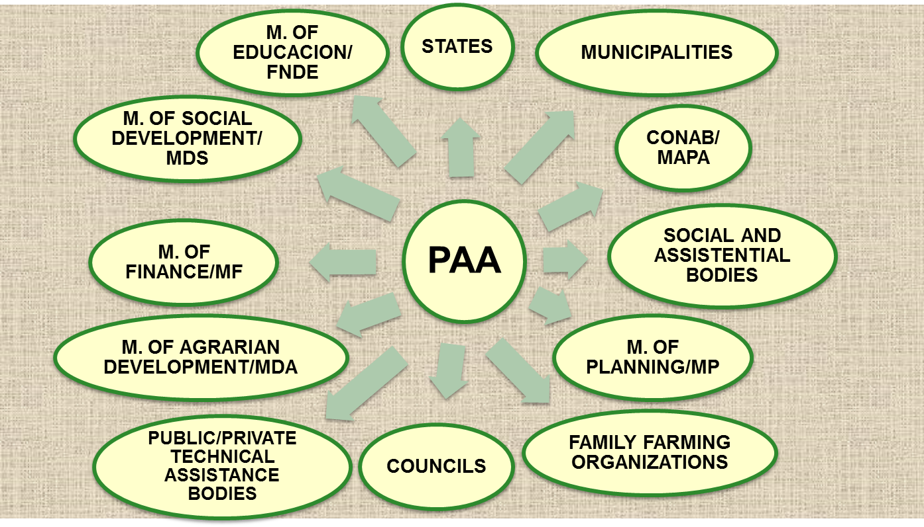
FOOD PURCHASE PROGRAM – PAA
Network of actors involved

Slide 7
Food Public Purchase Programme (PAA)
From 2003 to 2013
R$ 5.3 billion invested
3,000 types of products acquired
4 million tons of food purchased
50% CAD Único and 37% women

Slide 8
Food Public Purchase Program (PAA)

Slide 9
INSTITUTIONAL PURCHASE
Created in 2002, it is a new market opportunity for family farms; its aim is to meet demands of food consumption from the Union, the States, the Federal District and the Municipalities
Who can sell?
farmers, agrarian reform settlers, foresters, farmers, gatherers, fisherfolk, indigenous peoples and other traditional peoples and communities possessing the DAP (PRONAF Eligibility Declaration) either for the family or for the association
Limit of US$ 3,400 per DAP/year; it does not interfere with access to other modes of PAA

Slide 10
NATIONAL SCHOOL FEEDING PROGRAMME - PNAE
Ensures, through direct transfer of funds to the states and municipalities, school feeding for students of all basic education enrolled in public and philanthropic institutions
Its mission is to contribute to the improvement of education through the provision of healthy food and educational actions for food and nutrition
Law No. 11.947, of June 16ᵗʰ, 2009, states that at least 30% of the transferred funds must be used in the purchase of food directly from family farms
Facilitated acquisition process
Priority for food produced locally
Provision for payment of up to 30% more for organic products over conventional ones

Slide 11
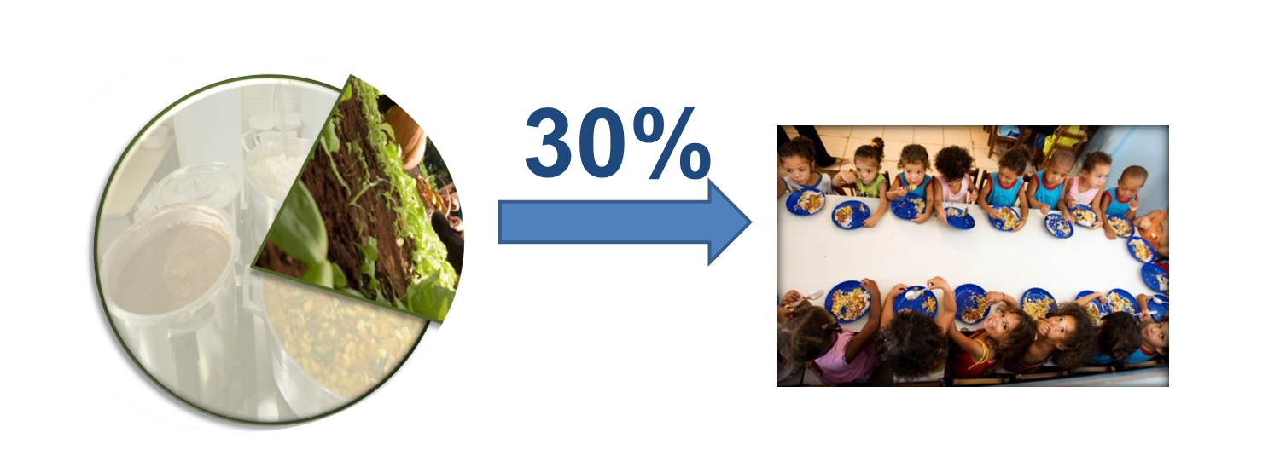
Ley 11.947/09:
Family Farming and School Feeding
minimum
Represent a market
reserve U$ 500.000.000.
47 million students in
public schools

