Slide 1
Report on Study on Organic Rice Industry in Indonesia
Written by API

Slide 2
An Overview: Organic Agriculture Situation in Indonesia
The total area of organic farming in Indonesia in 2010 was 238,846.14 hectares, an increase of 10% from the previous year. This includes:
the certified (organic and conversion) - 103,908.09 hectares
in certification Process - 14.50 hectares
PAMOR-certified (PGS) - 5.89 hectares
uncertified organic agriculture areas - 134,917.66 hectares
(source: Indonesia Organic Alliance, 2010).

Slide 3
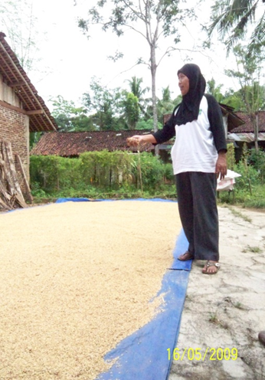
Situation of Organic Rice Industry
The dynamics of food (rice) access by Indonesians (farmers and general population) is affected by the production, distribution/trade, and consumption aspects.
Increasing public awareness on healthy food intake, environmentally-friendly food production, and farmers’ welfare, the demand on organic rice has also steady growth. People with special nutritional needs represent the largest demand of organic rice.
Pictures: women take the lead in organic practices in Central Java (“Istiqomah group”).

Slide 4
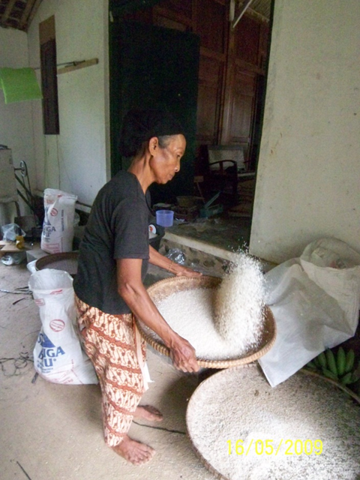
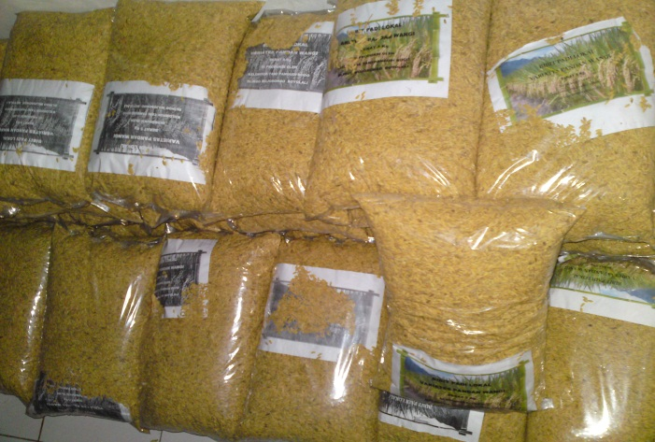
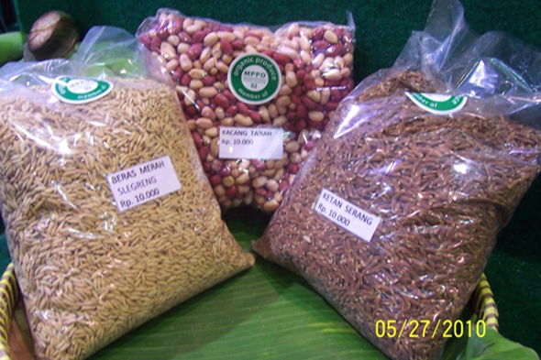
The organic agriculture area in Indonesia in 2010 is managed by thousands of producers, including the small farmers who are generally participated in farmer group and who are certified by various certification system.
Export has also been established.
Trends are welcomed by rice farmers, they shift gradually from the chemicals-intensive conventional farming to the environmentally-friendly (organic) farming which promotes the health of the producers (farmers), consumers, and the environment alike.
Pictures: women take the lead in organic practices in Central Java (“Istiqomah group”).

Slide 5
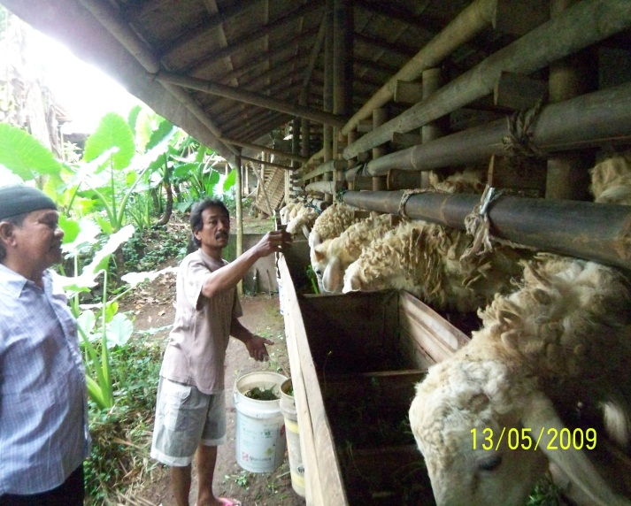
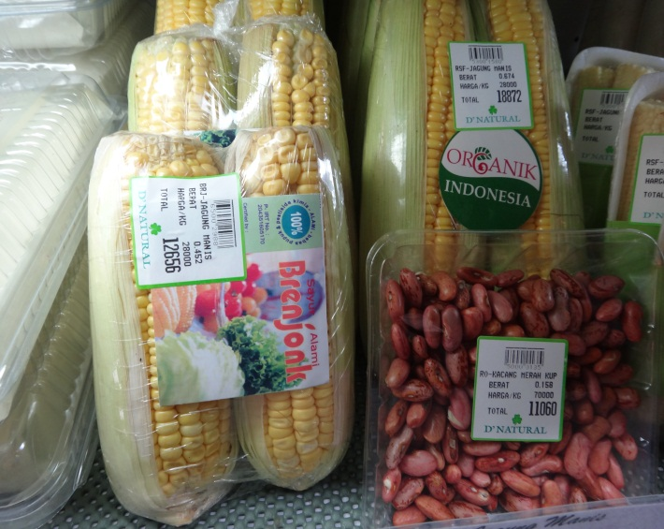
Issues and Challenges Faced by Key Stakeholders
Trust of the consumers
Quality and continuity of the products supply
Accessibility of the products
Distribution and Marketing (price, promotion, networking)
Climate Change (pest and diseases outbreaks, storm, drought, flood)
Setting of fair price
Certification (PGS)
Diversification of activities in farming (cattle, poultry, fishery, etc)
Limited diversification of product (processed food, food for infants, the variety of rice, etc)
Organizational matters (small farmers, consumers)

Slide 6
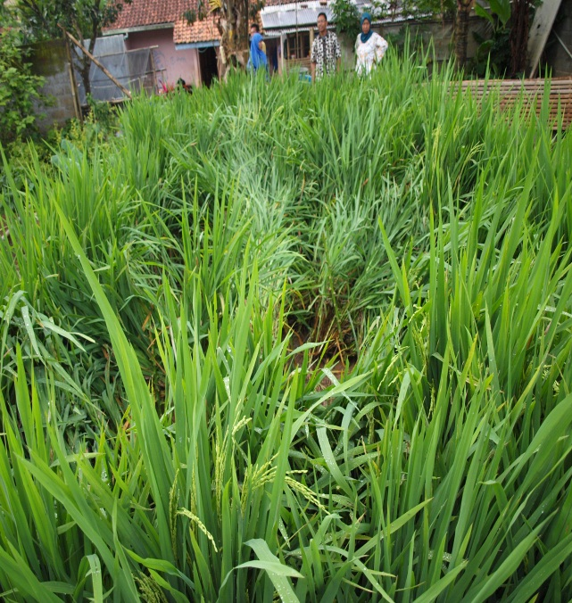
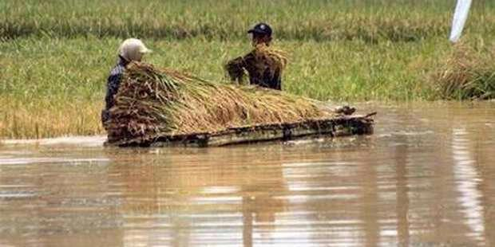
The Impact of Climate Change to Small Farmers
Organic farmland yields up to 6.5 tons/ha, but the number could be negatively affected by climate change, due to such effects as pests (e.g. wereng coklat or brown planthopper) and storms.
It is worth noted that, under similar conditions, organic rice yields better than non-organic rice.

Slide 7
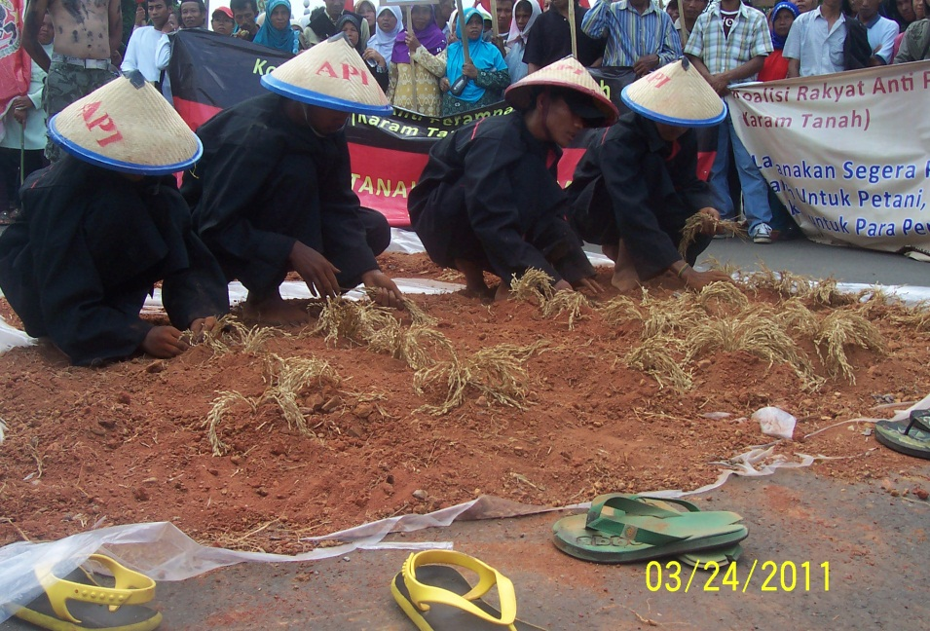
The Impact of Land Conversion to Small Farmers
Currently total area of paddy fields in Boyolali is 40 thousands hectares, and land use conversion rate into non-farming plots is 5%. The local government could only guarantee 20,000 hectares of farmland would be protected, while the rest might undergo land use conversion. The conversion will certainly affect the supply of organic rice in Boyolali.

Slide 8
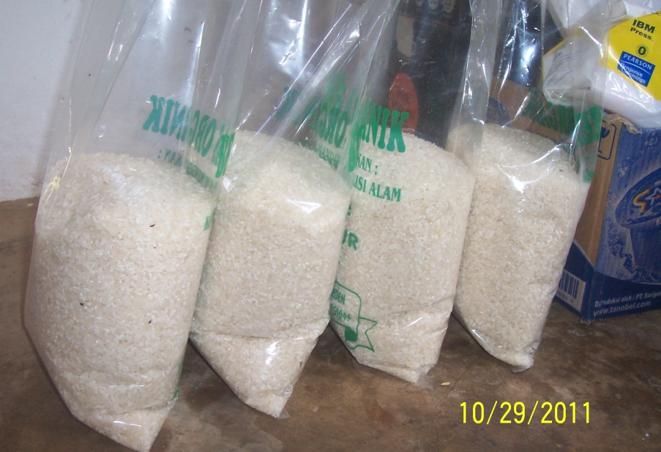
The Impact of Rice Price Volatility to Small Farmers
Fluctuations in international markets of rice price directly affect the local price.
Higher international price would drive export price up. On the other hand, lower price in international markets would increase imports, hence driving domestic
price down.
The price of organic rice is also
affected by the price of non-
organic rice. Organic rice is
usually sold at a 20% premium.

Slide 9
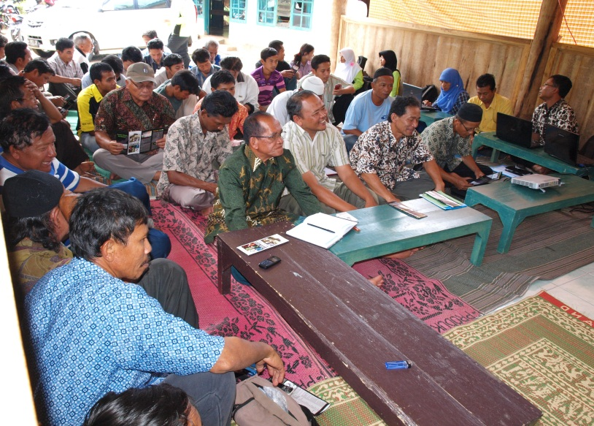
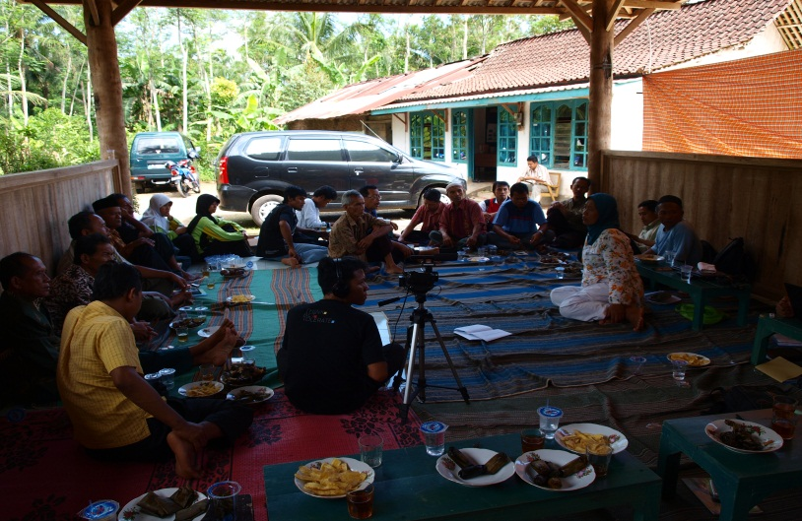
Policy Recommendation to organic rice industry
Advocacy of government policies to support and expand organic farming, and to facilitate credit access to raise reserve funds.
Strengthening of farmers’ association, developing economic organizations in rural areas, building the capacity of farmers in developing collective marketing.
Advocacy in regional and international levels with regards to international agreements governing the limitations or eliminations of transgenic seeds, which could harm local seeds as the main input in organic farming.

Slide 10
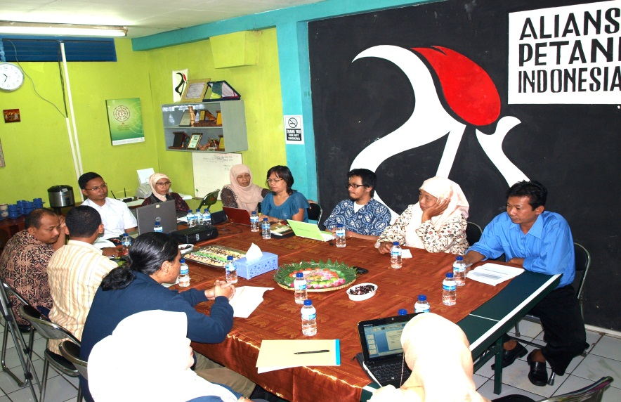
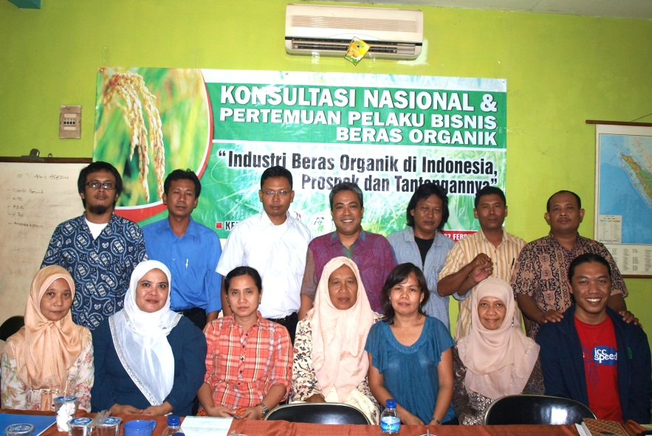
Action Plan
There is potential for technological supports from the national government.
Information gap between producers and consumers should be reduced.
Organization and economic management of producers should be strengthened.
More selling points should be developed to improve consumers’ access to supply.
Reserve funds for small producers (farmers) should be raised and maintained.
Information regarding consumer preference on organic rice is essential for producers.
Cooperation between farmers and main stakeholders as identified in the report should be established (consumers education, the engagement of consumers in a working group of organic rice task force at government office)

Slide 11
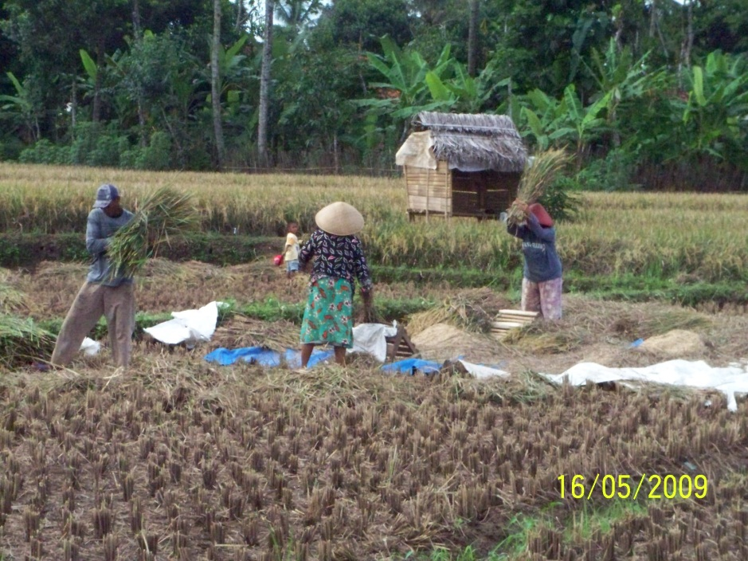
Thank You

