Slide 1
Consultation Meeting on Organic Rice conducted by
Farmer’s Federations Association for Development Thailand (SorKorPor) with collaboration of
Asian Farmers Association for Sustainable Rural Development (AFA) on February 23-24, 2012 at SorKorPor Building No.80 Tedsabal Rungsalid Nue, Chatujak, BKK

Slide 2
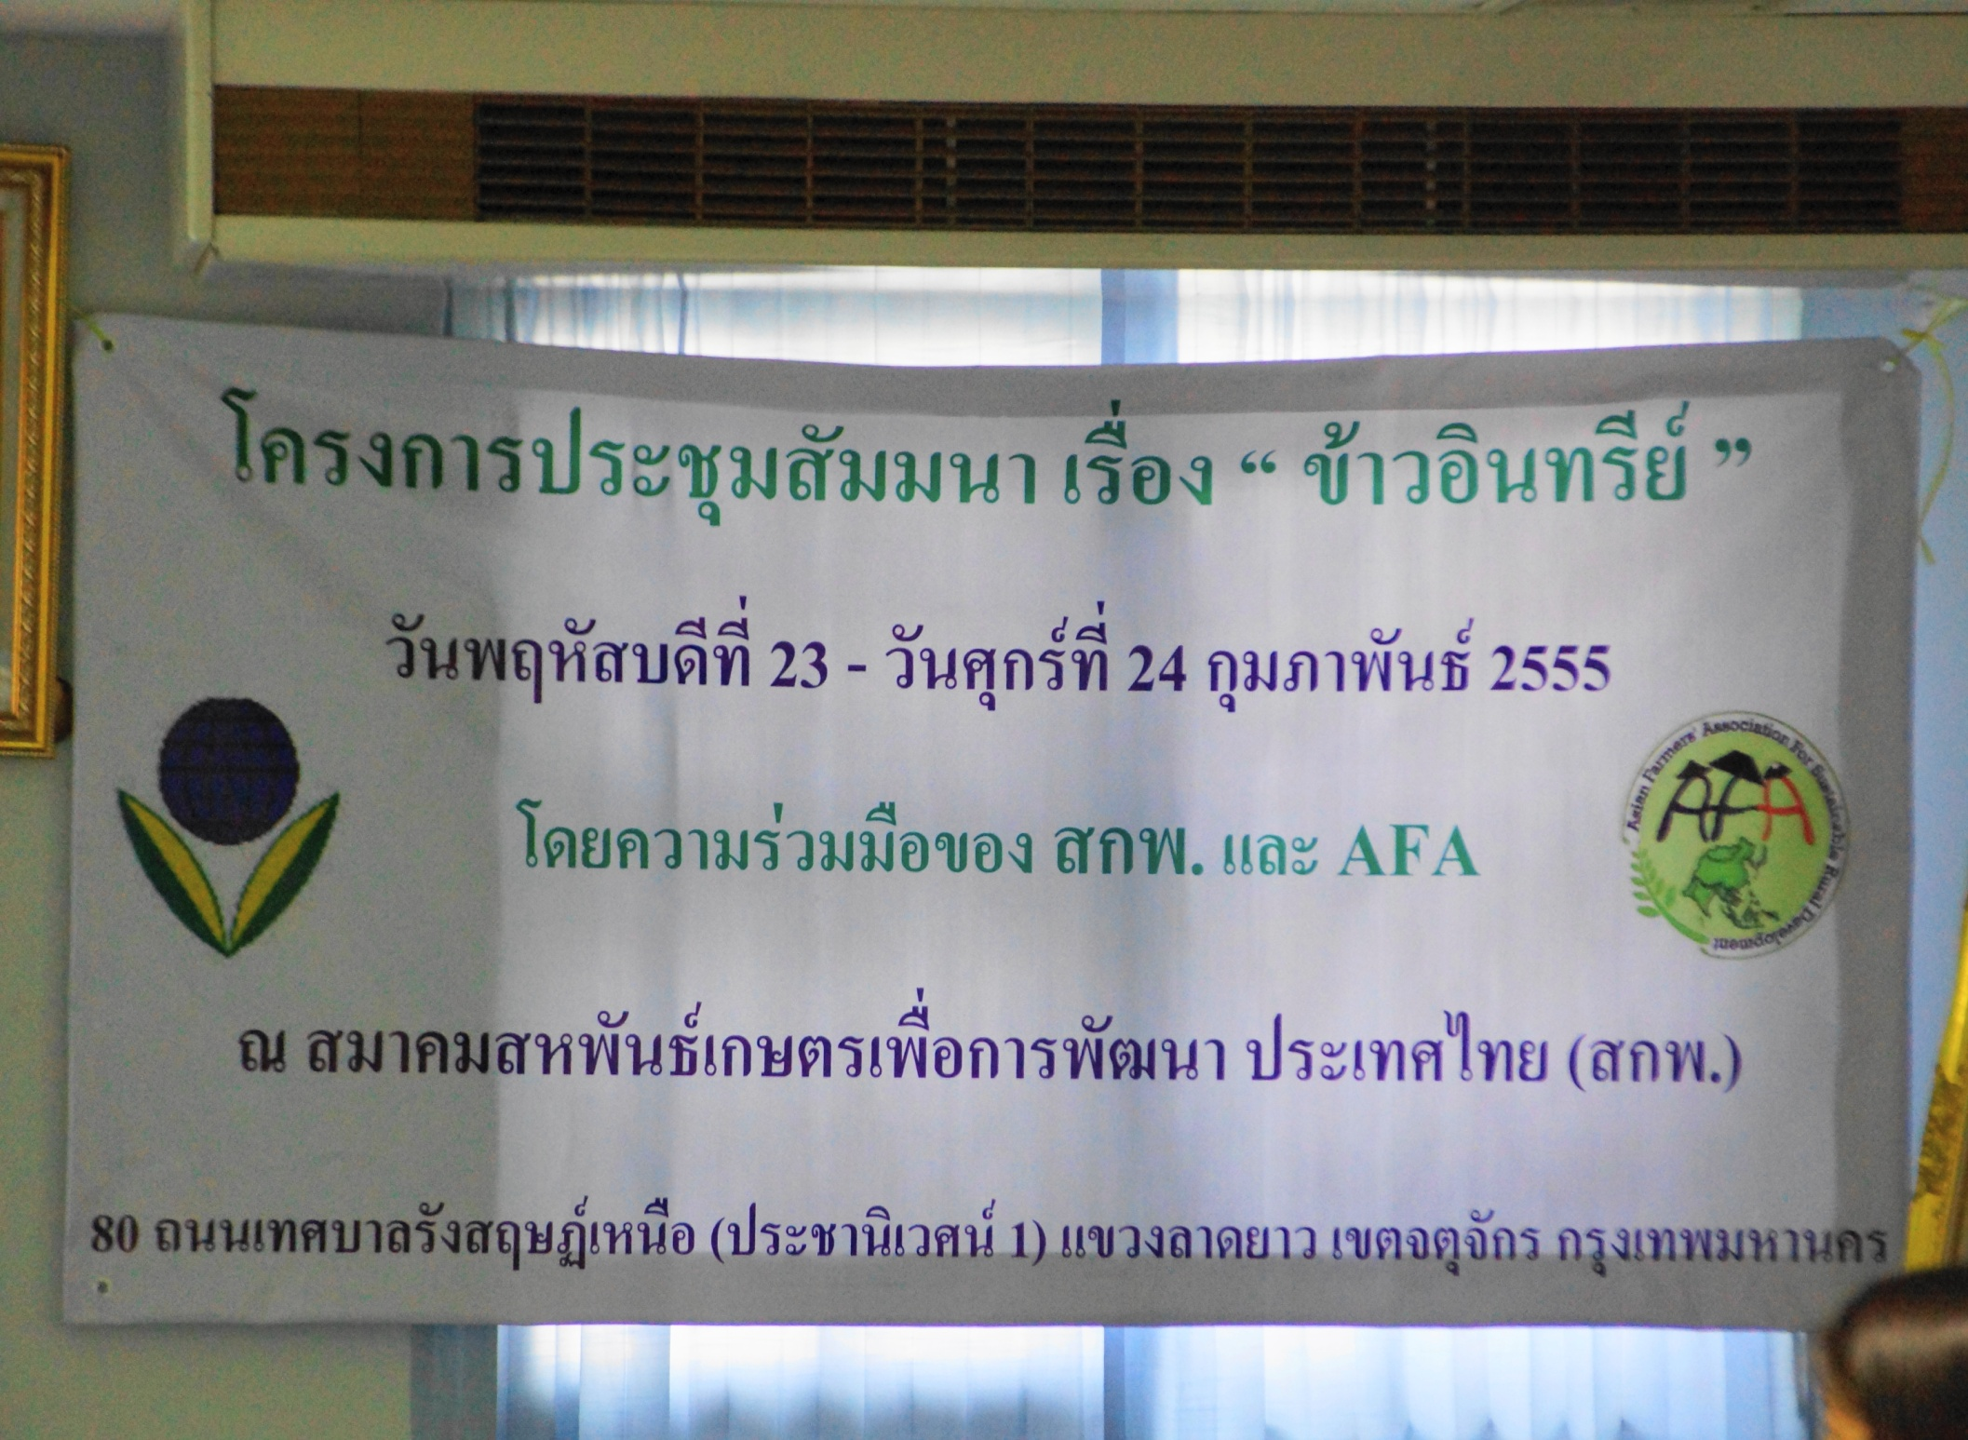

Slide 3
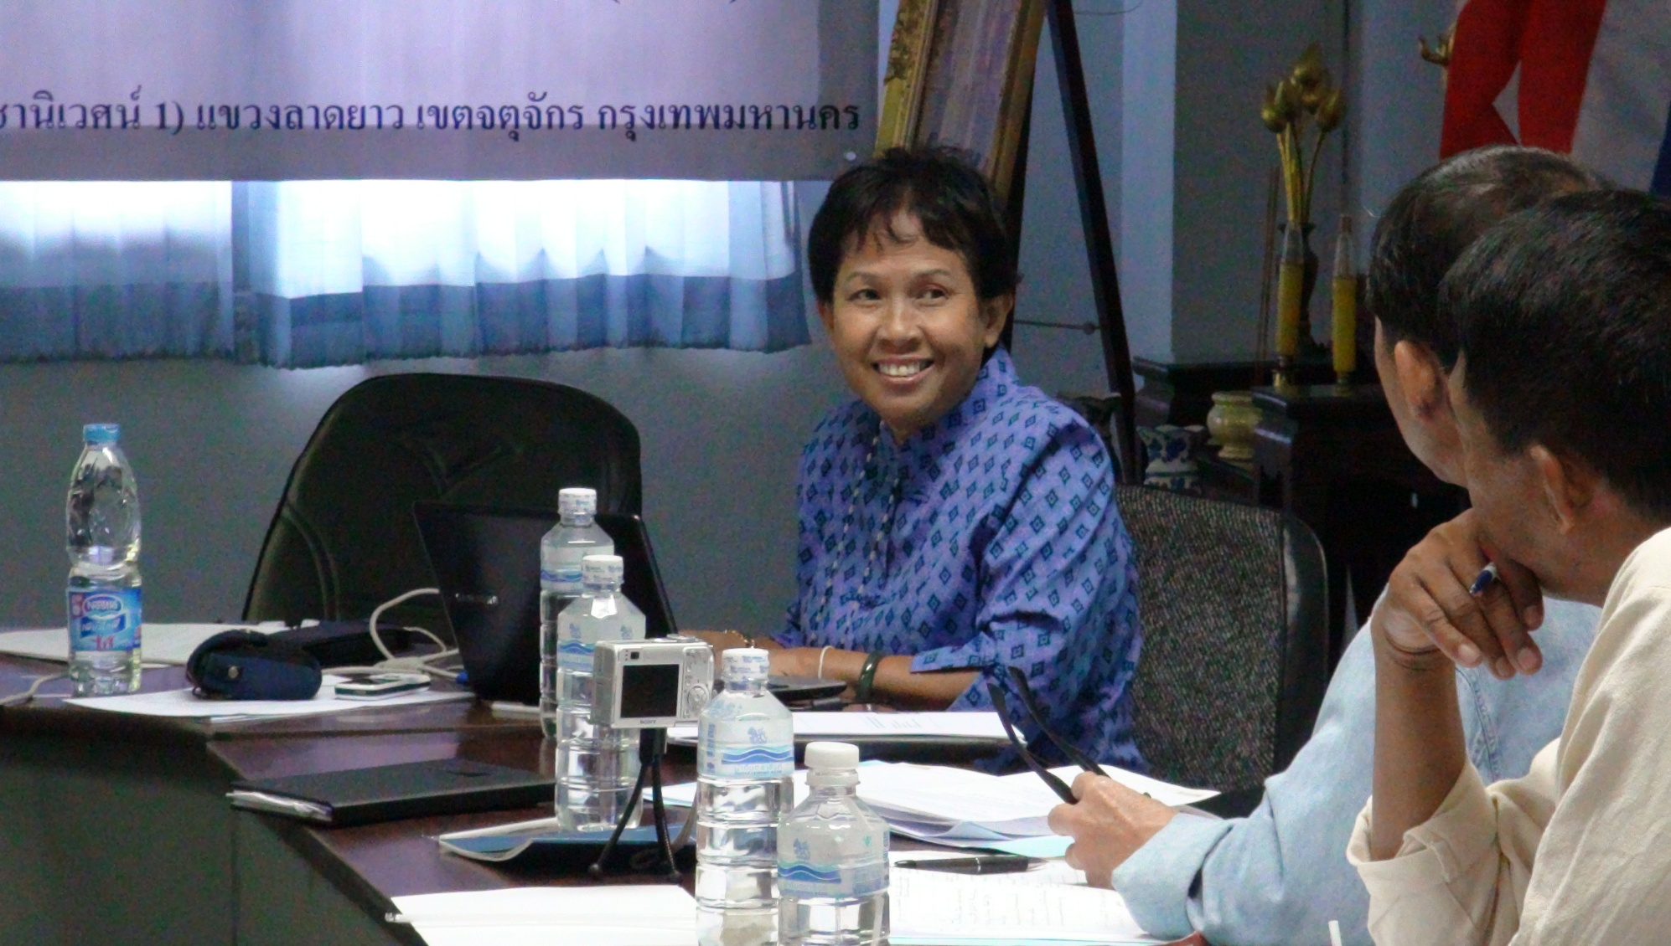
ดร.อมรา เวียงสระ ผู้เชี่ยวชาญข้าวอินทรีย์ กรมการข้าว

Slide 4
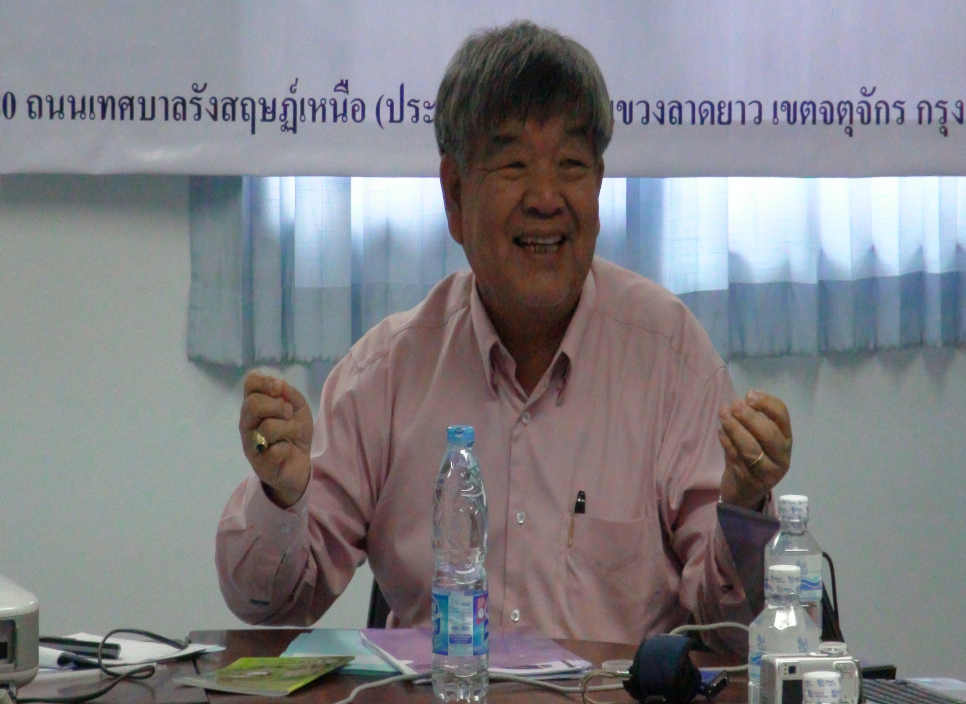
i
Mr.Somchai Visartpong, Director of Organic Agriculture Development Promotion Groups
Quality Development for Agriculture Goods Office, Department of Agriculture Extension

Slide 5
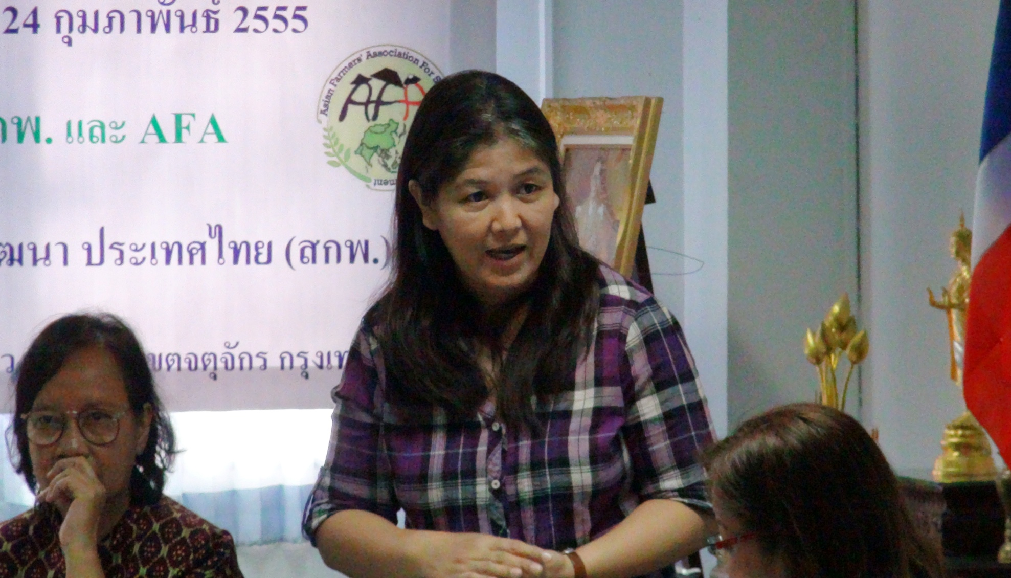

Slide 6
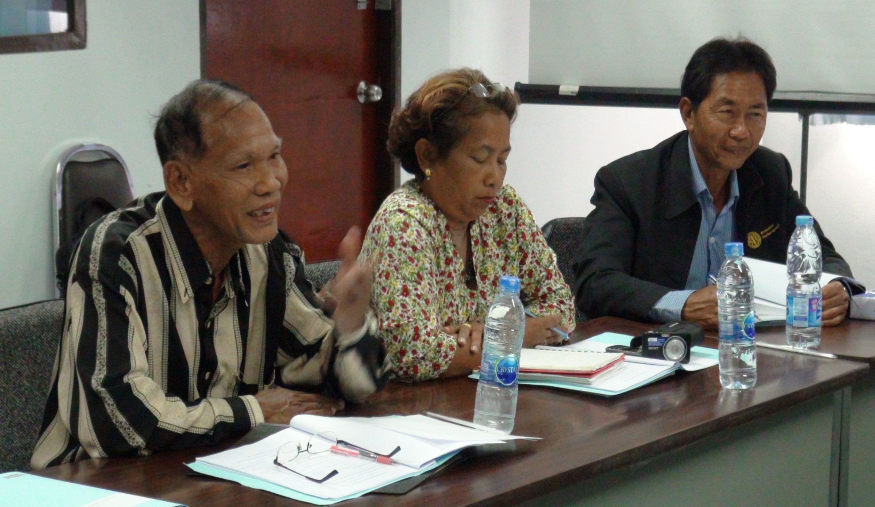
participants from sourthern and North easthen

Slide 7
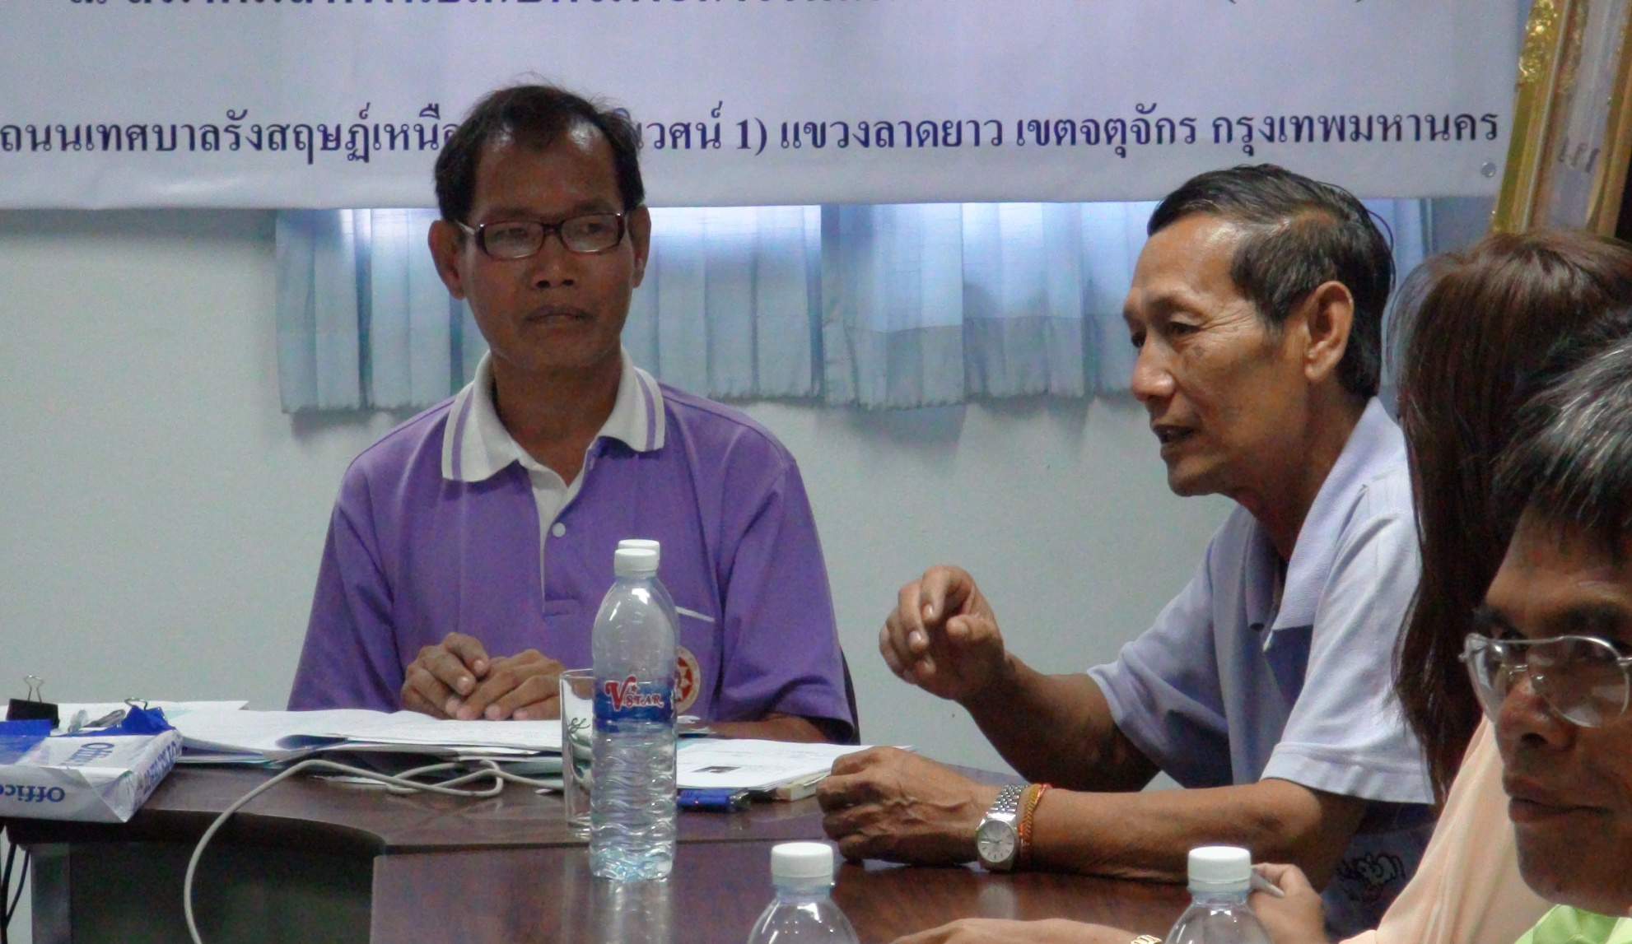
Mr.Vinit Chaishit member of SKP Board (thirst from right)

Slide 8
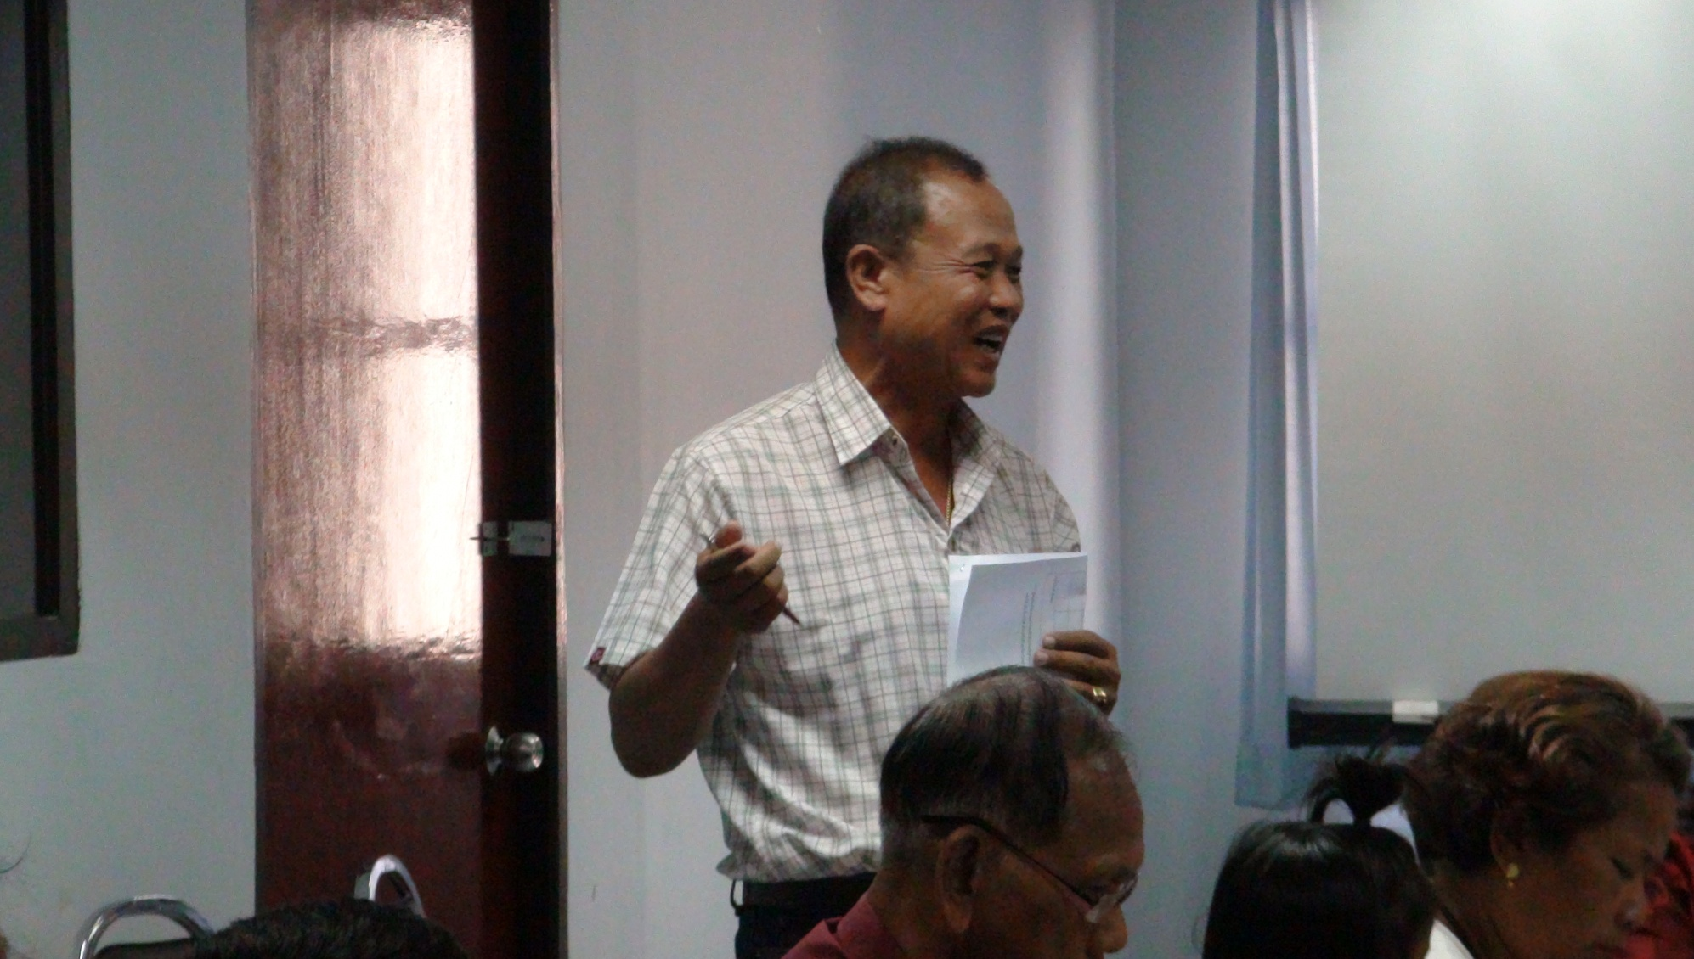
คุณสมชัย สงเคราะห์
สกพ. อีสานกลาง

Slide 9
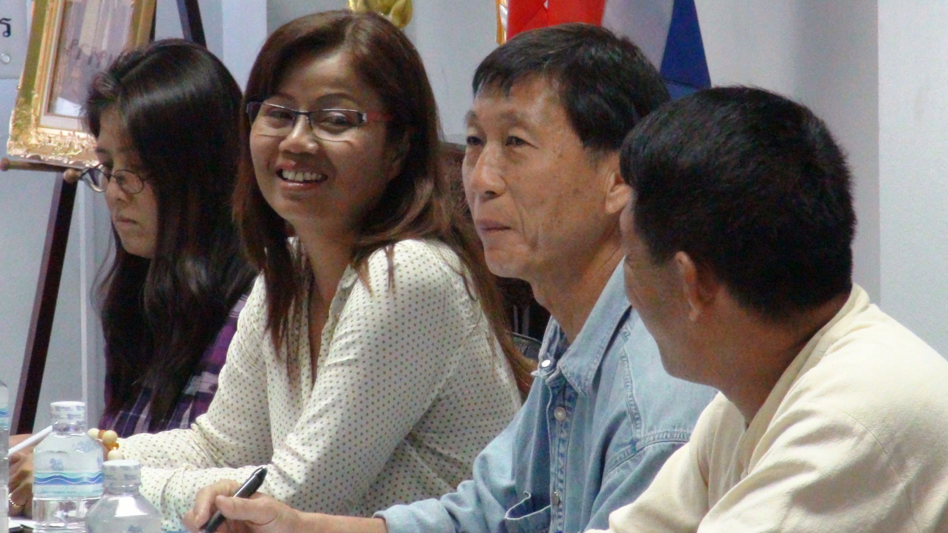
2 Participants from Khon Kaen - Middle Esarn/Esarn Klang SKP

Slide 10
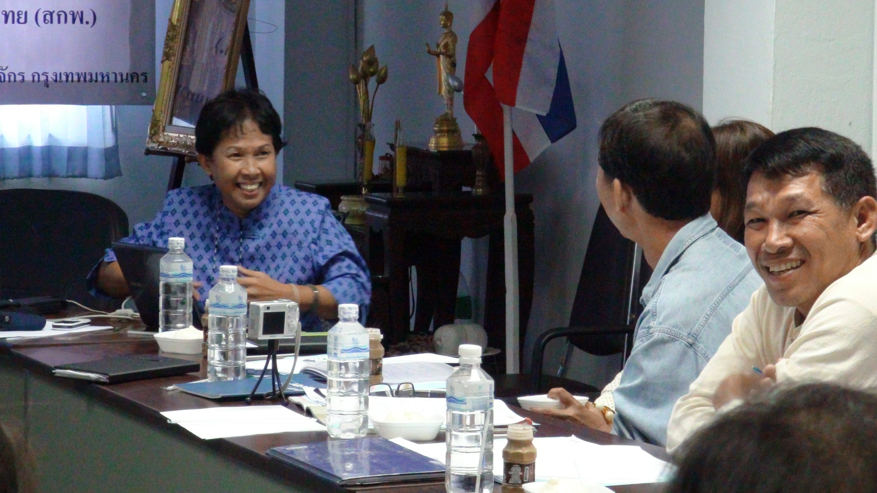
1 participant from Utaradit – Lower Northern SKP (right of picture)

Slide 11
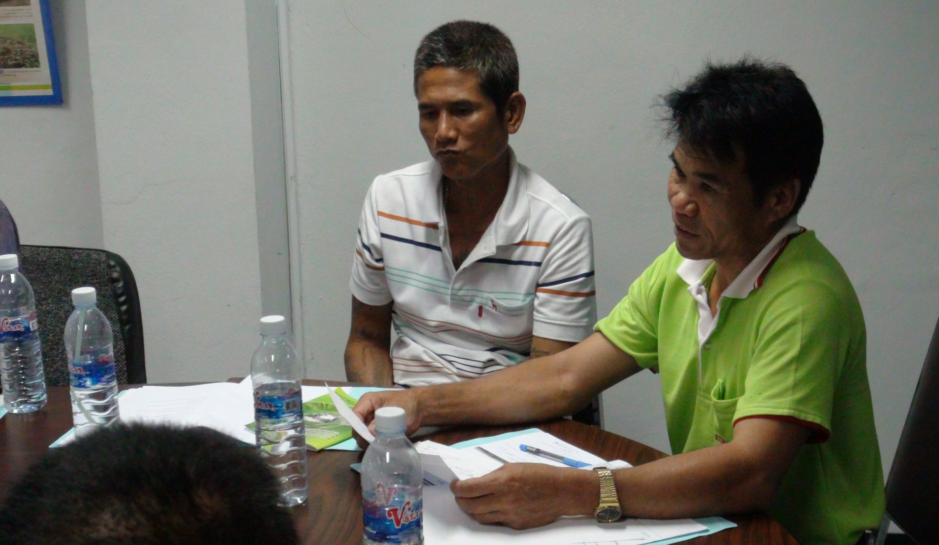
2 Participants from Srisaket

Slide 12
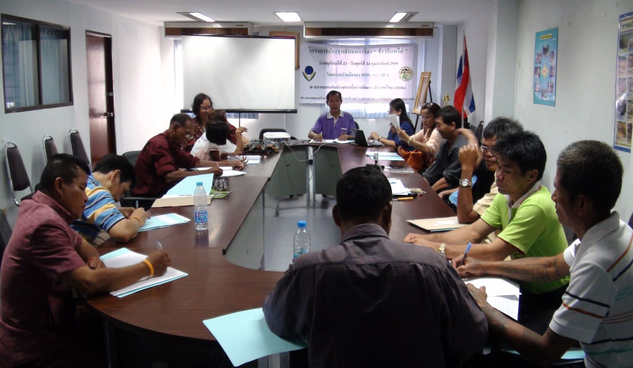

Slide 13
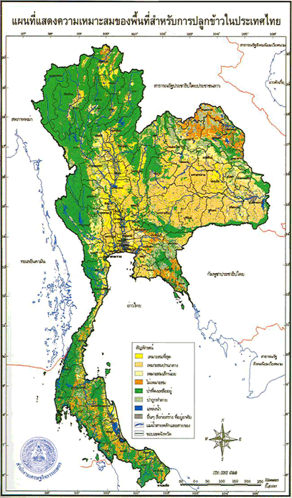
Potential areas in Thailand that can growth organic rice

