Slide 1
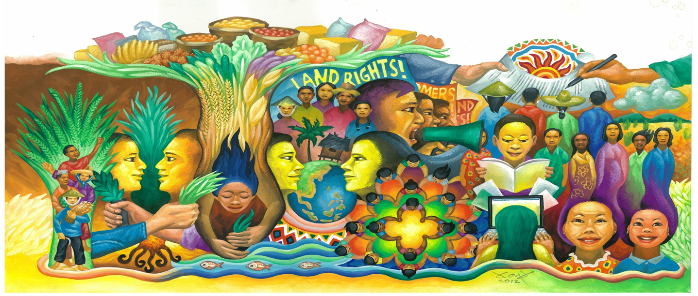
Attracting Youth to Agriculture in Asia
By Violeta Corral
Asian Farmers Association (AFA)
Notes:
.

Slide 2
Outline
Introduction
Findings – Issues, Initiatives
III. Recommendations & Reflections

Slide 3
IYFF 2014
2014 is declared by the UN as International Year of Family Farming
A recognition of the significant contribution of small-scale farmers in feeding the world and caring for the earth
The IYFF is an opportunity to tell the world to invest in smallholder agriculture, invest in women in agriculture and invest in the rural youth

Slide 4
AFA policy research on Youth in Agriculture
FACT process with AFA members in 9 countries (Farmers Advocacy Consultation Tool )
Four pillars:
consultation to members,
participatory research,
SMART proposal writing, and
lobby mapping and stakeholder analysis
Notes:
FACT process :
AFA is implementing a lobby and advocacy process on attracting the youth to agriculture through the Farmers Advocacy Consultation Tool (FACT), which is one of the priority issues this IYFF. It has 4 pillars: (1) consultation to members, (2) participatory research, (3) SMART proposal writing, and (4) lobby mapping and stakeholder analysis. It ensures that proposals are based on the needs, opinions and situations of farmers and are complemented by expert knowledge
AFA members in 9 countries conducted consultations, participatory researches and policy proposal writing . The initial results were presented during the regional consultation on youth issues in Bali last May 2014.
AFA is now in the process of consolidating the results of these consultations, researches and proposals, and combining them with desk study at the regional level in order to come up with a regional policy proposal that can be lobbied with decision makers in the context of the IYFF

Slide 5
Why focus on the rural youth?
60% world rural population are youth
Observation that youth do not want to farm
Unemployed or in informal labor
Migrating to cities inside or outside their countries for better jobs/opportunities
Farmers getting older, vanishing
No farmer , no food
Find ways to attract youth to agriculture
Notes:
Why the Focus on Youth ?
Afa members have observed that the young do not want to go into farming and opt to migrate to cities. We know that the farming population is ageing. In Philippines, average age is 55. In Japan, it is 70! . If there is no one to farm in the near future, where will we get our food ? No farmer, no food. So we have to make ways to attract the youth to agriculture. But how ? What enabling policies are needed to do so?
Sixty percent (60%) of the world’s rural population is made up of young men and women.
Unemployed or in informal labor :
Rural youth is often unemployed or work informally in unpaid, low skilled, insecure and hazardous jobs, leading to massive migration to cities
Not interested in agri courses :
For example, in University of Philippines Los Banos enrolment in agriculture courses has declined over the past 30 years from 51% of total students in 1980 to 4.7% of the total in 2012
According to a SEARCA study , outdated curricula and outmoded research and academic facilities are among the challenges on agricultural human resources in Asia .
Migrating to cities :
in Vietnam, increasing industrialization and modernization has resulted in fast pace of youth migration to cities from 40.7% of youth in 2009 to 56.4% in 2012

Slide 6
FINDINGS Situation / Issues of Rural Youth
Notes:
Let me share with you some initiatives of our young farmers members in AFA, from which we draw inspiration from.

Slide 7
General youth situationer
60% of world’s youth live in Asia Pacific
>750 million young men 15-24 years
in 2010:
INDIA: 234 million (19% of total population)
CHINA: 225 million (17%)
JAPAN: 12 million (10%)
BANGLADESH: 20%
PHILIPPINES: ~20 million (20%)
(Source: UN ESCAP)
Notes:
According to the UN ESCAP (2014), over 60 per cent of the world’s youth live in Asia- Pacific, i.e., more than 750 million young women and men aged 15 to 24 years. In 2010, India alone had 234 million young people, the highest number of any country in the world (representing 19 per cent of the country’s total population), followed by China with 225 million (representing 17 per cent of the total population). By comparison, Japan only had 12 million young people or 10 per cent of the population. Bangladesh and the Philippines both also had very high shares of youth – around 20 per cent.

Slide 8
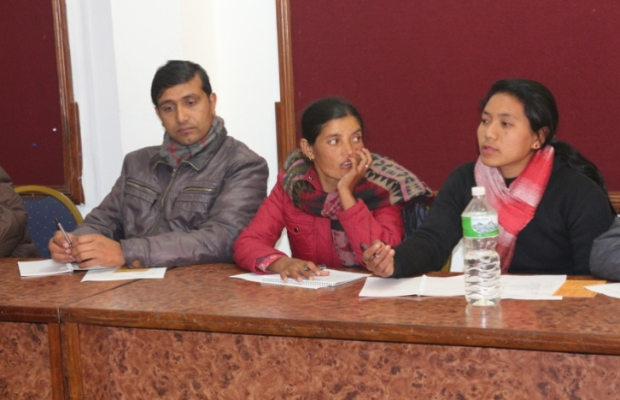
Youth in Nepal
~50% are youth 16-40 years
42% are youth 18-35 years
(Source: NLRF)
Notes:
According to NLRF, almost fifty percent of people are youth between 16-40 years of age. Those 18-35 years old make up 41.63 % of the total population of Nepal.

Slide 9
Youth in Mongolia
39% of Mongolia’s population are youth 16-36 years and 40.7% are women.
Of the 25,000 crop farmers in Mongolia, 38.9% are young farmers and 37% are women
(Source: NAMAC)
Notes:
According to NAMAC, 39% of Mongolia’s population are young people aged 16-36 years and 40.7% are women. Of the 25,000 crop farmers in Mongolia, 38.9% are aged young farmers and 37% are women.

Slide 10
% of rural youth decreasing
Migration (Philippines, Nepal, Kyrgystan)
Rapid industrialization (Japan, Korea, Vietnam)
Notes:
http://www.fao.org/docrep/012/al414e/al414e00.pdf

Slide 11
Rural youth in Vietnam
30% are youth aged 16-30 years
70% (17 million) are rural youth
Balanced gender ratio (50:50)
Youth’s Union survey in 2011:
4.1% of rural youth lacked employment
3% were unemployed
(Source: VNFU)
Notes:
Thirty percent (30%) of Vietnam’s population are youth aged 16-30 years old, and 70% of them (17 million) are rural youth, with balance between young men and women. According to surveys by the Youth’s Union in 2011, 4.1% of rural youth lacked employment while 3% were unemployed.

Slide 12
Young farmers in Kyrgystan
Young farmers are economically active rural youth 18-35 years and owning farming land and engaged in farming
356,000 family farmers, 61% are young men
No official records on youth in agriculture
Notes:
According to UWUA, the economically active section of rural youth 18-35 years and owning farming land and engaged in farming can be considered as young farmers. Practically, each family farm has representatives of youth engaged in agriculture. Young men and women in agriculture make up approximately 61% and 39%, respectively, of the 356,000 family farmers in the country. However, there are no records on young farmers and gender proportion in youth farming, and hence impossible to give official data relevant to youth in agriculture.

Slide 13
Ageing farmers
Average age of farmers in Japan: 70 years
Philippines: 57 years
Thailand: 54 years

Slide 14
Why Agri is not Attractive to the Youth
No money from farming / low income / unstable work / high risk / no prospects
No pride and dignity in farming, low self esteem
Rural life is boring, no “entertainment”
Exclusion in agricultural policy formation and decision- making processes
Lack of rural youth organizations focusing on agriculture
Notes:
No money from farming :
Their parents were poor farmers, they will be poor farmers
In Vietnam, rural youth expressed wish to farm if farming “makes them rich and feel confident”
In Mongolia, young farmers expressed need to earn at least “subsistence wage”
No pride and dignity in farming:
Agriculture is not seen as a respected occupation or prestigious work it is a lowly job; no pride and dignity in farming.
This low regard for farming is reinforced in society through disparaging remarks about farming
e.g. In Philippines, farming seen as fit only for school drop-outs (Go back to the farm and plant camote)
As form of punishment:
Diyan ka na lang sa bukid (You are only fit to stay in the farm)
Farmers tell their children:
Huwag kang tumulad sa akin na isang magsasaka lang
(Do not be like me, just a lowly farmer)
Rural life is boring, no entertainment :
In Cambodia, youth want to adopt “modern lifestyle”
Lack of socio-cultural activities esp. for youth / no rural youth orgs
Exclusion in agricultural policy formation and decision- making processes:
Thus their issues and concerns are not usually taken into consideration or are not prioritized
Lack of rural youth organizations focusing on agriculture
Thus there are no solidarity groups for exchange of information, ideas and supporting each others’ endeavors.

Slide 15
Low regard for farming
Philippines: good only for school drop-outs, those with no option
Bangladesh: no dignity in farming profession
Nepal: not seen culturally as a respectable profession
Not prestiguous work
Notes:
LOW REGARD FOR FARMING
Philippines: good only for school drop-outs
Bangladesh: no dignity on the farming profession
Nepal: not seen culturally as a respectable profession

Slide 16
Discrimination, low self-esteem
Due to lowly regard for farming
Lack of role models to motivate young farmers
Lack of options
Lack of opportunities in rural areas for self-development, self-realization
Notes:
DISCRIMINATION, LOW SELF-ESTEEM
Lack of role models to motivate young farmers
Self-development, opportunities
opportunities for self-realization

Slide 17
Lack of recognition, participation
Young farmers not formally recognized as a demographic group by government
No venue for participation in governance
Excluded in agricultural policy formation and decision-making processes, thus their issues not prioritized
Voices are not being heard
Lack of policy support/programs for young farmers

Slide 18
Lack of social life, rural youth orgs
Low social-cultural life potential in rural area
Lack of conditions for youth recreation
Lack of funds for community social activities
No socio-cultural events between youth in rural areas, commune level
Lack of socio-cultural events to promote agriculture
Boredom
No solidarity groups or venue for exchange of information, ideas and supporting each other’s endeavors
Notes:
LACK OF SOCIO-CULTURAL ACTIVITIES OR YOUTH ORGANIZATIONS
lack of rural youth organizations
There are no solidarity groups or venue for exchange of information, ideas and supporting each other’s endeavors.
Lack of funds for community social activities (such as socio-cultural activities of youth union at grassroots level).
Lack of socio-cultural events to promote agriculture
No socio-cultural events between youth in rural areas
low social-cultural life potential in rural area, lack of conditions for youth recreation
Boredom
Vietnam: Setting up and developing clubs on outstanding youth on economic development at commune level

Slide 19
(Mis)perception: No money in farming
Rural youth do not see farming as a way out of poverty
Their parents were poor farmers, they will remain poor farmers.
No income from farming
Highly indebted to middlemen/traders
Farming is not a profitable profession
Subsistence-oriented farming discourage youth to go into agriculture
Persistent perception of agriculture an outdated field with minimal financial returns
Notes:
Perception: NO MONEY IN FARMING
Rural youth do not see farming as a way out of poverty
Their parents were poor farmers, they will remain poor farmers.
No income from farming
Indebtedness to middlemen/traders
Farming is not a profitable profession
Subsistence-oriented farming discourage the youth to go into agriculture
Persistent perception of agriculture is an outdated field with minimal financial returns

Slide 20
Farming is hard work
Back breaking work, drudgery
Farm mechanization aims to make farming less laborious and attract youth but
Huge machines will displace farm labor
‘Mechanization level’
Phil, India, Pakistan: 2.31 hp/ha
China: 4.10 hp/ha
South Korea: 4.11 hp/ha
Japan: 7 hp/ha
Notes:
AGRICULTURE IS HARD, BACK-BREAKING WORK
Farm mechanization may be both a boon (make faming less laborious) and bane (will displace agricultural labor)
Mechanizing farm work is deemed to greatly reduce drudgery and make farming more attractive to the youth. The mechanization level of (rice and corn) farms in the Philippines, India and Pakistan is 2.31 horsepower per hectare (hp/ha), way behind the level of Japan (7 hp/ha), South Korea (4.11 hp/ha) and China (4.10 hp/ha).
Conrad M. Cariño, The potential of mechanization in agriculture, Manila Times, June 22, 2013

Slide 21
Farming is risky business
High risks, low returns
Traders control price and take advantage of farmers
Changing climate patterns has increased unpredictability for farmers
Major typhoons can wipe out earnings
Social protection, crop insurance is lacking
Notes:
FARMING IS RISKY BUSINESS
Engaging in agriculture is fraught with high risks and low returns. Traders control the price of agricultural products who take advantage of farmers’ vulnerabilities. Changing climate patterns has also increased unpredictability for farmers. Major typhoons can wipe out earnings, and social protection and crop insurance is sorely lacking.

Slide 22
Migration
Cambodia: youth generally migrate from villages and search job in cities, because farming is hard work
Indonesia: Imbalanced development between the urban and rural areas
Thailand: young people study and then leave the village. They work in cities and send money back. Only old farmers remain.
Kyrgystan. Young go to Russia and Kazakhstan – 20% of population now away; 2B remittance not invested in agriculture but on household consumption

Slide 23
Problems of Youth Who Farm
Access to land
Access to credit
Lack of support services targeting young farmers ( research, extension. Affordable seeds, markets)
Farm mechanization
Legacy of chemical farming
Notes:
However, there are still some youth who have decided, or mainly compelled or forced to farm.
Access to land
Many young farmers do not own land that they can cultivate. Under some land laws (e.g. Philippines), young people can apply as beneficiaries but they must first be considered as an independent household unit and not dependents of their parents
Access to credit:
in Vietnam, youth lacks capital and credit loans because young people are not the heads of their families hence hard for them to access loans and they do not have collateral needed by banks and financial organizations
Legacy of Chemical Farming :
Many young people know the harm of chemical farming, especially those who have been trained on sustainable agriculture, but they worry about expected low yields during initial stages of “conversion” or shift to organic/sustainable agriculture
Lack of support services targetting young farmers:
What support services are lacking or inadequate : ---Lack of exposure, knowledge and technical know-how : As this is inadequate or if offered, does not prioritize the young farmers
-- lack of support in terms of inputs, fertilizers, local seeds, access to capital, lack of information on price/market, access to market
Large Farm Mechanization that Displaces Agri Labor
Although machines make farming less laborious to attract more young people, young farmers worry that inappropriate machines will result in loss of jobs, as in case of huge tractors that can displace the labor of many farmworkers.
Lack of programs especially for young farmers :

Slide 24
Access to land
Many young farmers do not own land that they cultivate.
Philippines:
Young farmers have to wait for their parents’ demise before they can inherit/manage their parents’ land.
Young people can apply as agrarian reform beneficiaries only if they are considered as an independent household unit and not dependents of their parents.
Cambodia: Knowledge on land titling is limited
Notes:
ACCESS TO LAND
Many young farmers do not own land that they cultivate.
Philippines:
Young farmers have to wait for their parents’ demise before they can inherit and manage their parents’ land.
Young people can apply as agrarian reform beneficiaries only if they are considered as an independent household unit and not dependents of their parents.
Cambodia: Knowledge on land titling is limited

Slide 25
No more land
Agricultural land is decreasing
Conversion of non-agricultural uses (e.g. residential, industrial)
Most lands are in hands of medium and big farmers who are absentee farmers.
Landgrabbing
Notes:
LIMITED AGRICULTURAL LAND conversion to non-agricultural uses (e.g. residential, industrial)
Most of the lands are in the hands of medium and big farmers who are mainly absentee farmers.
Landgrabbing

Slide 26
Access to credit
Young farmers lack access to credit because they are not heads of their families and do not have collateral/property needed by banks
Lack of initial capital for young farmers
Kyrgystan: High interest rates of 30% per annum or lack of preferential access to credit
Notes:
ACCESS TO CREDIT
Young farmers lack access to capital and credit as they are not the heads of their families nor do they have the collateral needed by banks and financial institutions.
Modern agriculture needs huge investment and young farmers do not have capital
Lack of initial capital for young farmers
Kyrgystan: High interest rates of 30% per annum or lack of preferential access to credit

Slide 27
Lack of training
Lack of skills training in agricultural production, farm management, business development, marketing, etc
Women have less access to trainings , other support services (not seen as a farmer)

Slide 28
Indonesia: 3 main problems
Pest and disease of vegetables big problem
Importation of vegetables
Regulation or control of (organic) tobacco

Slide 29
Cambodia: Priority Issues
Address lack of govt support to agriculture sector
Govt support to young farmers’ livelihood
Capacity-building

Slide 30
Young people are interested in farming
Philippines (PhilRice research): Youth will farm if:
Agri will provide decent livelihoods
Agri can be a “wealth multiplier”
Support for capital investments in family farm is available
Nepal: There are still young farmers working at their farm as the last source of subsistence for their livelihood.
Vietnam: Rural youth expressed wish to farm only if farming makes them rich and feel confident
Notes:
Contrary to widely-held perception about the rural youth, award-winning research of PhilRice in 2012 found that farmers’ children express the desire to stay connected to agriculture if only these options were available:
--- Agri will provide decent livelihoods that support their family
--Agri can be a wealth multiplier
-- Young farmers will be seen as investors andwill be given support for capital investments in family farms

Slide 31
Initiatives / Proposals of Young Farmers from AFA Members
Notes:
Let me share with you some initiatives of our young farmers members in AFA, from which we draw inspiration from.

Slide 32
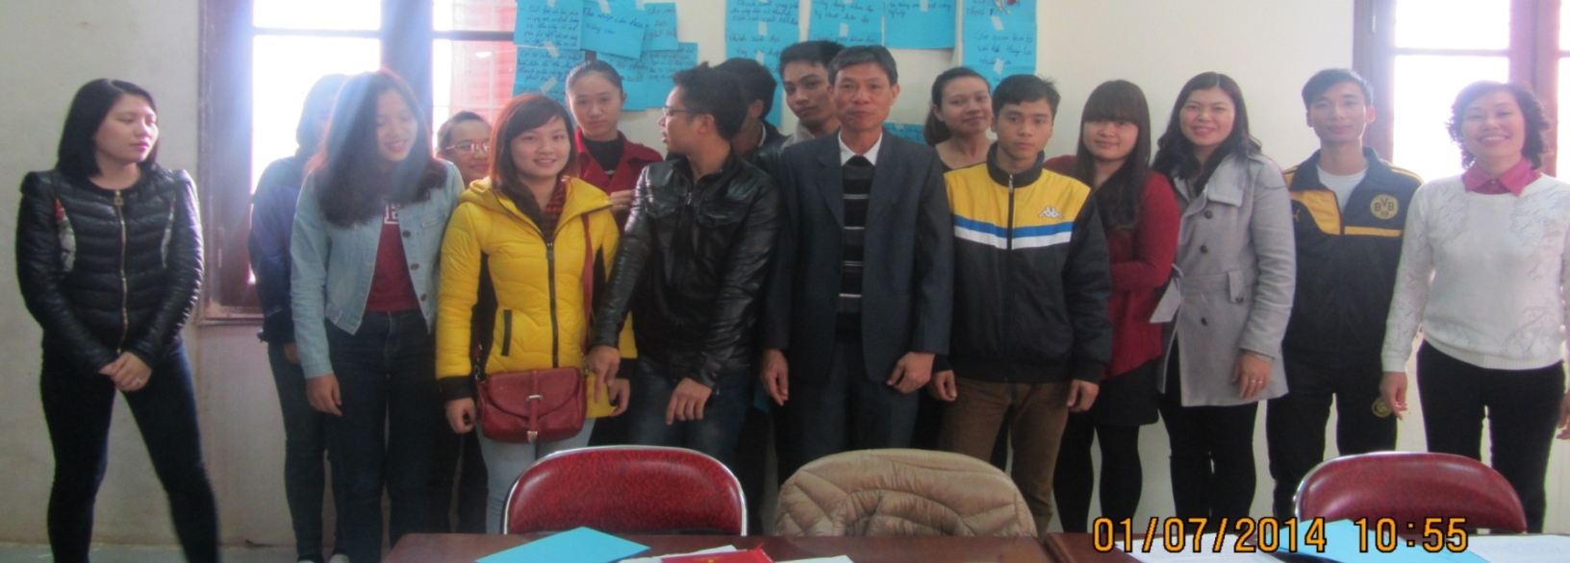
VIETNAM: Youth committee
A youth committee with representation in leadership structure
“green summer” program
Training and capacity building
Encourage young farmers to stay in their land instead of moving to cities to look for jobs
Provide avenues for self -reflection
Notes:
Vietnam Farmer’s Union has a youth committee that is represented in leadership structure
Government program : “green summer” where young people are invited to go to rural areas to help poor farmers through labor and other activities
Training on: knowledge and appreciation of agri; new agri technologies, environment and food security issues
Encourage young farmers to stay in their land instead of moving to cities to look for jobs
Provide avenues for self -reflection

Slide 33
Vietnam: Build respectable picture of farmers
Raise more awareness in recognizing role of farmers and agriculture
Develop models on production and business for rural youth
Develop clubs on youth extension, clubs on young creativeness, etc
Organize exchange visits for rural youth
1- Vocational training for young farmers – rural workers
2- Transfer technology for young farmers / coops to improve incomes
3- Help YF access loans for agri-business
Notes:
Our Vietnam member proposes policies to build a respectable picture of farmers by :
Raise more awareness in recognizing the role of farmers and agriculture
Develop and expand the models on production and business for rural youth
Develop clubs on youth extension, clubs on young creativeness, demonstration models on production
Organize exchange visits for rural youth to learn from good young farmers, participate in trade fairs, exhibition, competition on farming techniques for rural youth

Slide 34
INDONESIA: Rifai – Local seeds development
Rifai has been sharing knowledge among young and elder farmers through “musyawarah” or popular discussion (this is part of family farming). He has also been gaining customers by selling his locally-developed seeds which is of same quality as but 70% cheaper than private company seeds.
Notes:
Muhammad Rifai (31 yrs) is a young farmer entrepreneur developing quality corn seeds since 2009, working with Indonesia Peasant Alliance (Aliansi Petani Indonesia or API) . He developed quality local seeds from cross breeding in his hometown Brasilian, Mexican and Indonesian corn, seeds which were exchanged to him during an international conference he attended.
Rifai has been sharing this knowledge among young and elder farmers through “musyawarah” or popular discussion. He has also been gaining customers by selling his locally-developed seeds which is of same quality but is 70% cheaper than private company seeds.

Slide 35
PHILS - Policy on Magna Carta of Young Farmers
promote and protect rights of young farmers aged 15-40 years
Establish programs for young farmers
Institutionalize young farmers’ representation in all agricultural policy-making bodies
Define discrimination against young farmers
> Dialogue with Govt at IYFF –Philippines on Magna Carta, initial positive response
Notes:
Let me know share to you our findings with regards policy recommendations for attracting the youth in agriculture :
In Philippines we propose the enactment of a Magna Carta for Young Farmers which have the following provisions”
promote and protect rights of young farmers aged 15-40 years
Establish programs for young farmers, e.g, agriculture-sensitive educational curriculum students and broader scholarships for all agri-related courses
Institutionalize young farmers’ representation in all agricultural policy-making bodies and other bodies with reserved seats for youth
Define discrimination against young farmers as any age-based distinction that excludes or restricts young farmers in the recognition and promotion of their rights and their access to and enjoyment of opportunities, benefits or privileges

Slide 36
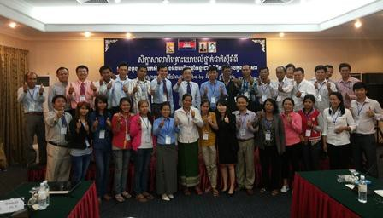
Cambodia: Youth Committee
Established Youth Committee , has 1 seat in Board
Notes:
Farmer and Nature Net (FNN) in Cambodia established youth committee within its organization. The committee has 1 seat in the Board. More than 100 young farmers already trained to be leaders and farmer entrepreneurs, and provide human resources that can help FNN in future

Slide 37
Cambodia’s priority
Need to emphasize the importance of agriculture
Organize savings associations among the youth

Slide 38
Thailand: Strategy to develop new generation of farmers
Seats in local and national governance structures
Training on leadership and agri activities (vegetable, livestock raising)
Networking among youth leaders
Facilitate links with government agencies for support

Slide 39
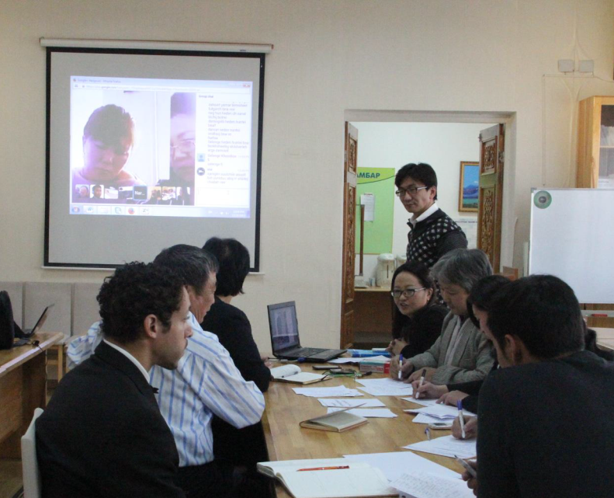
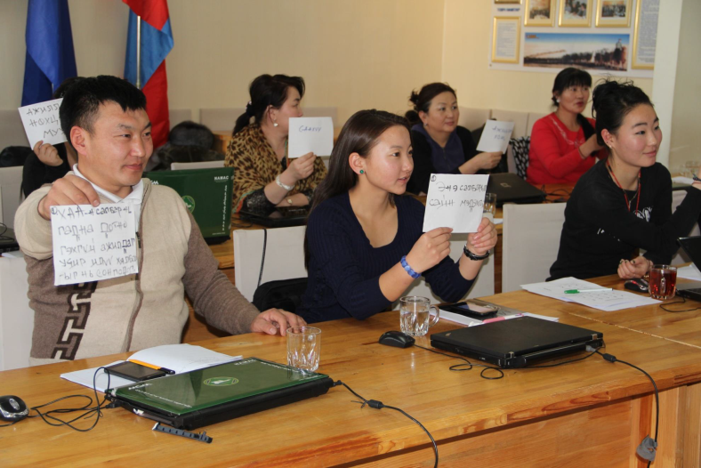
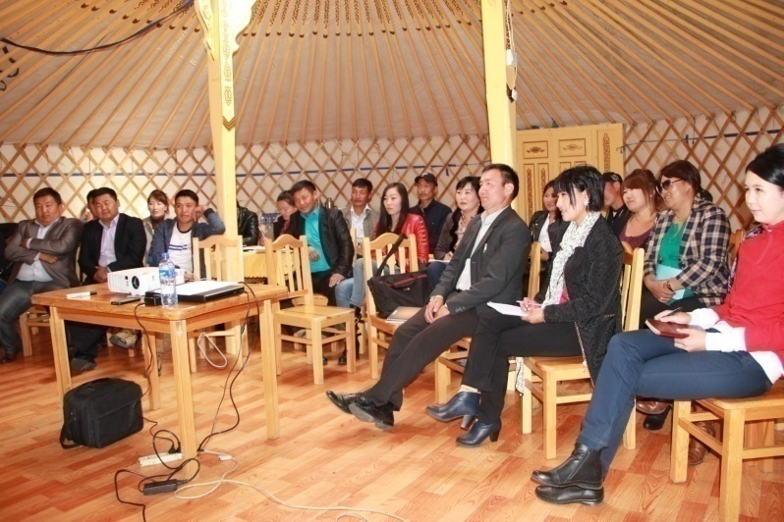
Mongolia: Govt support for youth
Support youth initiatives for development of rural areas and retard rural-urban migration
Elevate government focus and awareness on youth working and living conditions in agricultural sector
Boost the dignity and leadership of youth in agriculture

Slide 40
Mongolia Priority
Focus on herders
Special programs for herders
Engage Ministry of Agriculture, Parliament

Slide 41
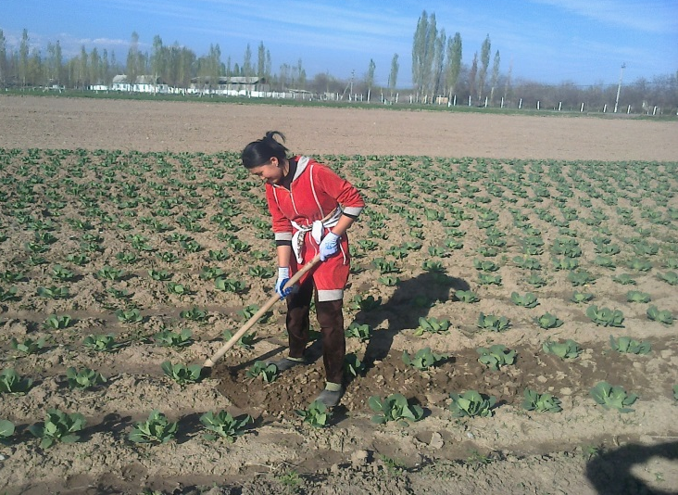
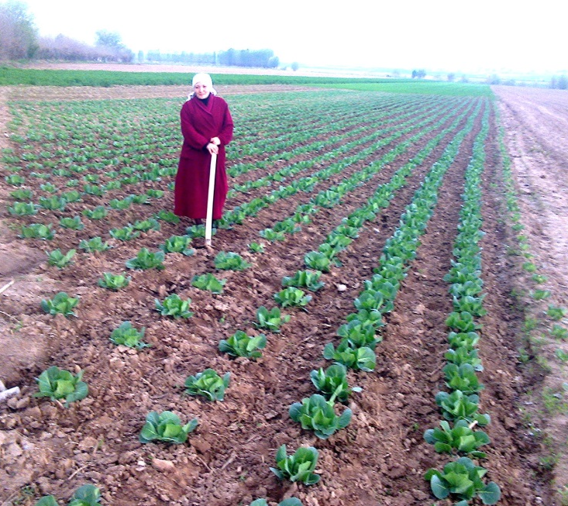
Kyrgystan: State support to young farmers
Develop and adopt state program for support to young farmers, rural women and rural development
Train young farmers on integrated water resources management

Slide 42
Nepal: priority
Increase investment in family farming
Research on situation of family farming in Nepal
Need to involve youth in ensuring farmers’ rights in new Constitution
Creating new network of youth for collective voice
More public awareness on importance of family farming

Slide 43
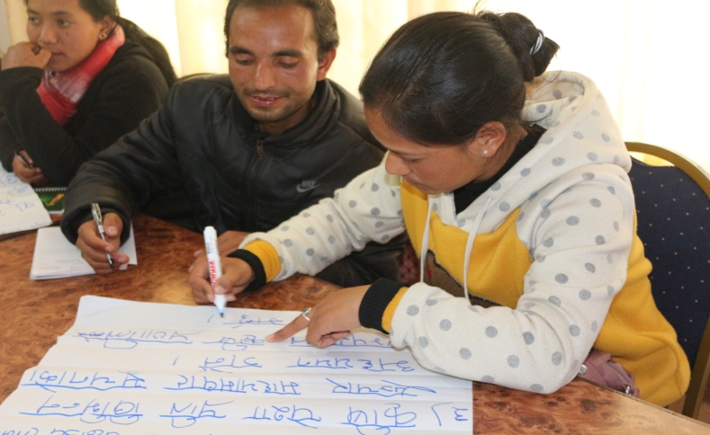
Bangladesh: Establish Agricultural Research Centres & Universities
Motivate, encourage, guide and train young people to harness their optimism about a career in agriculture
Establish agriculture as an active and secure profession
Notes:
Our member from Nepal has some recommendations for agri research centers and agri universities :
Motivate, encourage, guide and train young people to harness their optimism about a career in agriculture
Establish agriculture as an active and secure profession

Slide 44
Bangladesh priority
Govt should provide funds, implement programs to support family farms

Slide 45
JAPAN: Suggestion for the farmers and local government
Reflect the voice of young organic farmers to government
Diffuse organic products / safe food
Lectures, Cooking classes and other activities to campaign the lusciousness and safety of organic products. Training course for up-skilling
Organizing seminars to inquire better skills for organic and environment conservative farming. Improvement of cropping skills by organizing touring and interact with advanced farmers.
Farmers support
Support new farmers and change over to organic.
Support plans including ensuring the land / house and securing sales destination / training for the new farmers.

Slide 46
Japan priority
Development of new markets
Consumer education (go organic)
Community support for agriculture
Local food production for school meal /feeding program
Win-win: Farmers sell their products locally to govt-run schools
(“institutional food purchase”)

Slide 47
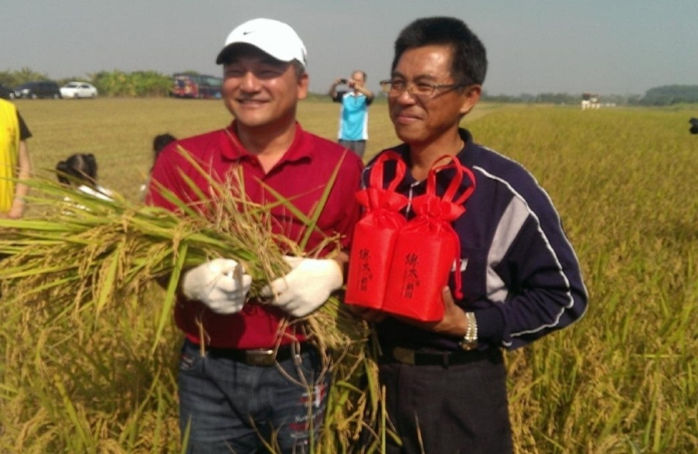
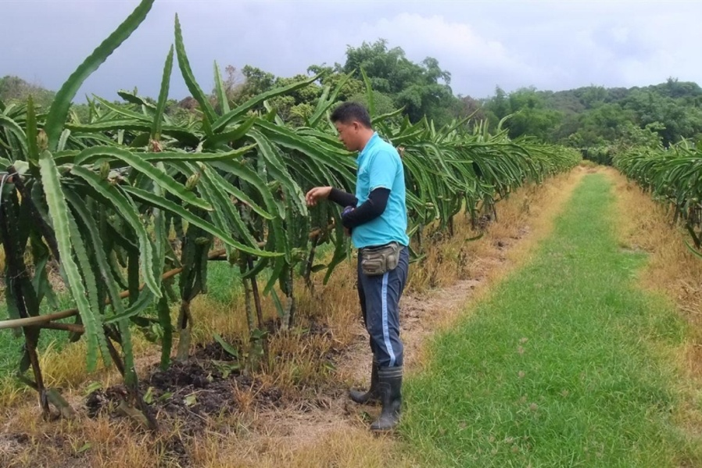
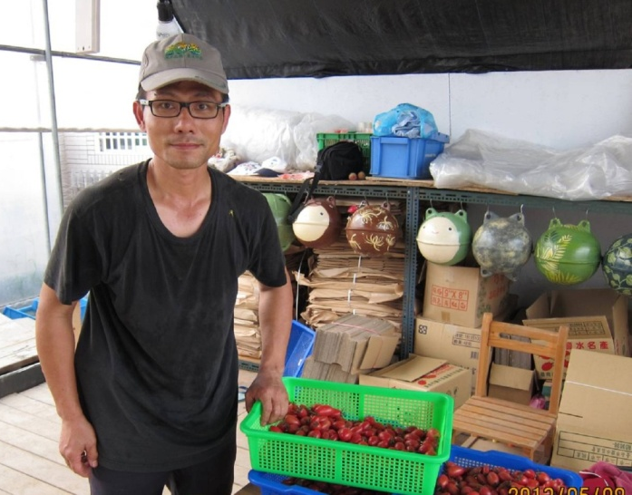
Taiwan: Support to new farmers
New Farmer Program - Govt support to young farmers under 45 yrs ensure that they have basic income, facilities or equipment support, and technical knowledge; some are now successful millionaire farmers
Notes:
There are 3 categories of young farmers in Taiwan. The first category is the second generation young farmers whose parents are doing farming, which they continue. The second category is young farmers without any experience. The third are those who are a little bit older, like professionals who want to go into agriculture.
For the first category, the key factors to attract them into agriculture are: (1) if parents are making profit; (2) if farming is promising; and, (3) if
farming is not too much work for their parents. For the third category, it is not so difficult, because they are more mature and know why they want to go into agriculture, and because they also have more financial support. It is the second category, those without experience, which finds it harder to go into agriculture.
The government supports them in different ways, either through the central government’s Council of Agriculture, or through the city government.
One project is the New Farmer Program from Tainan City government. The city government selects young farmers who decided to go into agriculture. Right now there are 268 young farmers in this program, all under 45 years
of age. The government extension unit provides technical and financial support to these young farmers.
Technical support is provided through
experts, apprenticeship (master and student), agriculture courses, and
counselling system. The agriculture experts and masters who teach
agriculture to young farmers are deployed through the district farmer
associations. Financial support comes in the form of government loans with
low interest to young farmers to buy facilities, supplies or equipment.

Slide 48
Taiwan

Slide 49
KOREA: Financial incentives to young farmers
Financial support
For the purpose of revitalizing young farmers, the government provides the loan with only 1% of interest rate, which is very low.
Developed
Countries
Lowering
Interest rate
Down to 1%
KAFF is negotiating with the central government
to decrease from current3% to 1%
Through adopting credential recognition system, more financial support to be possible on young farmers
Extra progressive financial support system
Notes:
In developed countries, for the purpose of revitalizing young farmers, the government provides the loan with only 1% of interest rate, which is very low. In Korea, KAFF members negotiating with the central government to decrease interest rate from current 3% to 1%. Through adopting credential recognition system, more financial support is made possible to young farmers and there is some hope for the youth to be attracted to agriculture.

Slide 50
Quick updates

Slide 51
Indonesia
API is pushing regulation of tobacco imports through price control, may have some results

Slide 52
Some Reflections / Recommendations

Slide 53
Vietnam: Lessons learned
Policy must respond to farmers’ needs/problems
Identify key decision-makers
Increase capacity of FOs in policy advocacy

Slide 54
Mongolia
If we are creative and work together, we can achieve something - “Light at the end of tunnel”

Slide 55
Priority recommendations from AFA GA Regional Consultations in Bali (May ‘14)
Capacity building: appropriate training and exposure through education to motivate young farmers
Research (e.g., incentives for young farmers)
Technical support on seeds, production techniques
Policy advocacy especially focused on youth
Regional Exchange program
Organization development: to give voice to young farmers, strengthen cooperation groups
Notes:
Capacity building: appropriate training and exposure through education to motivate young farmers
Organization development: to give voice to young farmers, strengthen cooperation groups / cooperatives, to organize support to advocacy work, to develop knowledge networks
Policy advocacy especially focused on youth
Partnership with various actors (government, business sector, banks, academe)

Slide 56
Reflections
The youth can be attracted to agriculture if they see (1) meaning ; (2) income opportunities as well as feel a sense of pride.
The youth needs training, as well as the presence of mentors, coaches, motivators
The youth needs to be provided with basic resources esp land, capital and equipments to make farming less tedious work and primarily be viable and sustainable
The youth needs their own spaces to find their voice and actualize themselves as young farmers

Slide 57
Let us listen to the youth when they say:
“HELP US PUT DIGNITY AND PRIDE
BACK INTO FARMING”

Slide 58
☺ thank you for your attention ☺

Slide 59
PHILS Young farmer: Maximizing every space in farm
One of Jon’s trainees is Ana (21 yrs). “I love farming and I dreamed to have my own farm and manage my own farm business. After IDOFS training, I started vermi composting, build a fishpond, made a vegetable garden, and raised free range chicken in a 2,500 sqm farm. I am now training other young farmers in our neighborhood on IDOFS. Our family motto is: Maximize every space in the farm“

