Slide 1
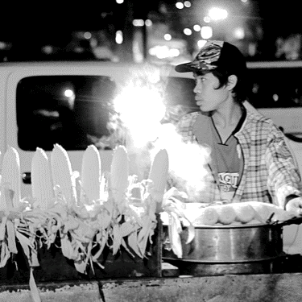
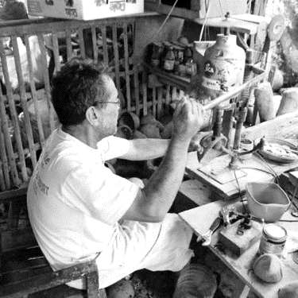
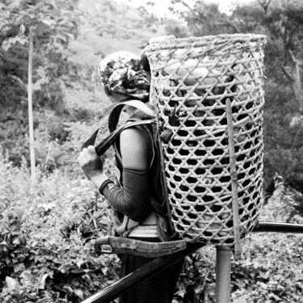
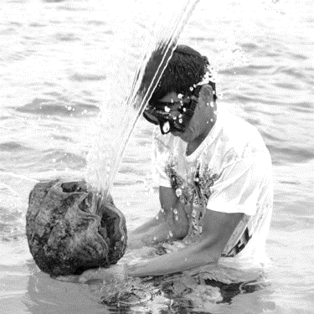
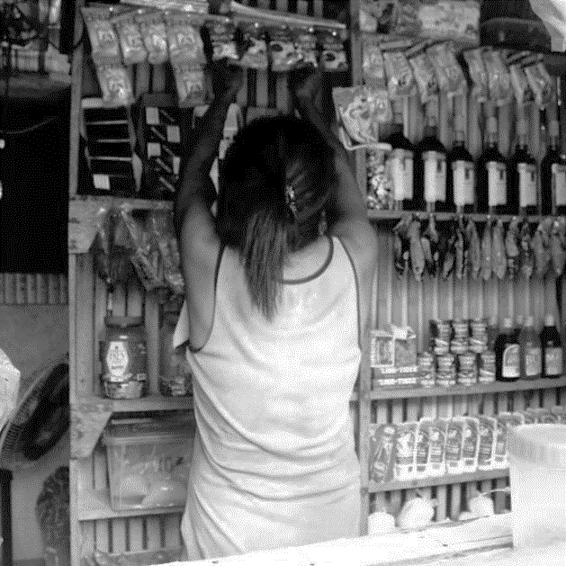
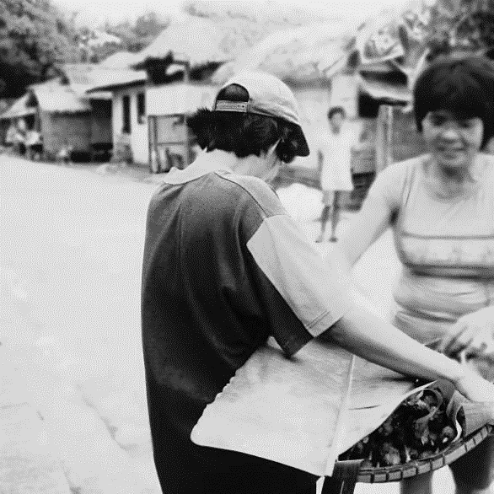
SLP
SUSTAINABLE LIVELIHOOD PROGRAM
24 March 2015

Slide 2

Overview of the program

Slide 3
SUSTAINABLE
LIVELIHOOD
A program that aims to improve the socio-economic capacity of the participants through micro-enterprise development and employment facilitation activities that shall ultimately provide a sustainable income source
ELIGIBLE RECIPIENTS
NHTS-PR household, Pantawid Pamilya family, or vulnerable individual/family (PWDs, senior citizens, disaster affected, etc.)
Notes:
The SLP is a program that aims to improve the socio-economic capacity of the participants through micro-enterprise development and employment facilitation activities that shall ultimately provide a sustainable income source.
Eligible recipients under the programs include NHTS-PR household, Pantawid Pamilya family, or vulnerable individual/family (PWDs, senior citizens, disaster affected, etc).

Slide 4
MICRO-ENTERPRISE DEVELOPMENT (ME)
Skills Training for Microenterprises
Cash for Building Livelihood Assets
Self-Employment Assistance - Kaunlaran
Commodity Cluster Model
EMPLOYMENT FACILITATION (EF)
Skills Training for Employment
Pre-Employment Assistance Fund
Notes:
SLP is implemented through a two-track program.
The first track, the Microenterprise Development Track, supports micro-enterprises in becoming organizationally and economically viable. Meanwhile, the second track, the Employment Facilitation Track, assists participants to access appropriate employment opportunities.
Under the microenterprise development track, the different program modalities include the following:
Self-Employmeny Assistance – Kaunlaran (SEA-K) Capital Seed Fund: Provide start-up capital for individual or group enterprises to be rolled-back to the Field Office Revolving and Settlement Fund (RSF) within a period of 2 years
Skills Training: Acquisition of technical skills, knowledge and other inputs necessary in managing livelihoods and accessing jobs
Cash for building livelihood assets (CBLA): Short-term employment of program participants for the development, rebuilding or protection of physical and natural assets to increase productivity for profitable, sustainable livelihood projects
Commodity Cluster Model: Organizing program participants of SLP who will be engaged in food production; Clustering is based on the common product which will be consolidated and sold
Under the employment facilitation track, the following are the different forms of interventions:
Skills Training (similar to the first track)
Pre-employment Assistance Fund (PEAF): Grant to assist SLP participants who have potential or guaranteed employers that need financial assistance to obtain the necessary pre-requisite requirements for the job. This seeks to ensure prompt submission of requirements to access jobs

Slide 5
Program modalities

Slide 6
Cash for Building
Livelihood Assets
(CBLA)
Short-term employment of program participants for the development, rebuilding or protection of physical and natural assets to increase productivity for profitable, sustainable livelihood projects
Notes:
Cost Parameter: 75% of the regional minimum wage; standard period is 11 days, but may be extended up to three months as required by the scope of work
Mode of Disbursement: Cash assistance payroll to participants; Fund transfer to Provincial, City or Municipal LGUs
Addresses the need to develop natural assets to enhance agri-based livelihoods where physical assets linking to these resources are not well developed and ready market opportunities for the produce and community support to sustain the investment is assured
Implementation Strategies:
through public-private partnership involving National Government Agencies and private sectors
Through the support and initiative of Local Government Units (provincial down to barangay level)

Slide 7
TECHNICAL-VOCATIONAL SKILLS TRAINING FOR ENTERPRISE
& EMPLOYMENT
Grant to be utilized for the acquisition of technical skills, knowledge and other inputs necessary in managing livelihoods and accessing jobs
Notes:
Cost Parameter: Maximum of P20,000 per person, per training, except in cases of pilot training projects where the full training costs may be covered
Mode of disbursement: Direct implementation by FOs/ LGUs; Cash assistance payroll to participants; Partnership with training centers; Procurement of service providers
Costs that may be covered by the Skills Training Grant:
Tuition or Registration Fee (for a training institution); Honorarium or Professional Fees (for an individual expert or resource person)
Training materials and supplies
Starter kits
Food, board and lodging
Transportation allowance
Assessment fee (for TESDA)

Slide 8
SELF-EMPLOYMENT ASSISTANCE KAUNLARAN (SEA-K) CAPITAL SEED FUND
Provide start-up capital for individual or group enterprises to be rolled-back to the Field Office Revolving and Settlement Fund (RSF) within a period of 2 years; Organization of community based credit and savings facilities
Notes:
Cost Parameter: Maximum of P10,000.00 per participant
Mode of Disbursement: Checks are issued to individuals or SEA-K Associations (SKAs) with a minimum number of 5 members per SKA
SEA-K Requirements for Fund Release
Mother Project Proposal
Copy of DSWD Convergence/Unified MOA with LGU and/or SLP MOA with LGU
Certificate of Eligibility
Profile of Beneficiaries
Amortization Schedule
Photocopy of Passbook
Association’s Picture
Constitution and By-Laws of the SEA-K Association

Slide 9
PRE-EMPLOYMENT ASSISTANCE FUND
(PEAF)
Grant to assist SLP participants who have potential or guaranteed employers that need financial assistance to obtain necessary pre-requisite requirements for the job.

Slide 10
LINKAGES with government programs

Slide 11

Department of Trade and Industry
In various provinces, DTI assists SLP participants in product development, for better access and linkage to market opportunities.

Slide 12

Department of Agriculture
National Program for Fisherfolk Registration
  Households will be enlisted to ensure implementation of relevant programs to assist LGUs in the development, administration, management, protection and care for fisheries resources.
Containment of Knifefish Infestation in Laguna de Bay Project (Knifefish Project)
  Seeks to diminish the infestation of knifefish, an invasive species of fish in Laguna de Bay, while converting the same to sources of livelihood for the people.

Slide 13

DEPARTMENT OF AGRARIAN REFORM & Department of Agriculture
Partnership Against Hunger and Poverty (PAHP)
  Agrarian reform beneficiaries and Pantawid Pamilya beneficiaries are capacitated to supply the food needs of Day Care Centers under the Supplementary Feeding Program
Serves as a major partner in the pilot areas in regions Region V, VIII, and IX.

Slide 14

SUPPLEMENTARY FEEDING PROGRAM

Slide 15
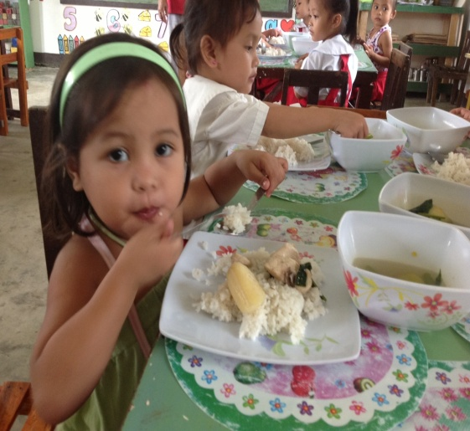
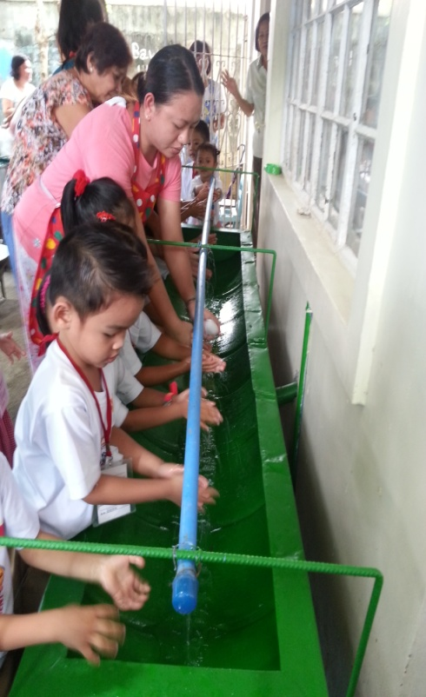
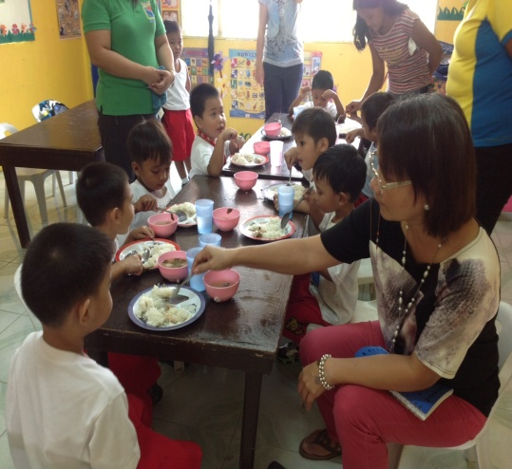

Slide 16

DESCRIPTION
The Supplementary Feeding Program is the provision of food in addition to the regular meals, to children ages 2-5 years old in the day care center/under Supervised Neighborhood Play (SNP).
Notes:
II. DESCRIPTION:
The Supplementary Feeding Service is the provision of food in addition to the regular meals, to children ages 2-5 years old in the day care center/under Supervised Neighborhood Play or children enrolled in Madrasah ages 5 to 12 years old.

Slide 17
DESCRIPTION
The food supplementation will be in a form of hot meals to be served during snack/meal time to children five (5) days a week for 120 days.
Menu equivalent to 1/3 of the Daily Recommended Energy and Nutrient Intake (RENI)
Notes:
II. DESCRIPTION:
The food supplementation will be in a form of hot meals to be served during snack/meal time to children five (5) days a week for 120 days. The feeding will be managed by parents of the beneficiaries based on a prepared meal cycle using available indigenous food supplies. Children beneficiaries will be weighed at the start of the feeding and 3 months thereafter and

Slide 18
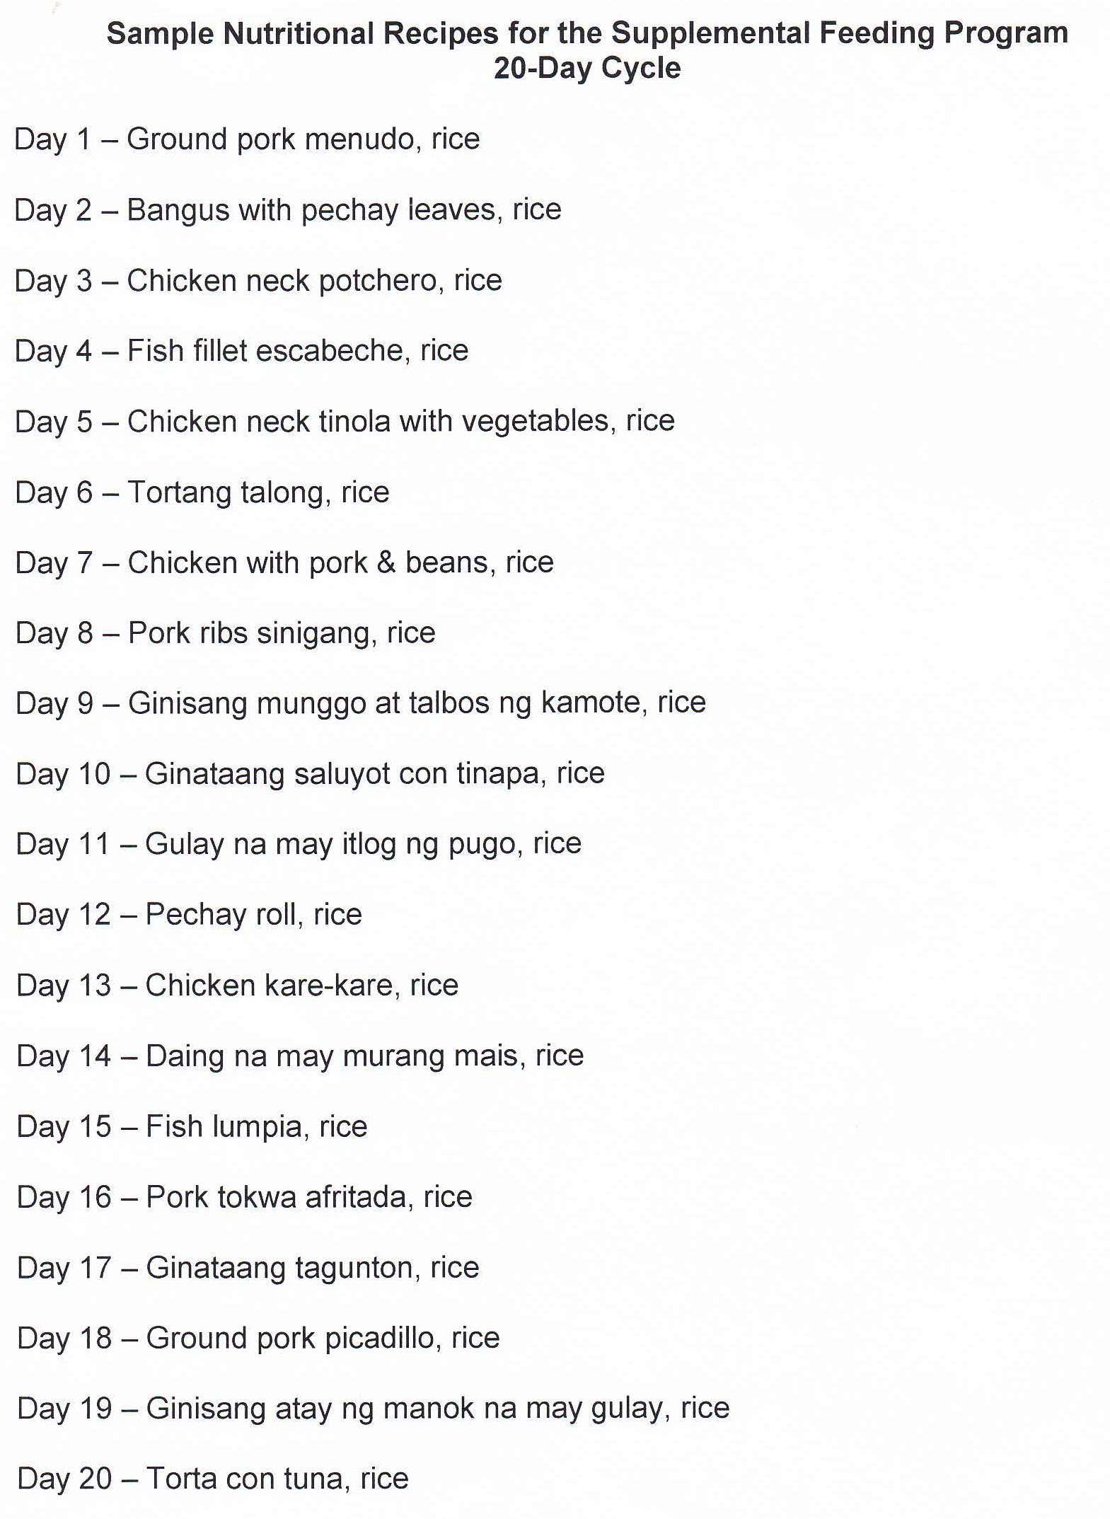
Notes:
II. DESCRIPTION:
The food supplementation will be in a form of hot meals to be served during snack/meal time to children five (5) days a week for 120 days. The feeding will be managed by parents of the beneficiaries based on a prepared meal cycle using available indigenous food supplies. Children beneficiaries will be weighed at the start of the feeding and 3 months thereafter and

Slide 19

OBJECTIVES
To provide supplementary feeding to children ages 2-5 years old in the day care center/supervised neighborhood play.
Notes:
OBJECTIVES:
To provide supplementary feeding to children ages 2-5 years old in the day care center/supervised neighbourhood play or children enrolled in Madrasah in identified communities endorsed by the Moro Islamic Liberation Front (MILF) to the Department of Social Welfare and Development (DSWD) through the Task Force Bangsamoro Development (TFBD).

Slide 20
OBJECTIVES
2.To improve knowledge, attitude and practices of children, parents and caregivers through intensified nutrition and health education.
Notes:
OBJECTIVES:
To improve knowledge, attitude and practices of children, parents and caregivers through intensified nutrition and health education.

Slide 21
OBJECTIVES
3. To improve and sustain the nutritional status of the target children beneficiaries.
Notes:
OBJECTIVES:
To improve and sustain the nutritional status of the target children beneficiaries.

Slide 22
IMPLEMENTING PROCEDURES
1. Target Beneficiaries
2-4 year old children in Supervised Neighborhood Play (SNP) areas;
3-4 year old children enrolled in day care centers;
5-year old children not enrolled in the DepEd preschool children but enrolled in DCCs; and
Notes:
IMPLEMENTING PROCEDURES
Target Beneficiaries
2-4 year old children in SNP;
3-4 year old children enrolled in day care centers; and
5-year old children not enrolled in the DepEd preschool children but enrolled in DCCs
5-12 years old children enrolled in Madrasah

Slide 23
IMPLEMENTING PROCEDURES
  Organize the community
    Conduct of barangay meetings (Local official orientation) .
    Parents shall be organized by the day care/SNP worker into working committees.
Notes:
Organize the community through the Project Management Team (PMT) as a prerequisite in the implementation of Supplementary Feeding Service.
The following activities shall be undertaken by the PMT prior to the implementation:
Conduct of Meetings to get the support of the people in the barangay.
A month prior to the actual feeding implementation, parents shall be organized by the day care/SNP worker/Madrasah mudarres/mudarresah and their support and commitment to the program shall be obtained. They shall be grouped into working committees to involve parents in various activities in the center. Regular meetings shall be held to discuss issues affecting the implementation.

Slide 24
IMPLEMENTING PROCEDURES
  Measuring of children (height and weight) under the supervision of a medical staff using the New WHO Child Growth Standards (CGS) or available weighing scale and height boards.
Notes:
Measuring of children under day care/supervised neighbourhood play shall be done by trained DCWs/SNP volunteer worker and Madrasah mudarres/mudarresah under the supervision of the medical staff using the New WHO Child Growth Standards (CGS) or available weighing scale and height boards. The result will determine the nutritional status before the start of feeding. The DCW/SNP worker/ Madrasah mudarres/mudarresah should establish a permanent growth monitoring record for each child that contains the name, age, birthday, and the baseline and monthly weight record of the child. The data obtained at this stage shall be maintained at the PMT databank.

Slide 25
Conduct of Feeding
The feeding shall be implemented for a minimum of 5 days and maximum of 7days, for a period of 120 days.
2. If there are two sessions, feeding shall be given to both and shall consist of daily hot meals.
Notes:
Conduct of Feeding
The feeding shall be implemented for a minimum of 5 days and maximum of 7days, for a period of 120 days. If the need arise, 7 days a week feeding can be done to catch-up with the implementation.
Feeding shall be provided to all the children beneficiaries for the duration as stated above. If there are two sessions, feeding shall be given to both and shall consist of:
Daily Hot Meals. The suggested cycle menu as recommended by FNRI Nutritional Guidelines for Filipinos and/or the menu prepared by the Nutritionist-Dietitian which shall be equivalent to 1/3 of the Daily Recommended Energy and Nutrient Intake (RENI) shall be used in the preparation of hot meals. The parents group and/or Day Care/SNP worker/Madrasah mudarres/mudarresah may enhance the cycle menu depending on available nutritionally adequate food items in the community.

Slide 26
Conduct of Feeding
3. The Parent Committee on Food Preparation shall provide voluntary labor for the cooking/preparation of food and management of feeding sessions.
Notes:
The Parent Committee on Food Preparation shall provide voluntary labor for the cooking/preparation of food and management of feeding sessions. The DCW/SNP Volunteer Worker/ Madrasah mudarres/mudarresah and the President of the DCSG/SNP/Madrasah parents group shall prepare a monthly schedule of cooks.
Aside from feeding, children should be taught proper hygiene such as washing the hands before and after eating, table manners, and simple concepts on health care and nutrition and importance of nutrition for their health and development, among others.

Slide 27
Conduct of Parent Effectiveness Sessions
Has nine sessions - self, family, parent effectiveness, health and nutrition, etc. to improve/enhance their knowledge, attitude, skills and practices on parenting.
Notes:
. Conduct of Parent Effectiveness Sessions
The parents shall be encouraged to complete all the nine sessions on self, family, parent effectiveness, health and nutrition, etc. to improve/enhance their knowledge, attitude, skills and practices on parenting.
The sessions facilitated by a trained staff shall be held at least twice a month, depending on the available time of parents. It shall be conducted following the order of importance established/agreed upon by the parents. Resource persons may be invited to discuss specific topics.
In the conduct of sessions, the methodologies should be evocative and should involve the maximum participation of the parents

Slide 28
Fund Allocation
  Php13.00 per child per day for 120 days hot meal feeding:
      P10.00 for the viand per child per day
      P3.00 for the rice per child per day.
  Php P75 per child for the eating utensils while P1,000 per day care center/SNP for cooking utensils.
Notes:
Fund Allocation
The amount of thirteen pesos (Php13.00) per child per day for 120 days hot meal feeding shall be allocated. Of this amount, P10.00 shall be used for the viand per child per day and the P3.00 will be used for the rice per child per day. An average of 10 children shall be covered in a kilo of rice.
The amount of P75 per child should be allocated for the eating utensils while P1,000 per day care center/SNP/Madrasah should be allocated for the cooking utensils.
The eating utensils shall be composed of:
spoon
fork
bowl
plate
drinking glass/ tumbler
The cooking utensils shall be composed of:
carajay/ frying pan
cauldron/ pot
ladle
Savings from the SFP funds could be utilized in the extension of feeding days prioritizing the underweight/malnourished beneficiaries.

Slide 29
Procurement of Goods
The rice shall be procured by the FO, LGU or Day Care Center Services Parent Group (DCSPG) / Supervised Neighborhood Play Parent Group (SNP PG)
Viand should be procured by the FO, LGU or DCSPG/SNP PG.
The eating and cooking utensils should also be procured by the FO.
Notes:
Procurement of Goods
The rice shall be procured by the DCSPG/SNP PG/MPG;
Viand should be procured by the DCSPG/SNP PG /MPG;
The eating and cooking utensils should also be procured by the DCCs/SNP/Madrasah;

Slide 30
Procurement of Goods
All purchases/procurements shall be supported by
  official receipts,
  RER/acknowledgement receipts/statement of market purchases,
  invoices,
  billings.
Notes:
Procurement of Goods
All purchases/procurements shall be supported by official receipts, RER/acknowledgement receipts/statement of market purchases, invoices, billings and other supporting documents required under the existing budgeting, accounting and auditing rules and regulations.

Slide 31
Liquidation
  The DCSPG/SNP PG shall liquidate the funds transferred in accordance with accounting rules and regulations.
Notes:
Liquidation
The DCSPG/SNP PG/MPG shall take responsibility in the proper disposition/disbursement of funds for the implementation of the program in accordance with the existing budgeting, accounting and auditing rules and regulations and shall liquidate the funds transferred in accordance with accounting rules and regulations.
The FO should encourage monthly liquidation by the DCSPG/SNP PG/MPG at least 70% of the amount spent for the month, and require submission of full liquidation of funds released to them 30 days after the completion of the program for transparency and accountability

Slide 32
Liquidation
  The FO should encourage monthly liquidation by the DCSPG/SNP PG at least 70% of the amount spent for the month, and require submission of full liquidation of funds released to them 30 days after the completion of the program for transparency and accountability.
Notes:
Liquidation
The FO should encourage monthly liquidation by the DCSPG/SNP PG/MPG at least 70% of the amount spent for the month, and require submission of full liquidation of funds released to them 30 days after the completion of the program for transparency and accountability

Slide 33
Day Care Service Parents Group/Supervised Neighborhood Play Parents Group (DCSPG/SNP PG)
Organize into committees for marketing, inspection of goods, financial management, and preparation of food.
Manage and implement the daily feeding of the day care children according to the guidelines and protocol of the program.
Notes:
6. Day Care Service Parents Group/Supervised Neighborhood Play Parents Group (DCSPG/SNP PG) Madrasah Parents Group (MPG)
Organize into committees for marketing, inspection of goods, financial management, and preparation of food
Manage and implement the daily feeding of the day care children according to the guidelines and protocol of the program.
.

Slide 34
Day Care Service Parents Group/Supervised Neighborhood Play Parents Group (DCSPG/SNP PG)
Apply for a petty cash advance.
In case of fund transfer to the DCSPG/SNP PG open a bank.
Immediately purchase food items in accordance to list upon receipt of funds;.
Maintain simple bookkeeping and accounting for the inspection and SF reports .
Liquidate all funds transferred.
Notes:
Immediately purchase food items in accordance to list upon receipt of funds;
Maintain simple bookkeeping and accounting for the inspection and SF reports
Liquidate all funds transferred by DSWD Field Office in accordance with accounting and auditing rules and regulations.
Immediately purchase food items in accordance to list upon receipt of funds;
Maintain simple bookkeeping and accounting for the inspection and SF reports
Liquidate all funds transferred by DSWD Field Office in accordance with accounting and auditing rules and regulations.

Slide 35
Day Care Service Parents Group/Supervised Neighborhood Play Parents Group (DCSPG/SNP PG)
List the food requirements based on the menu prepared by the nutritionist.
Generate counterpart from fellow parents to augment the resources
Attend the PES sessions.
Notes:
List the food requirements based on the menu prepared by the nutritionist.
Generate counterpart from fellow parents to augment the resources
Attend the PES sessions.

Slide 36
Challenges
Delay in Procurement
Quantity, Quality, Regularity of supply of food products/Ingredients
Indigenous foods and/or locally produced foods
Food menu equivalent to 1/3 of Recommended Energy and Nutrient lntake (RENI)
Notes:
List the food requirements based on the menu prepared by the nutritionist.
Generate counterpart from fellow parents to augment the resources
Attend the PES sessions.

Slide 37


