Slide 1
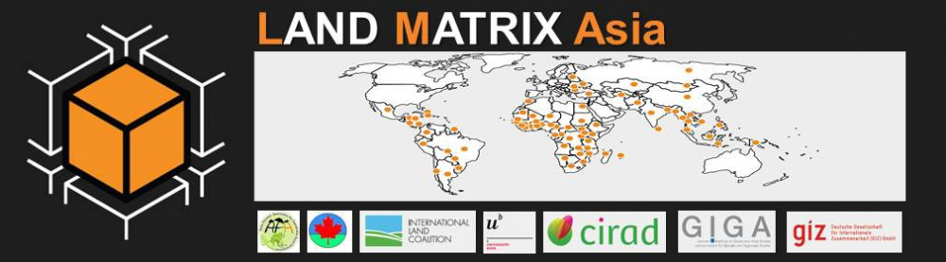
The Land Matrix Initiative in Asia
Jun Virola
Land Matrix Asia Focal Point
Asian Farmers’ Association for Sustainable Rural Development (AFA)

Slide 2
Outline
Introduction to the Asia Focal Point
Some trends in large scale land acquisitions in Asia
A few examples of land deals (Cambodia)

Slide 3

The Asia Focal Point
Structure includes:
  Regional data unit composed of data coordinator and data assistant
  Country coordinators being established in 12 Asian countries where AFA has members and partners
  Network of data contributors being established in 40 Asian countries assigned
Asian Farmers’ Association (AFA): a regional association of 17 farmer organizations in 13 countries in Asia
Areas of work include: data gathering, networking, research and communication

Slide 4
Updates
Data gathering
Review/update/improvement of data on existing land deals
Entry of data on new land deals
Networking
Introduction of Land Matrix to AFA members (General Assembly, May 2014; Executive Committee Meeting, November 2014)
Introduction of Land Matrix to ILC Asia members (Land Forum and General Assembly, October 2014)
Introduction of Land Matrix to MTCP2 farmer organizations (Regional Steering Committee Meeting and Sub-Regional Steering Committee Meetings; 2014-2015)
Introduction of Land Matrix to APAARI (Executive Committee Meeting, May 2015)

Slide 5
Research
Capacity building on data analysis being planned
Linking with research institutions and other groups who can use the LM data for research
Communication
Blog – www.landmatrixasia.wordpress.com
Facebook Page: www.facebook.com/landmatrixasia
Twitter Account: www.twitter.com/landmatrixasia (@landmatrixasia)
Brochure
Poster

Slide 6
How much land is being acquired?
(Negotiation Status)
 | Number of cases | Intended size (has) | Size under contract (has)
Concluded deals | 398 | 13,493,896 | 10,464,269.00
Intended deals | 46 | 5,479,179.00 | N/A
Failed deals | 15 | 2,385,172.00 | 1,138,745.00
No Information | 33 | 719,339 | 214,958
Total | 492
398 deals concluded
with 10.5 million hectares under contract
Data as of 2/14/15

Slide 7
81% of deals have been concluded
Indicating high success rate in negotiation

Slide 8
Intended size exceeds size under contract
Indicating possible expansion of contracted area in the future

Slide 9
How much of the land acquired is already being utilized?
(Implementation Status)
 | Number of concluded deals | Size under contract (has) | Current size under production (has)
Project not started | 52 | 899,379 | NA
Startup phase (no production) | 61 | 614,702 | NA
In operation (production) | 194 | 4,845,434 | 1,352,439
Project abandoned | 8 | 1,131,592 | NA
No information | 177 | 4,393,072 | NA
Total | 492
194 deals in operation
with 1.4 million hectares under production
Data as of 2/14/15

Slide 10
39% of deals are in operation
Can increase once more information is gathered

Slide 11
Only 22% of areas in operation are under actual production
Indicating slow phase of implementation

Slide 12
What kinds of land are being acquired?
(Former Use of Land)
 | Number | Percent
Commercial (large-scale) agriculture | 18 | 3.66
Smallholder agriculture | 69 | 14.02
Pastoralists | 2 | 0.41
Forestry | 10 | 2.03
Conservation | 12 | 2.44
No information | 381 | 77.44
Total | 492 | 100
5 categories of former uses of land
Data as of 2/14/15

Slide 13
Agricultural lands are being targeted
Can change once more information is gathered

Slide 14
What is the land being used for?
(Intention of investment)
Intention of investment | Number | Percent
Food crops | 108 | 21.95
Non-food-agricultural Commodities | 105 | 21.34
Agrofuels | 93 | 18.9
Agriculture unspecified | 89 | 18.09
For Wood and Fibre | 22 | 4.47
Other | 21 | 4.28
No information | 13 | 2.64
Industry | 12 | 2.44
Livestock | 11 | 2.24
Forestry unspecified | 10 | 2.03
Tourism | 7 | 1.42
Renewable Energy | 1 | 0.2
Total | 492 | 100
12 categories of intention of investment
Data as of 2/14/15

Slide 15
Food, non-food agri commodities, unspecified agriculture, agro-fuels are main drivers
Almost evenly distributed among 4 main intentions

Slide 16
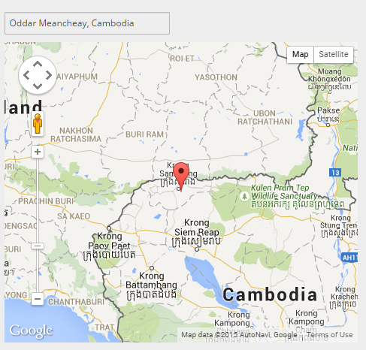
How do the deals look like?
(Some examples from Cambodia)
Some companies use sub-companies to lease lands more than the allowed 10,000 hectares (e.g. Mitr Phol Group)
Most lands were leased by the government (economic land concessions)
Communities forcedly evacuated

Slide 17
Mitr Phol Group (secondary investor)
 | Deal #17 | Deal #73 | Deal #95
Location: | Oddar Meancheay, Cambodia | Oddar Meancheay, Cambodia | Oddar Meancheay, Cambodia
Current size under contract | 6523 ha | 6595 ha | 6618 ha
Intention of the investment: | Agriculture, Biofuels, Food crops | Agriculture, Biofuels, Food crops | Agriculture, Biofuels, Food crops
Produce Info: | Sugar Cane | Sugar Cane | Sugar Cane
Investor (primary): | Angkor Sugar Co. Ltd. | Cane and Sugar Valley | Tonle Sugar Cane Co. Ltd.

Slide 18
A call to action
Help us improve the data in the region
  Validate or update existing deals
  Report a new deal not yet in the database
Use the data
  For research and analysis
  For policy dialogues
  For advocacy and campaigns
Tell us how it can be made more relevant and useful to you
  Data needed
  In what form
  How you can get involved

Slide 19
Thank you!

Slide 20
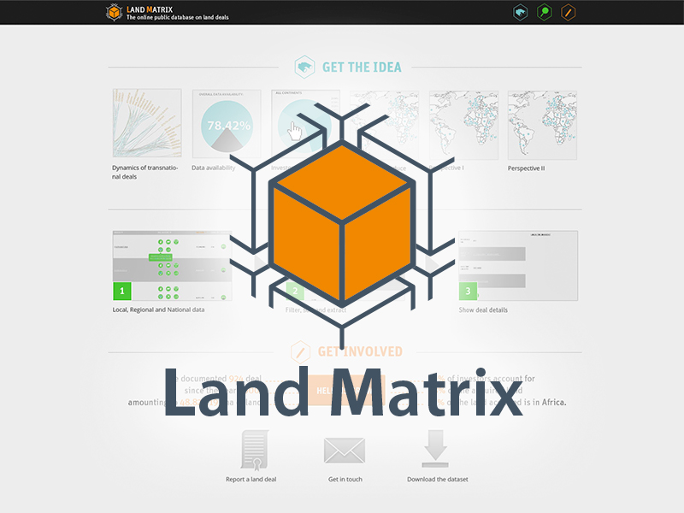
The Land Matrix Initiative in Central Asia
Bolormaa Tsooj
Environmental Development JASIL Association

Slide 21
Engagement and role
Oct.2014 became part of LM team
Provide land deal data’s for the LM database
Data collection, facilitate regional network
Establish networking with CA organizations
Broaden the LM in CA (Mongolia, Kazakhstan and Kyrgyzstan)
Main drivers on LSLA in CA is mining and agriculture deals
Data analysis on certain deal to show the land deal trend

Slide 22
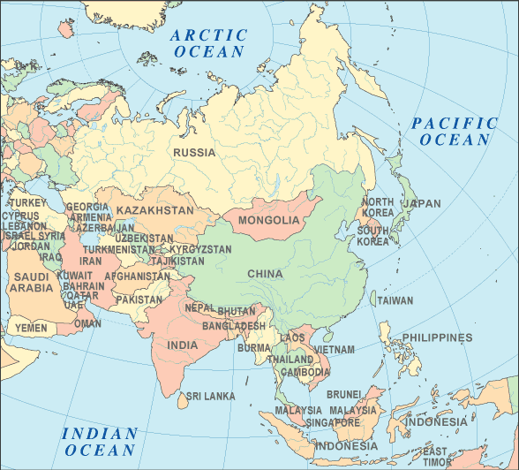
Progress on the LM database
Mongolia- uploaded 3 new and pending 2 new land deal transactions, updated the existing deal
Kyrgyzstan- reviewing and preparing the the 79 new land deal data to add on LM database
Kazakhstan- reviewing and validating the existing land transactions

