Slide 1
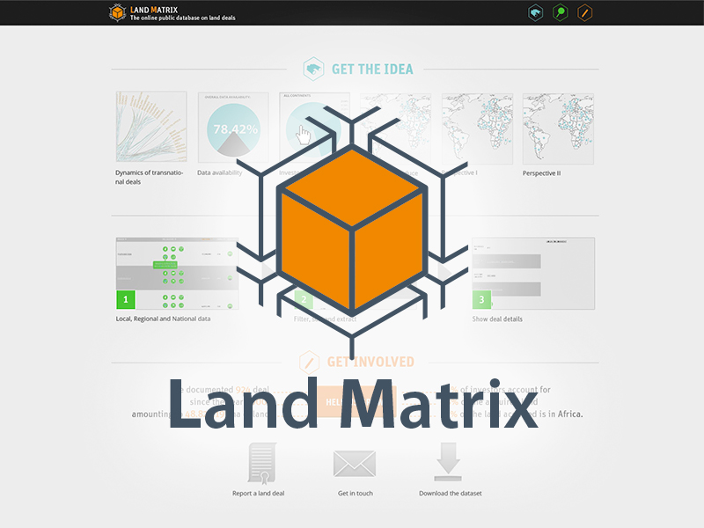
The Land Matrix Initiative
Key-features, limits and applicability of a comprehensive database
Kerstin Nolte and Martin Ostermeier
GIGA German Institute of Global and Area Studies

Slide 2










The Land Matrix Initiative
…is a global and independent land monitoring initiative
… has the aim to: Promote transparency and open data in decision-making over land and investment
… was set up to respond to the lack of data on large-scale land acquisitions
Ongoing process of decentralization
  five Regional Focal Points
  Project Support Unit (PSU) at University of Pretoria

Slide 3
Database characteristics of the Land Matrix Global Observatory
Records intended, concluded or failed land acquisitions (land acquired by purchase, lease or concession)
  In low and middle income countries
  For agricultural production, forestry, carbon trading, industry, renewable energy production, conservation and tourism
Land deals in the database …
  Entail a transfer of rights to use, control or ownership of land through sale, lease or concession
  Have been initiated since 2000
  Cover an area of 200 hectares or more
  Imply the potential conversion of land from smallholder production, local community use or important ecosystem service provision to commercial use

Slide 4
Database sources
Data collection methods of LM partners and Regional Focal Points
  Global and local networks
  Land Observatories
  Thematic Observatories
  Crowdsourcing
  Land Policy Initiative (Africa only)

Slide 5
Database sources
Data collection methods of LM partners and Regional Focal Points
Company sources (50.26%)
Media report (59.92%)
Govern-ment sources (25.18%)
Contract (5.56%)
Research / Policy Paper
(47.85%)
Personal informa-tion (14.38%)
Other (4.41%)
Crowd-sourcing (0.31%)

Slide 6
Database content (static)
Spatial data (location, coordinates, etc.)
Investor information (origin, type, etc.)
Nature of the deal (intention, contract type, etc.)
Pre-investment information (former land use, owner, etc.)
Employment
Community benefits
…

Slide 7
Database content (dynamic)
1. Negotiation status
Expression of interest
Under negotiation
Oral agreement
Contract signed
Negotiations failed
Contract cancelled
2. Implementation status
Project not started
Start-up phase (no production)
In operation (production)
Project abandoned
Intended
Intended size
Concluded
Size under contract
Failed
Intended size
Size under contract

Slide 8
Data overview: Negotiation status
International large-scale land acquisitions according to negotiation status
 | Number of cases | Intended size | Size under contract
 |  | (in million ha) | (in million ha)
Concluded deals | 1.041 | 64,2 | 38,2
Intended deals | 194 | 16,0 | n.a.
Failed deals | 84 | 7,6 | 1,9
No Information | 85
High area sizes under concluded deals
Aggregate global demand for land is very high indicating a large number of pending deals
Intentions/announcements still exceed actual contract size by far
Quite some failure at negotiation and concluded stage (contract cancelled)
Note: Data as of Feb 14, 2015

Slide 9
Data overview: Implementation status
International land acquisitions according implementation status
 | Number of concluded deals | Size under contract | Current size under production
 |  | in millon ha
Project not started | 72 | 3.1 | n.a.
Startup phase (no production) | 131 | 2.8 | n.a.
In operation (production) | 536 | 17.9 | 3.6
Project abandoned | 33 | 1.4 | n.a.
No information | 269 | 13.1 | n.a.
Total (deals or ha) | 1,041 | 38.2 | 3.6
An important and growing number of deals starts operating (contracted area: 17.9 million ha)
Continued trend of project implementation: Deals are moving towards the production phase, it is not (only) land speculation
Little but fast growing area comes actually under production
Note: Data as of Feb 14, 2015

Slide 10
Data challenges
Dynamic
Time-lag
Reliability
Contradicting information
Potential biases due to…
  Open data policies of some countries (e.g. Cambodia)
  Interest of media and researchers in certain regions (e.g. Africa), on certain investors (e.g. emerging investor countries) and in certain sectors (e.g. agrofuels)
  Extent of global / local networks

Slide 11
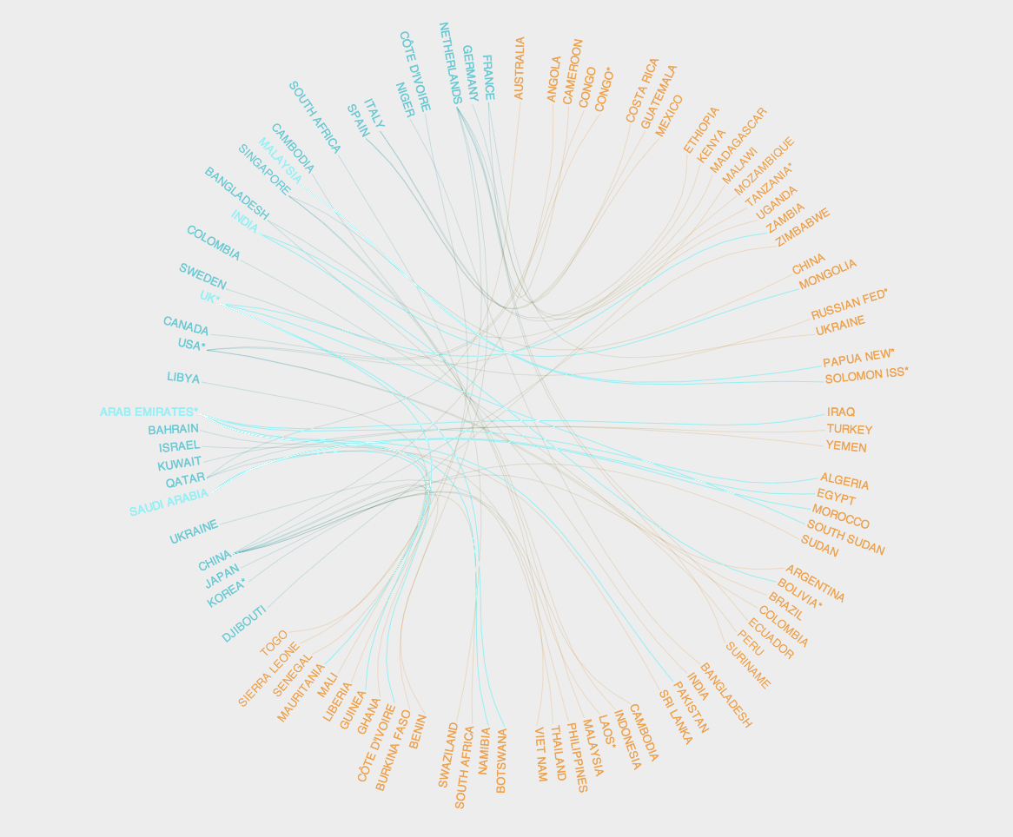
http://www.landmatrix.org
Kerstin Nolte / Martin Ostermeier
GIGA German Institute of Global and Area Studies
Neuer Jungfernstieg 21 / 20354 Hamburg (Germany)
Tel. +49-(0)40-42825-768
Email: Landmatrix@giga-hamburg.de
Skype: Martin-Ostermeier
Homepage: http://www.giga-hamburg.de

Slide 12
Discussion
How can you contribute?
What can we do better?
…

