Slide 1
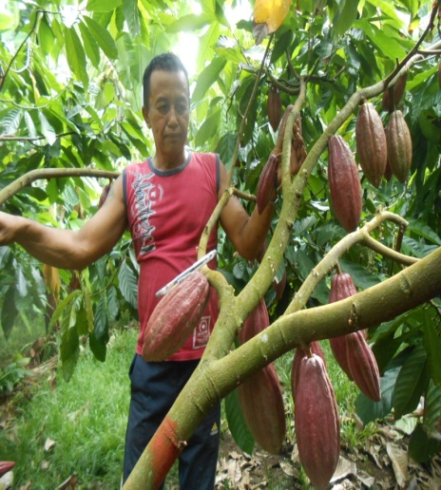
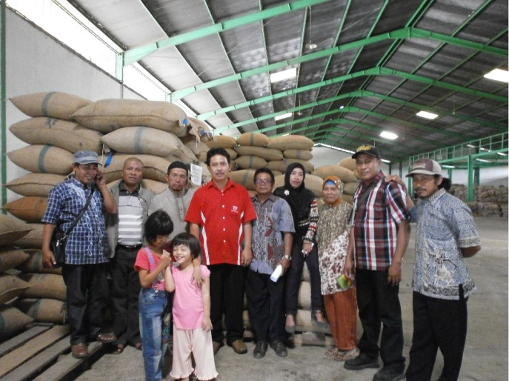

Farmer-led Social Enterprise Development Models In Rural Areas
The Experience of Indonesia Peasant Alliance
7 August 2015
Presented at Regional Knowledge Sharing and Learning Workshop
Manila, September 6-8 2015

Slide 2
API Service Model for Member in the Agri-Enterprise Development
Environment
Climate
Riskk
Goverment
Policy
Regulation
Additional Material Supplier
Retail
Outlet
Seed Providing
Post Harvest Handling
Fuel Supplier
Agricultural Machinery
Farmers
Trader /supplier
Processing Industry
Distributor
Consumer
Farmers Supplier
Equipment Supplier
Eksportir
Importir
Fertilizer and Pesticides
Packaging Suppler
Trading House
Goverment
Agri
Coop
Trade
BDS
API
Support Fund
Bank
Inve
stor
Insu
rance
R and D
Gov Agency
Private
University
Enterprise Dev Program
Donor
NGO’s

Slide 3
The API Services for Developing The Agri-Enterprise
The chalenges in Developing the Agri-enterprise to Small-scale farmers.
Small-scale farming and it is not organized
low productivity, quality and continuity
Low market access and long market chain and not organized
Low access credit to capital circulation because they have not colleteral
Dependence with midleman

Slide 4
The API Services for Developing the agri-enterprise
The objectives
make to the farming scale into a profitable agri-enterprise with organizing many farmers to joint into cooperative and collective marketing
Make to the productivity and quality of farmers’ production to be improved.
Make to the market access to be strengthened and organized market value chain
Make to the farmer-led cooperative or collective marketing can access credit and organizing the circulating capital from internal and external

Slide 5
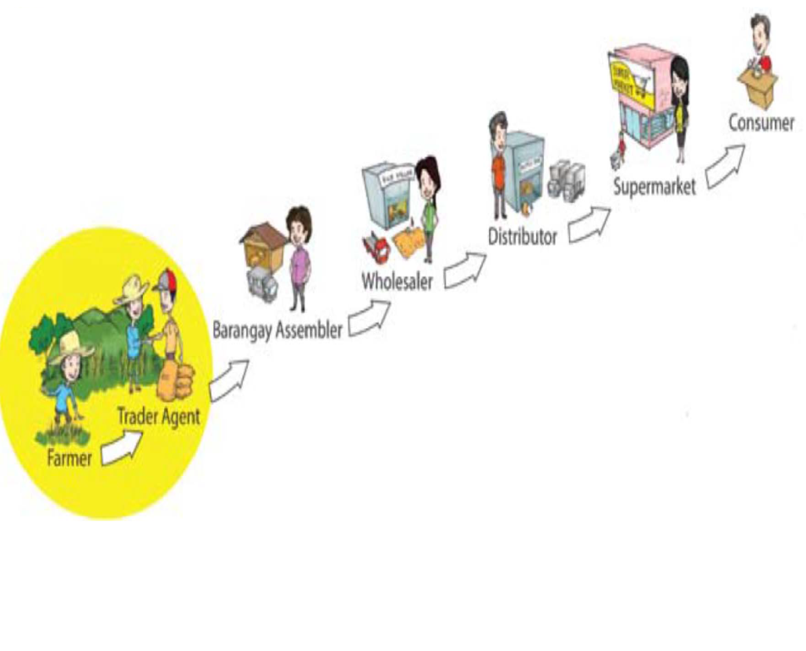
Forms of API service for members in agri-enterprise development
Provide the technical assistance in developing the farmer-led cooperative and colective marketing
--members consolidation
--provide the technical assistance for bussiness-model
--provide the technical assistanve for preparing the bussines plan and business feasibility.
--provide service for financial mangemen and accounting to farmer-led cooperative.
Provide service for farmer teacher (agricultural axtension) on plant cultivation, pest controling, post harvest processing, and quality control

Slide 6

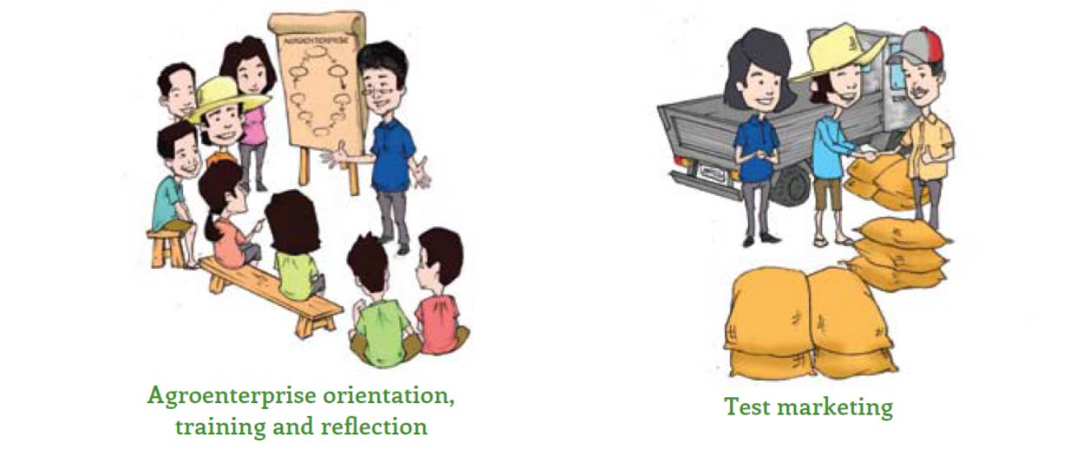
Provide service for members in market mapping and field visit to potential buyer, juxtapose the farmer-led Cooperative to potential buyer
Provide service to farmer led cooperative makes the capital planning, and strengthen to organize the capital from internal “invesment capital from members)
Advocacy to goverment regulation on farmer empowering and protection

Slide 7
Achievement of API Services for Developing the agri-enterprise
There are 8 farmer led cooperative who initiated by local farmer organization as members of API can provide service to farmers in marketing, production input, save and credit services
Quality and productifity can be enhanced
The services of farmer led cooperative can enhance to farmers income
Independence with midleman can be reduced

Slide 8
Enterprise Developmet and Managemet
Feasibility Study
Trisno Tani Cooperative
Bussines Planning
Sinar Kakao Cooperative
Proposal, Budgeting
Sumber Lestari Coperative Cocoa
Financial Management
Sridonoretno CV (Banana and Coffe Robusta)
Hanjuang Cooperative Forest Honey
Rice Organic
Amanah Cooperative Cocoa

Slide 9
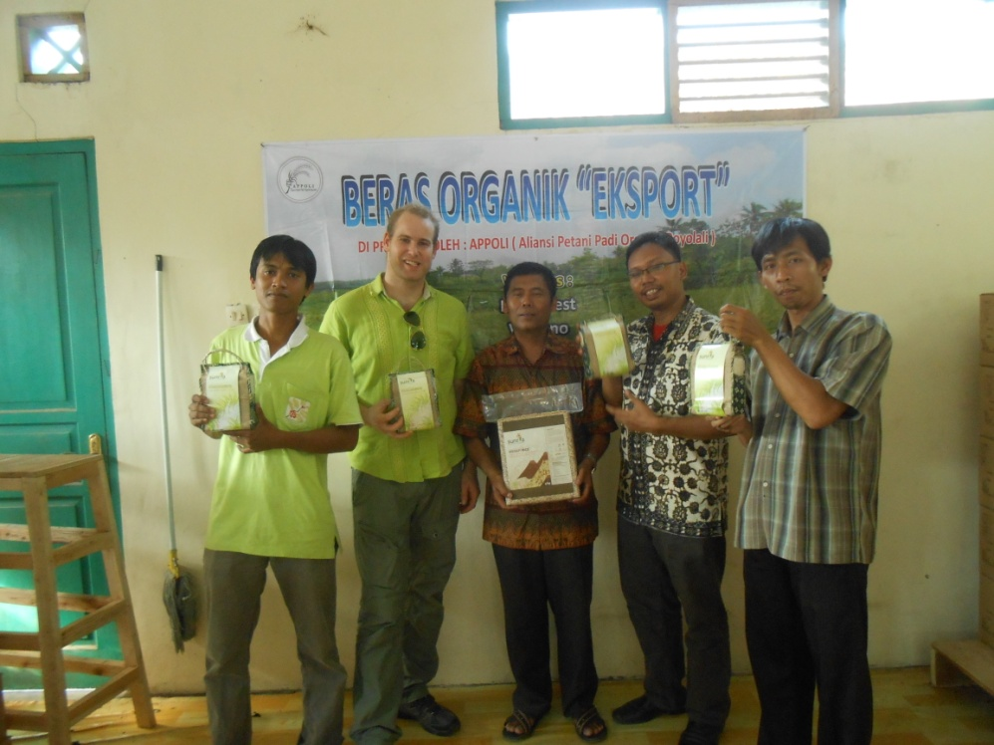
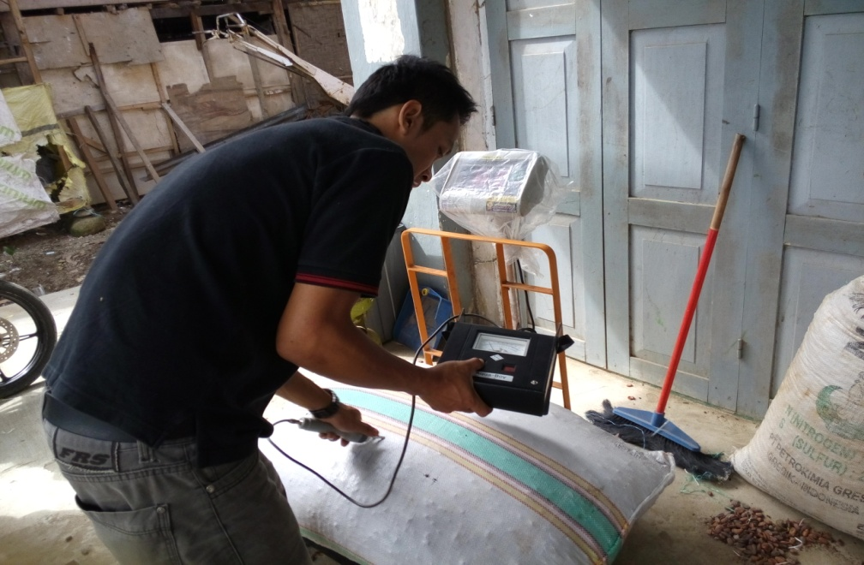

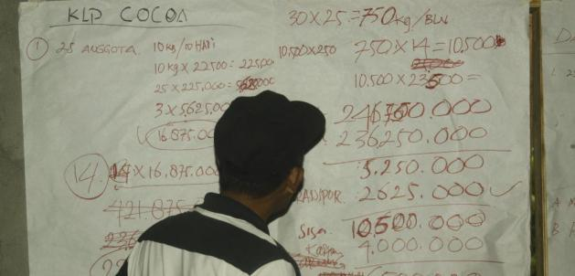
Organic Rice, production of Tresno Tani Cooperative/APPOLI
The Quality control from Staff Amanah Cooperative
Field visit to PT. Bumi Tangerang In Central Sulawesi
services

Slide 10
Bussiness Models: Amanah Cooperative in Polewali Mandar, West Sulawesi

Slide 11
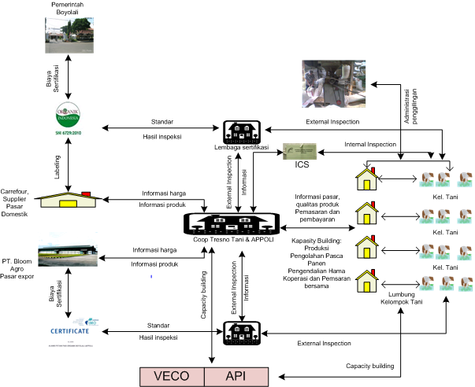
Busness Model: Tresno Tani Cooperative and APPOLI in Boyolali, Central Java

Slide 12
8 Cooperative Members of API
Hanjuang Cooperative, Pandeglang District : Forest Honey
Trisno Tani Cooperative, Boyolali District : Rice Organic
Sumber Lestari Cooperative, Jembrana Distric : Cocoa
Lembor Cooperative, West Manggarai : Saving and Loan
Agro Niaga Cooperative Nangapenda, Ende District : Cacao
Jantan Cooperative, East Flores : Cocoa
Amanah Cooperative, Polman District : Cocoa
KSU Toraja Cooperative, Tana Toraja District : Arabica Coffe

