Slide 1
FARMER AND NATURE NET (FNN)
Contact details: No 56 AU, Street 230, Sangkat Boeng Salang, Khan Tuol Kork, Phnom Penh (Cambodia)
P.O BOX: 1118, Tel: 855-23-636 9990,
Fax: 855-23- 885 146

Slide 2
1- FNN History
FNN was established be CEDAC, sponsored by FNF, in December 2003, and officially registered at the Ministry of interior (MoI) on March 10, 2006. Main goals of FNN are to promote the family economy of small scale farmers and develop equitable and sustainable rural community through typical activities of agricultural extension, saving and credit cooperatives and business rice cooperatives. Besides that, FNN has also supported rural farmer youth, poorest and women groups to raise awareness on management of natural resources, climate change and advocacy.

Slide 3
2. Goal
The goal of the Farmer and Nature Net is to “promote family economy of farmers and develop equitable and sustainable rural community”

Slide 4
3. FNN mission and Tasks
Unite farmers as one force to protect farmer’s rights and interests
Provide services to Farmer Associations members;
Promote the ecological agriculture movement in the whole country;
Promote the rural society with good cooperation and good solidarity between farmer and farmer and other stakeholders;
Support the Associations in developing agriculture and in managing natural resources;
Ensure the cooperation between Associations and Organizations and relevant institutions inside and outside the country.

Slide 5
4. Achievements results
Number self-help saving and credit groups | 1,072
Number of self-help saving associations | 914
Number of villages | 863
Number of commune | 212
Number of district | 56
Number of province | 16
Number of member | 53,226 (women: 35,128 persons)
Amount of saving capital of self-help saving groups | US$ 26,212,395
Amount of saving capital of Sosor | US$ 601,148
Collective fund of rice mill cooperative | 430,000 US$

Slide 6
5. Main activities of FNN
Saving and loan
Linkage farmer products to the market
Saving and loan : ​​ Up to date FNN supporting 1072 farmer saving groups and have a capital US$ 26,212,395. We stated from small group and also less then 10 members per group. Now FNN forming farmer saving union at a central for release loan to other group less loan and also establishing to farmer bank in the future.

Slide 7
Problems and challenges
Not regular monthly saving ( poor farmer)
Saving one or two year want withdrawal among of saving
No long term vision for saving to invest farm to increase their income from production
Member unwilling ( low commitment)
Lesson learn
Doing with farmer want to do
Stating from small group and learning by doing
Presenting more advantage of saving

Slide 8
Analysis on how poor farmer will have money to saving every month ( reduce expenses, reduce income and keep it for monthly saving)
Comparing saving group to others MFI
Working with saving group, we should ensure all saving capital are stable ( need collateral)

Slide 9
b. Linkage farmer products to the market :
Process:
Formed producer group
Technical training ( SRI, compost, cover crop, soil improvement, botanical pesticide….)
Certification
How to record ICS book
Hire BCS company to certify organic rice ( From Germany)
Marketing
Opening shop for selling farmer product
Contracting with farmer ( rice, chicken, vegetable….)

Slide 10
b. Linkage farmer products to the market : Up to 2015, FNN and CEDAC , purchasing organic paddy from farmer producer group 2000Tone for exportation and 1000Tone for local market. For exportation we always hire certification body from BCS ( from Germany) to certified organic rice for export to USA, Gemany, Hong Kong, Singapore and Viet Name. For local market we use the paddy certification by CEDAC and FNN ( use internal control system). Up to now 11 markets opening in the Phnom Penh for selling farmer organic product, and we ready

Slide 11
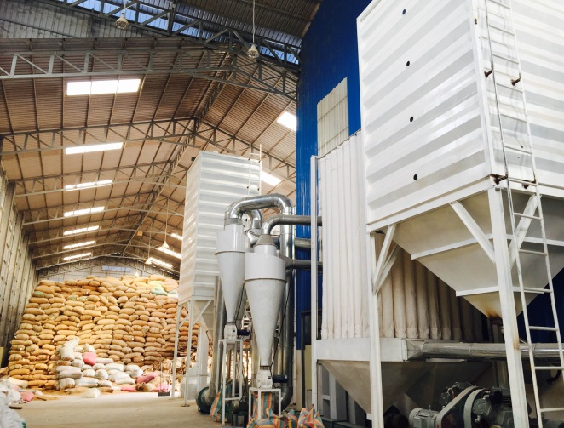
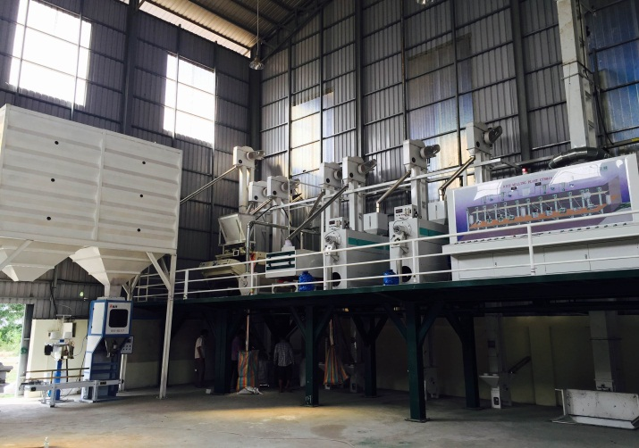
Installed milling rice five places
At central for milling export
2 at Prey veng and 2 at Takeo province for milling ICS paddy to CEDAC shop at Phnom Penh.
Central milling machine

Slide 12
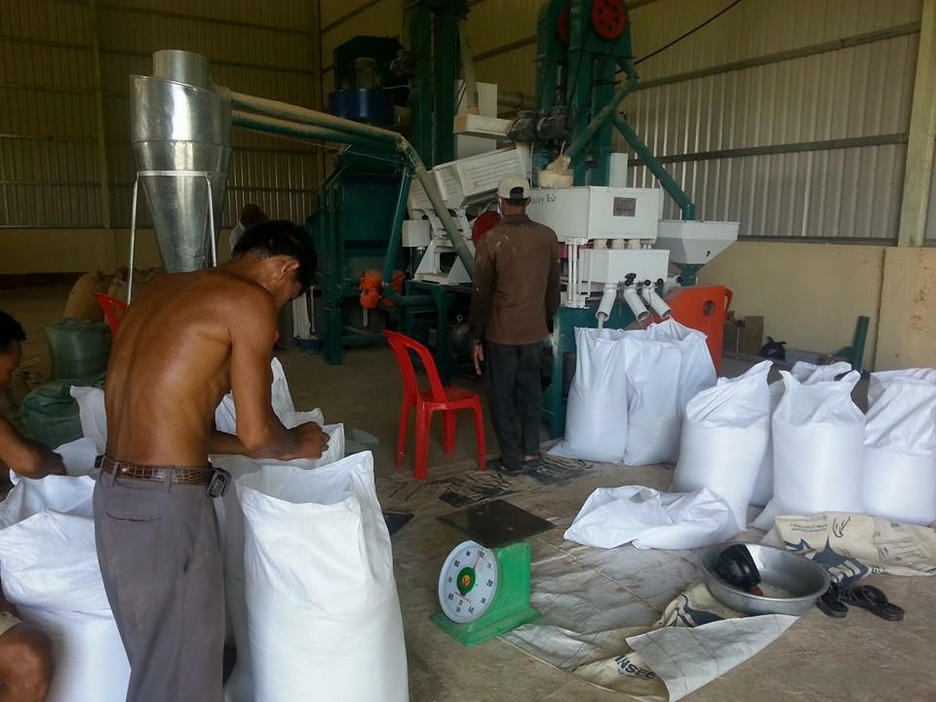
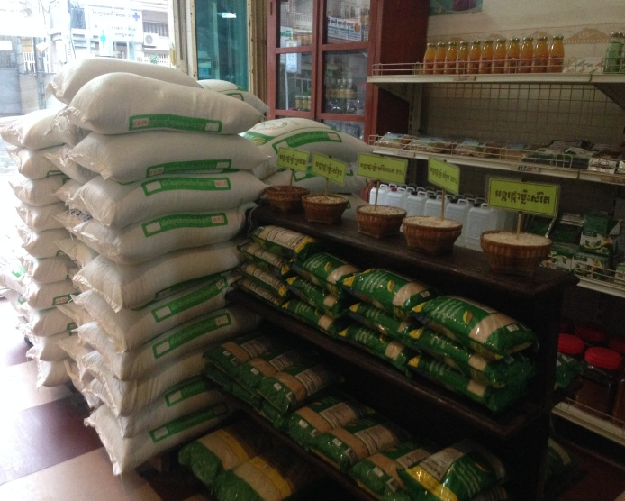
Provincial milling machine Shop selling farmer products

Slide 13
Problems and challenges
Lack of capital for purchase organic rice
Competition with exporter
Paddy flow to border country ( VN and Thai)
Low quality of paddy
No dryer machine
Lesson learnt
Contracting with district cooperative among of paddy for export to selling in Phnom Penh.
Working in Cooperative so members no need to selling out of their organic rice

Slide 14
Re-training on SRI to all member of producer groups, especially seed purify
Promote farmer cooperative have milling machine to set up drying machine.

Slide 15
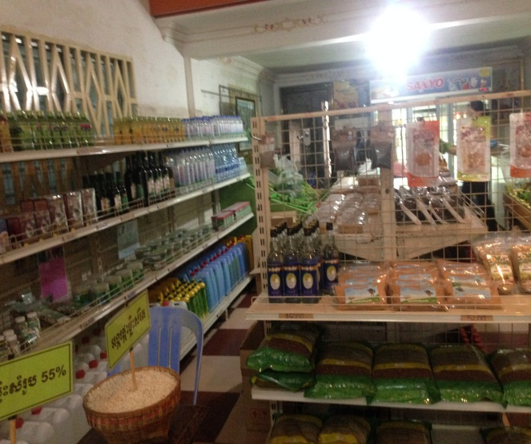
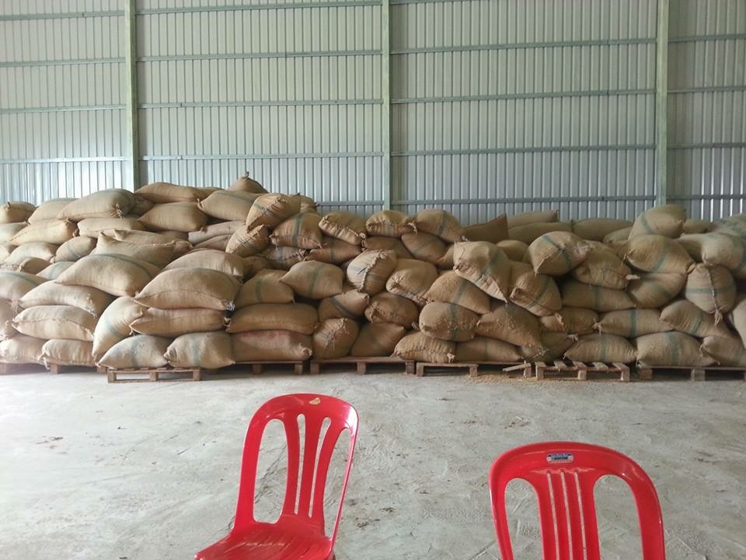
THANKS YOU FOR YOUR ATTENSION

