Slide 1
KM 4 SAE
Knowledge Management for Sustainable Agro Enterprises

Slide 2
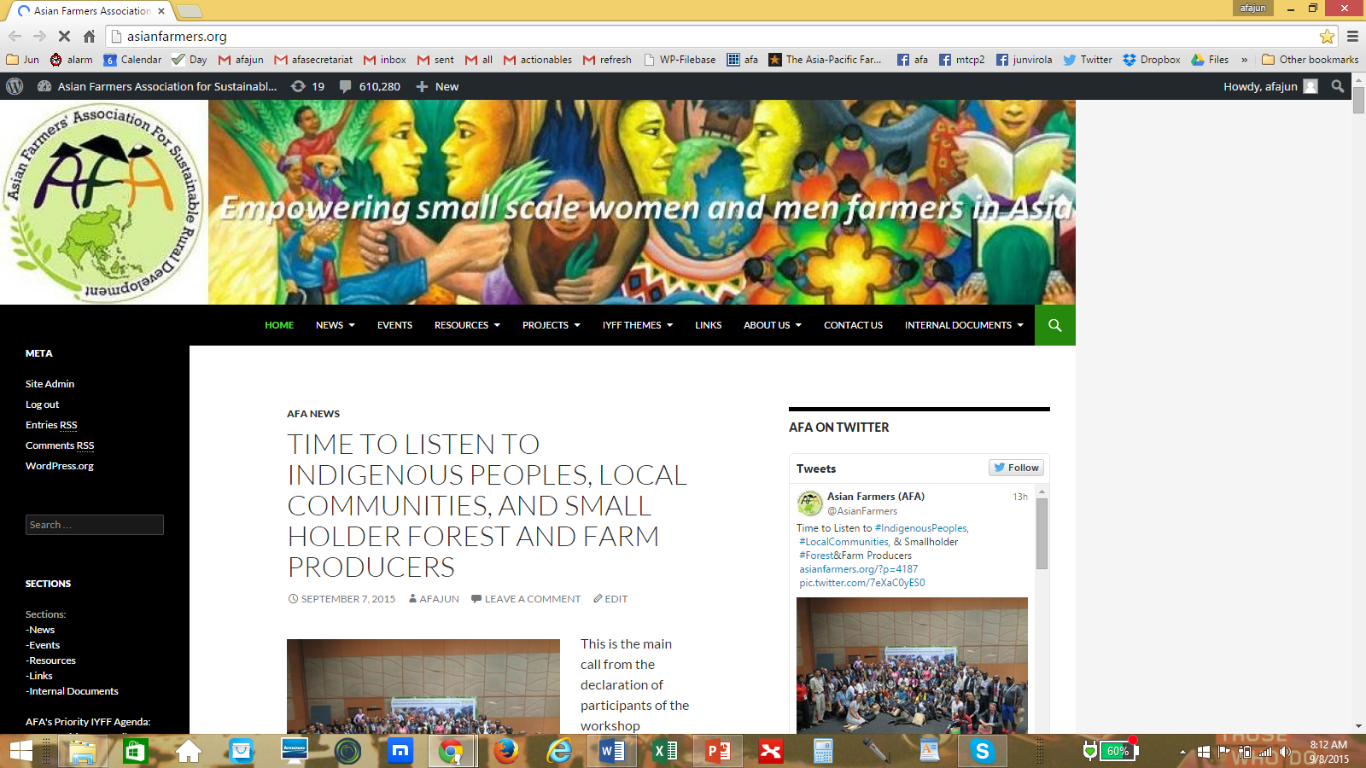
AFA Website (www.asianfarmers.org)

Slide 3
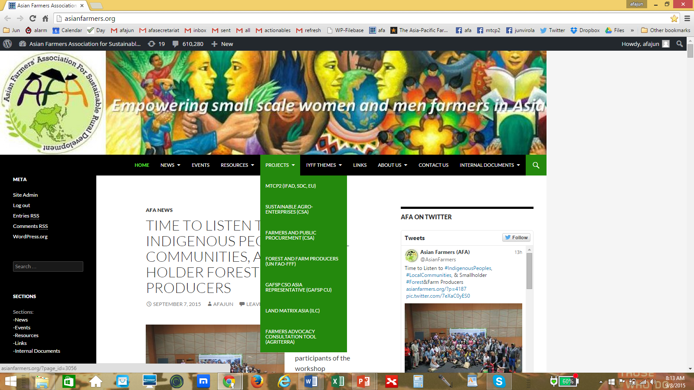

Slide 4
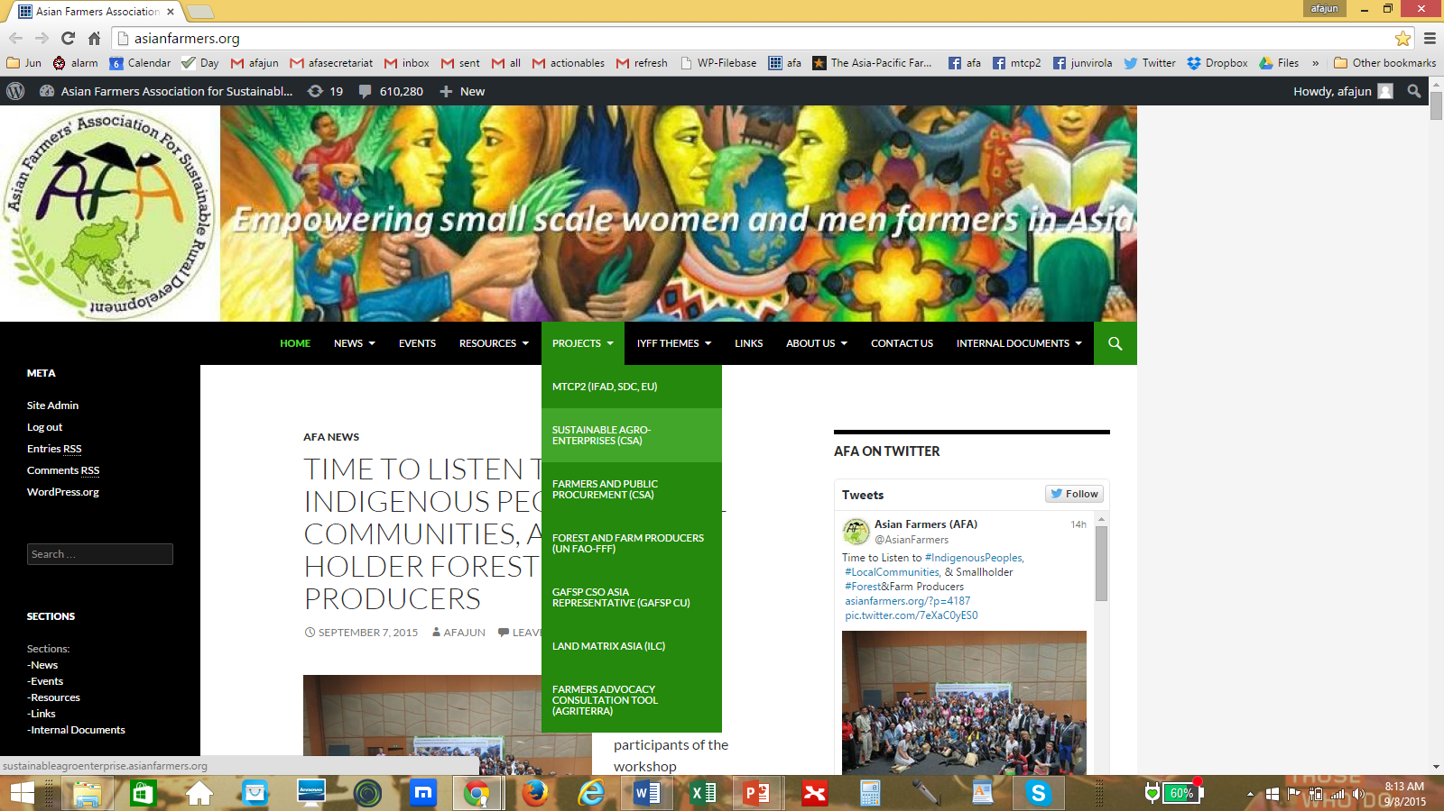

Slide 5
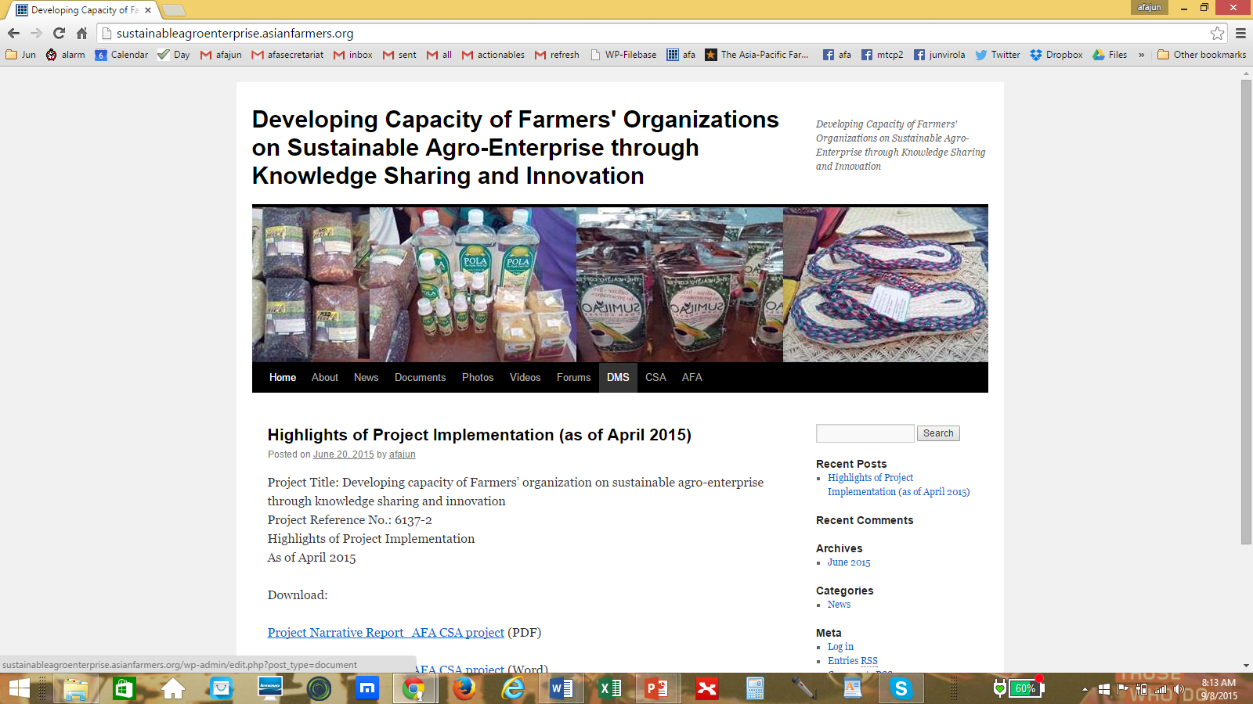
AFA SAE Website (www.sustainableagroenterprise.asianfarmers.org)

Slide 6
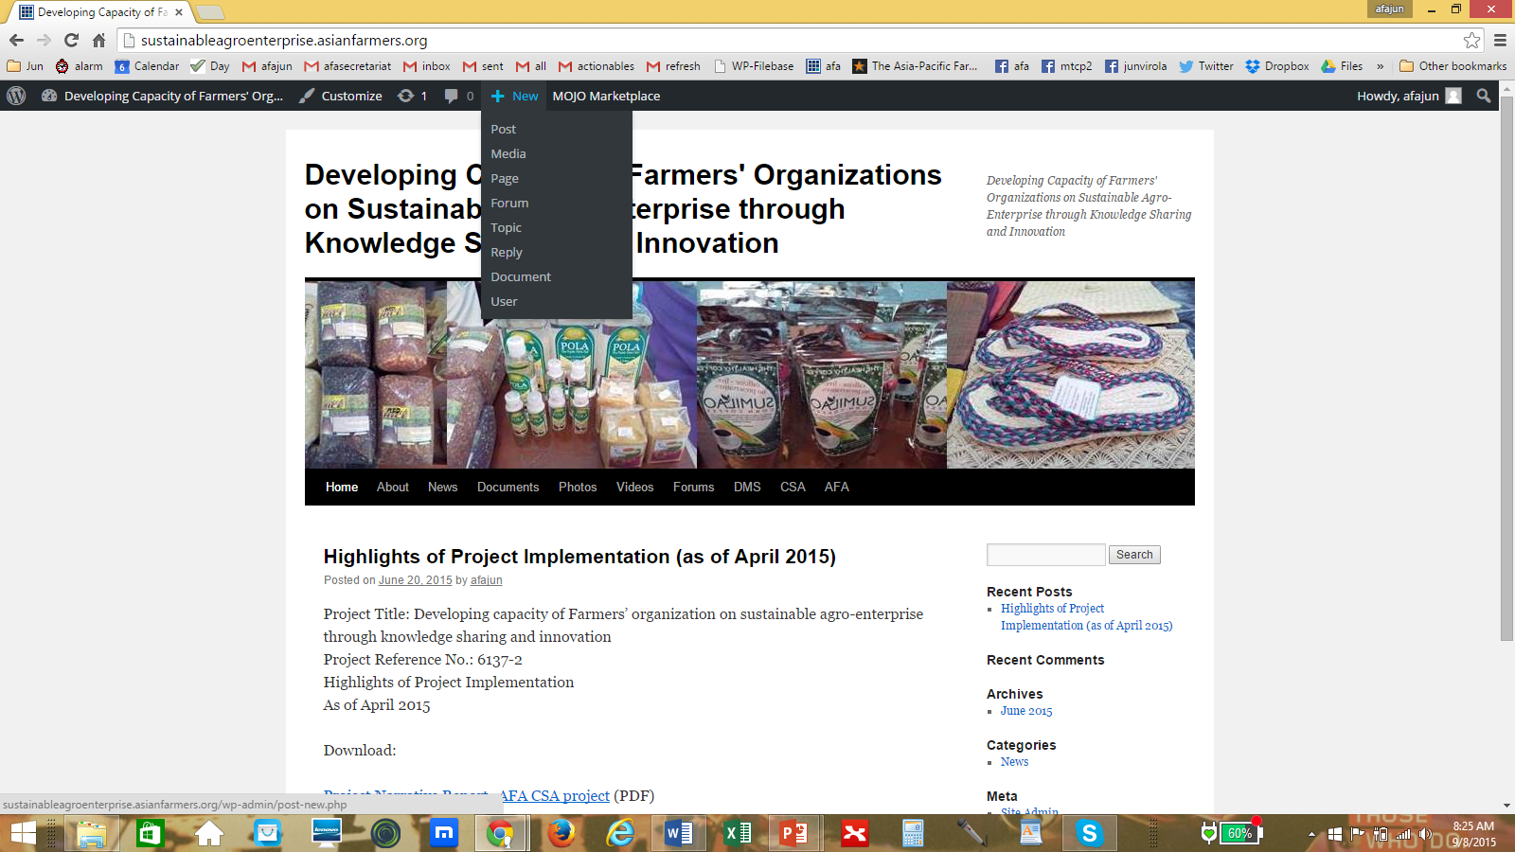

Slide 7
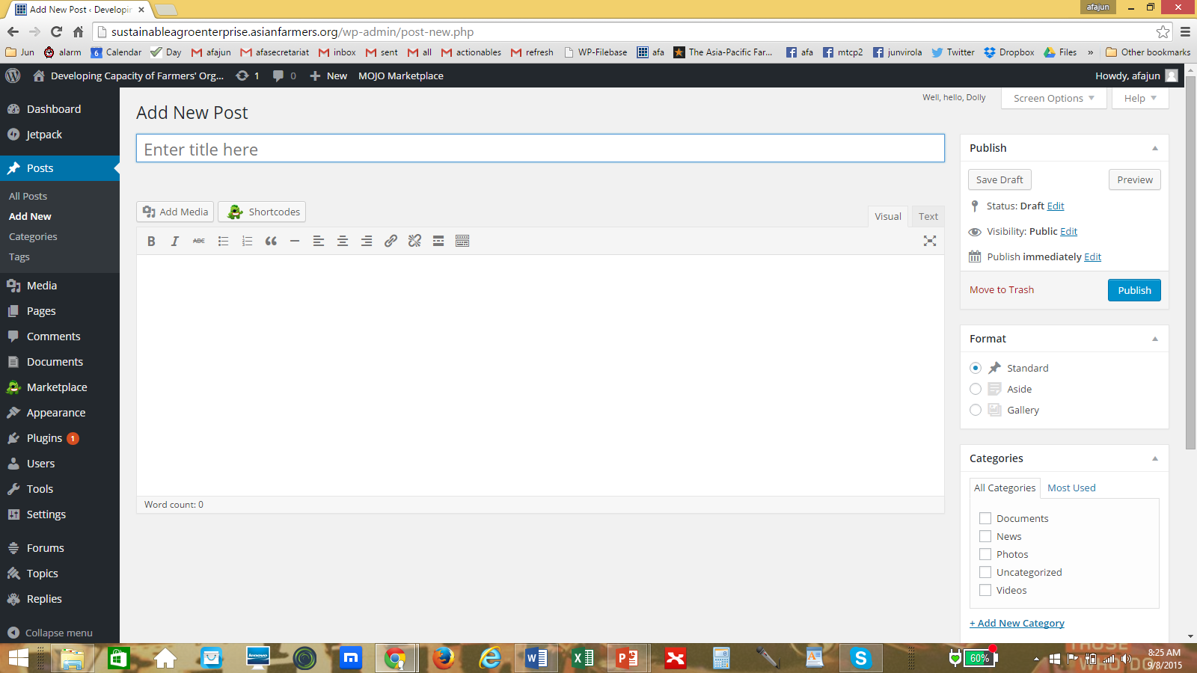

Slide 8
AFA DMS (Document Management System)

Slide 9
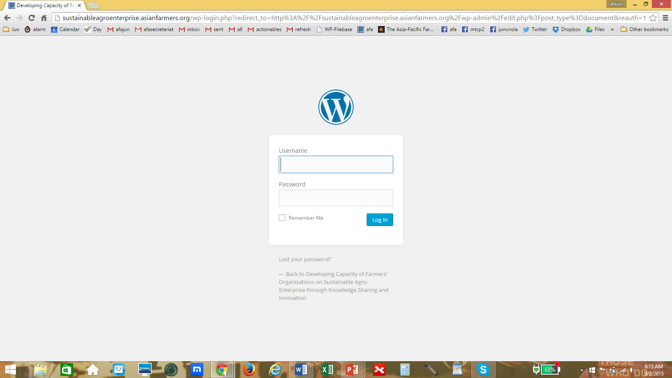

Slide 10
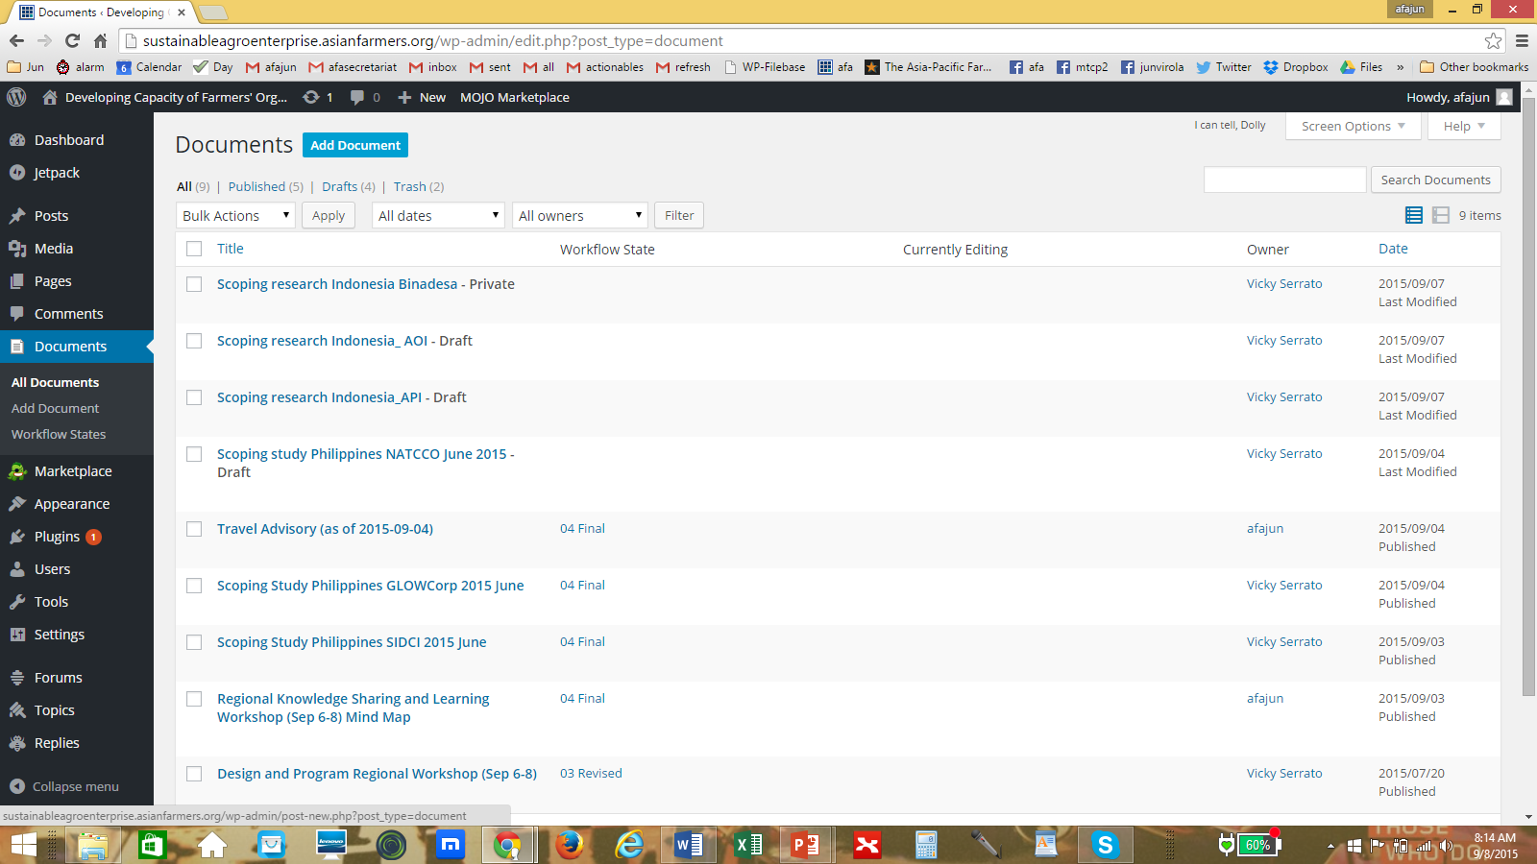

Slide 11
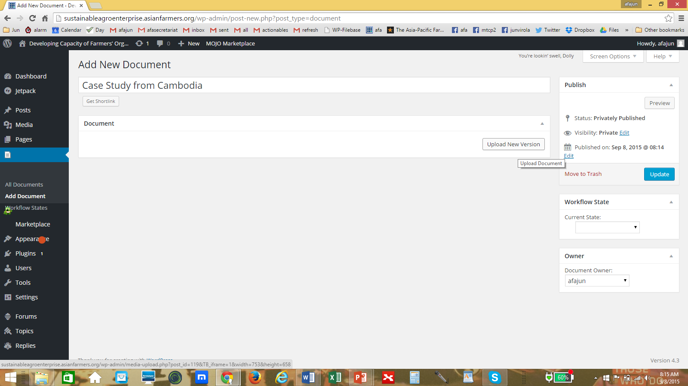

Slide 12
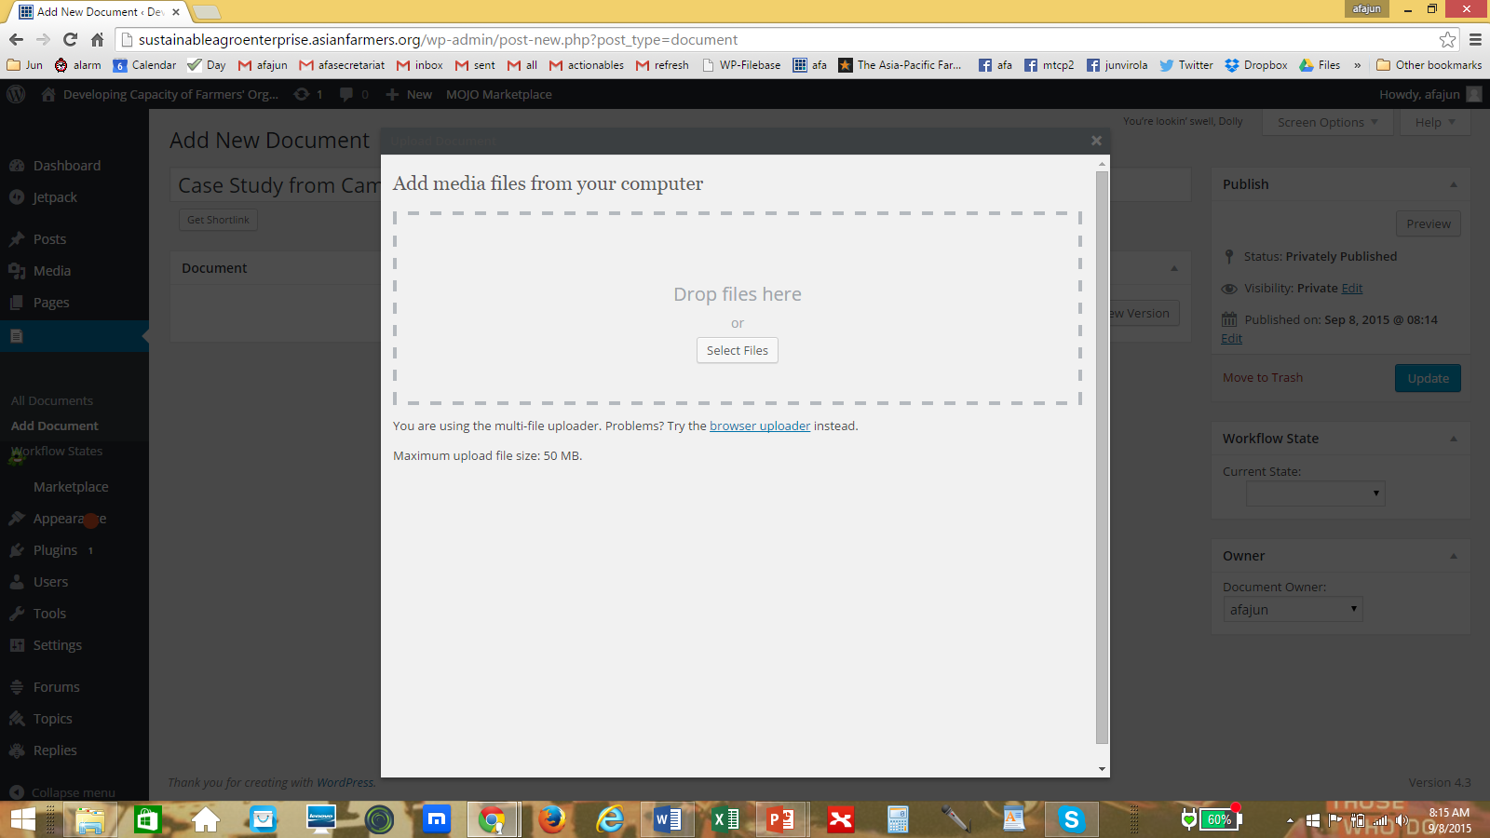

Slide 13
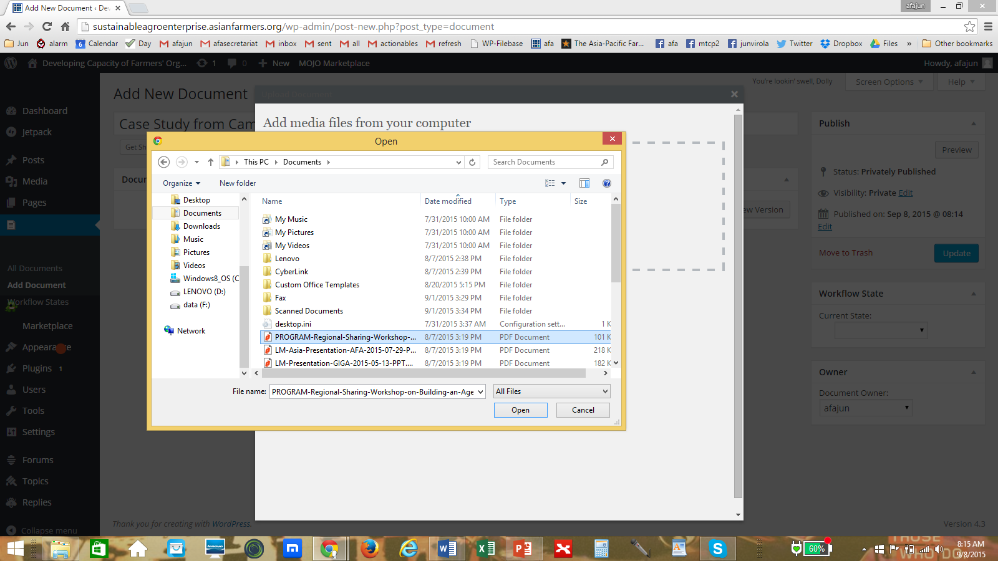

Slide 14
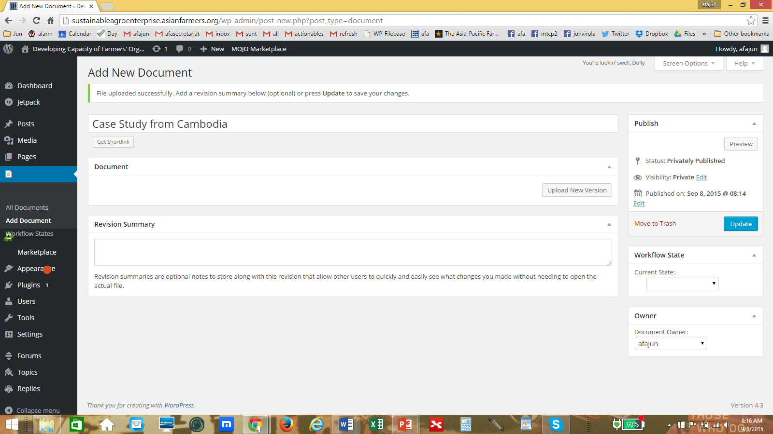

Slide 15
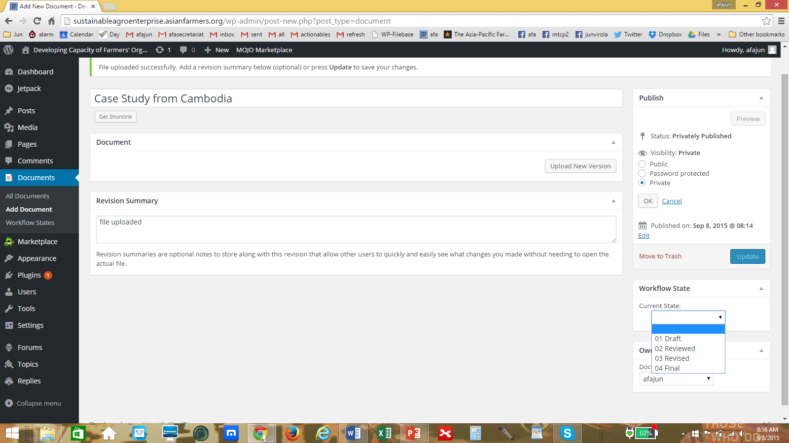

Slide 16


Slide 17
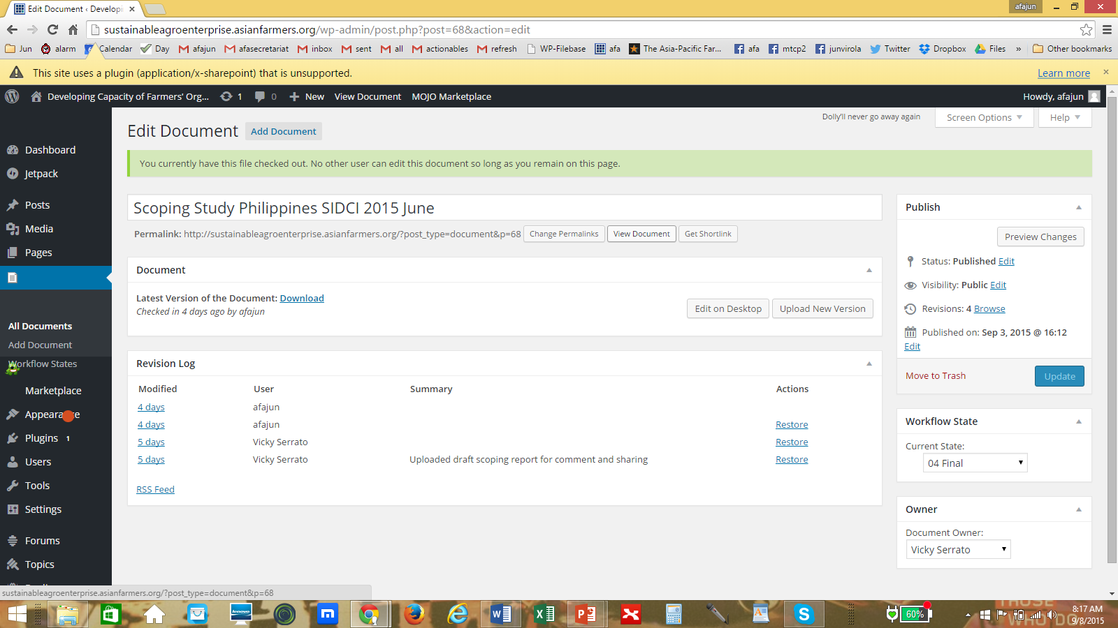

Slide 18
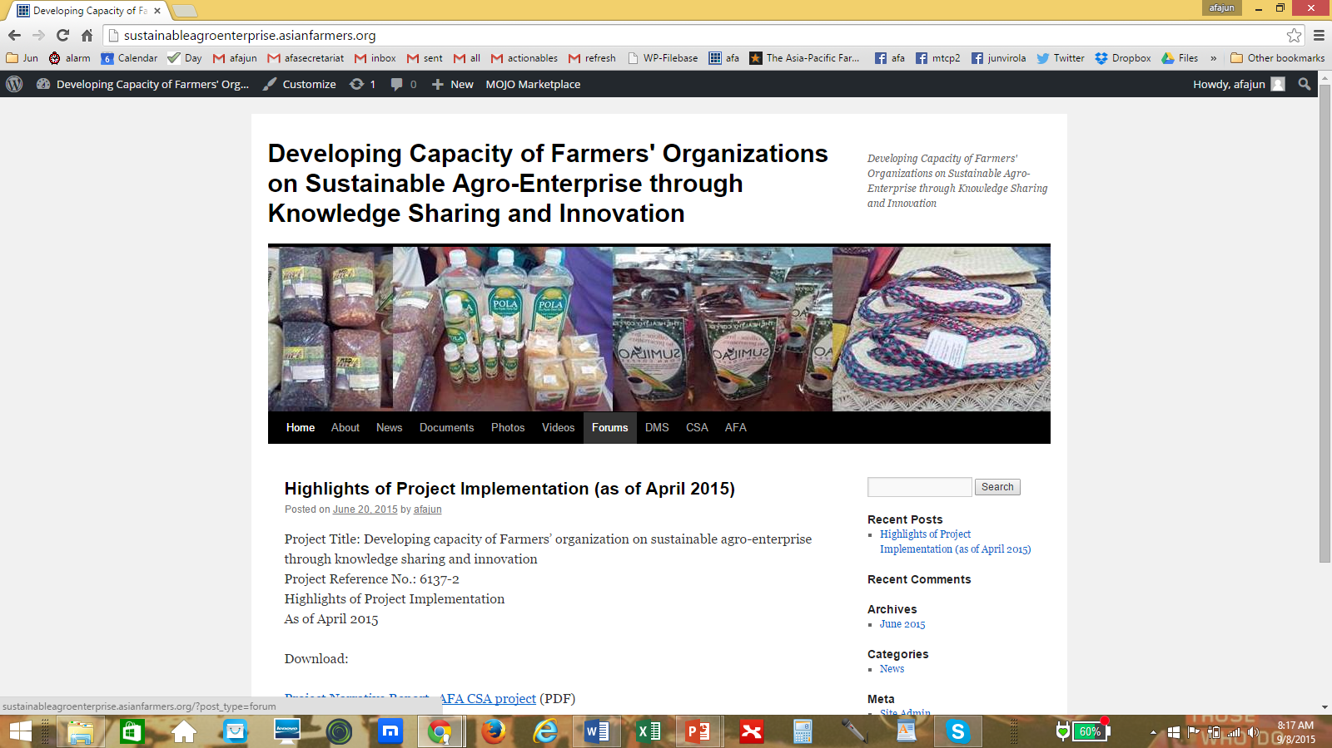
AFA SAE Online Forum

Slide 20
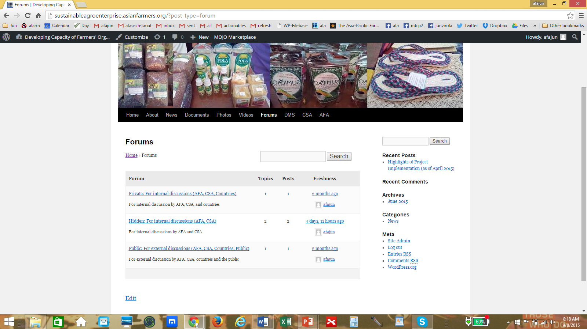

Slide 21
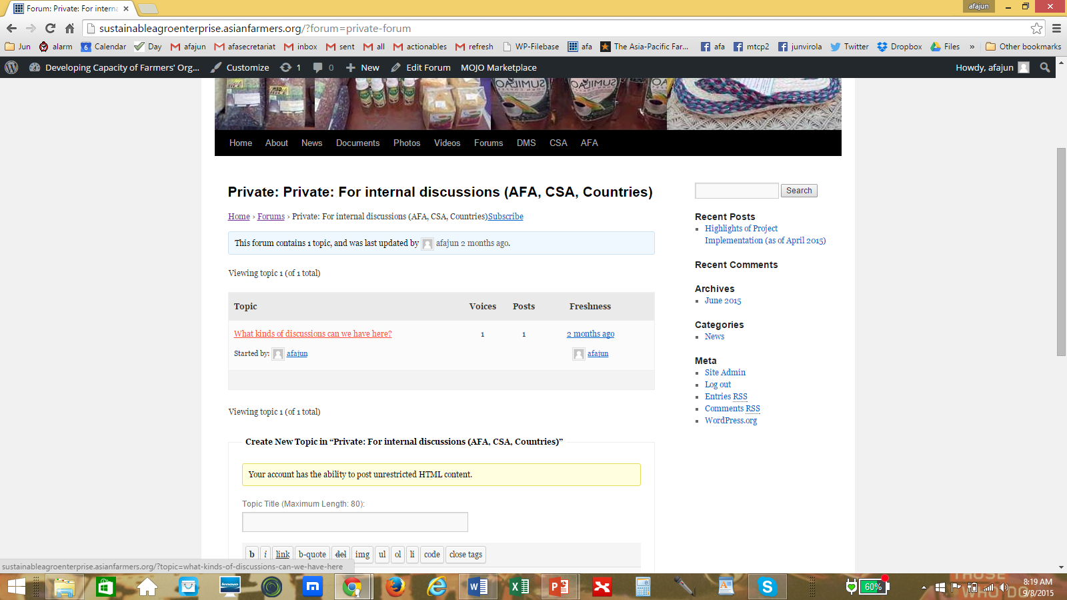

Slide 22
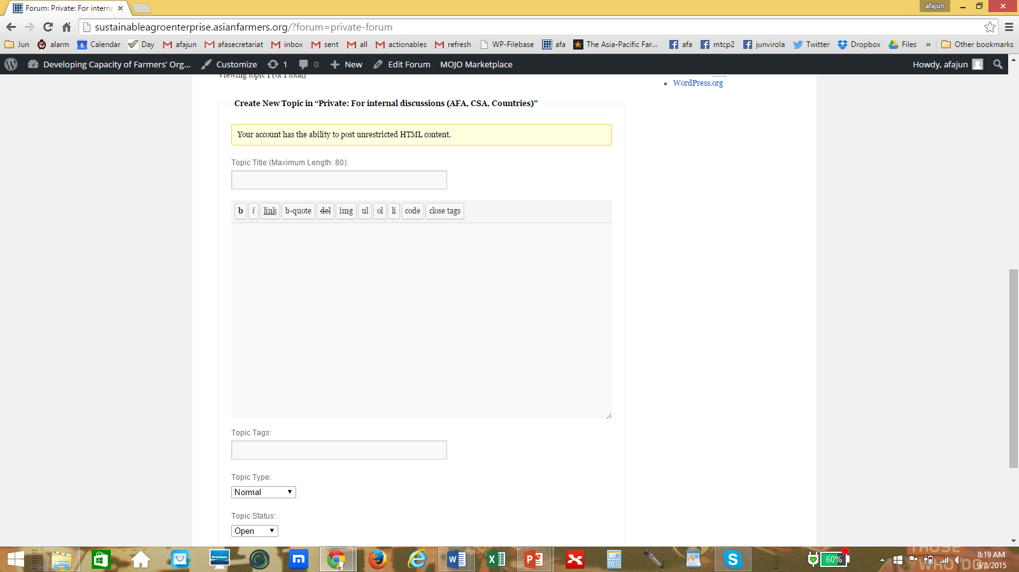

Slide 23
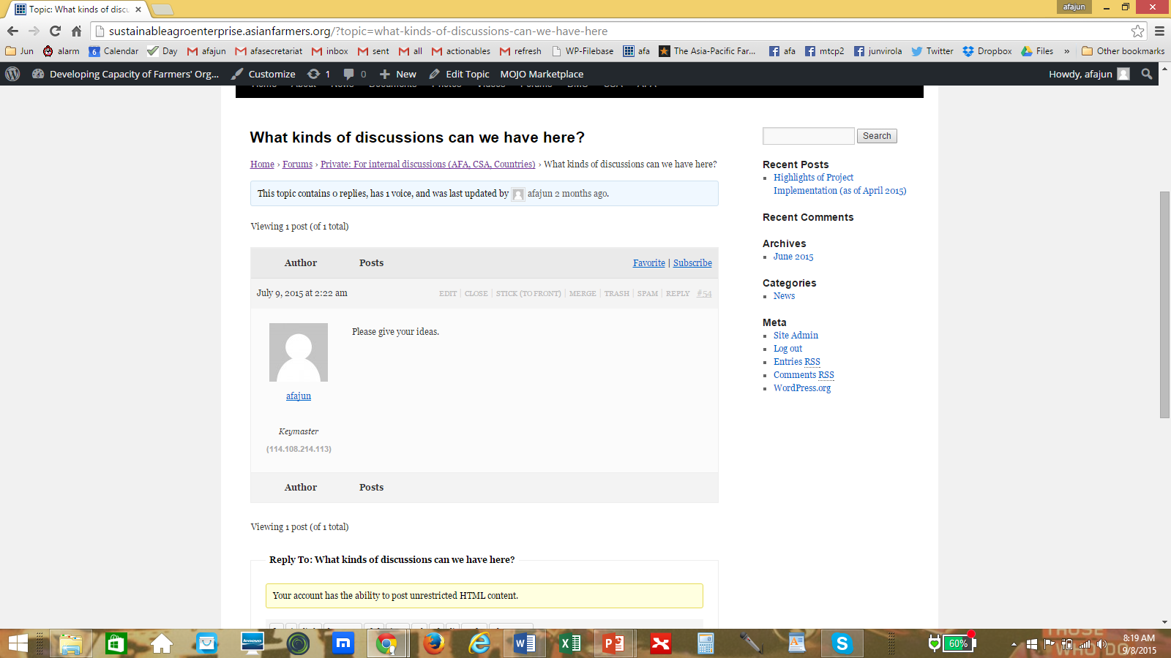

Slide 24
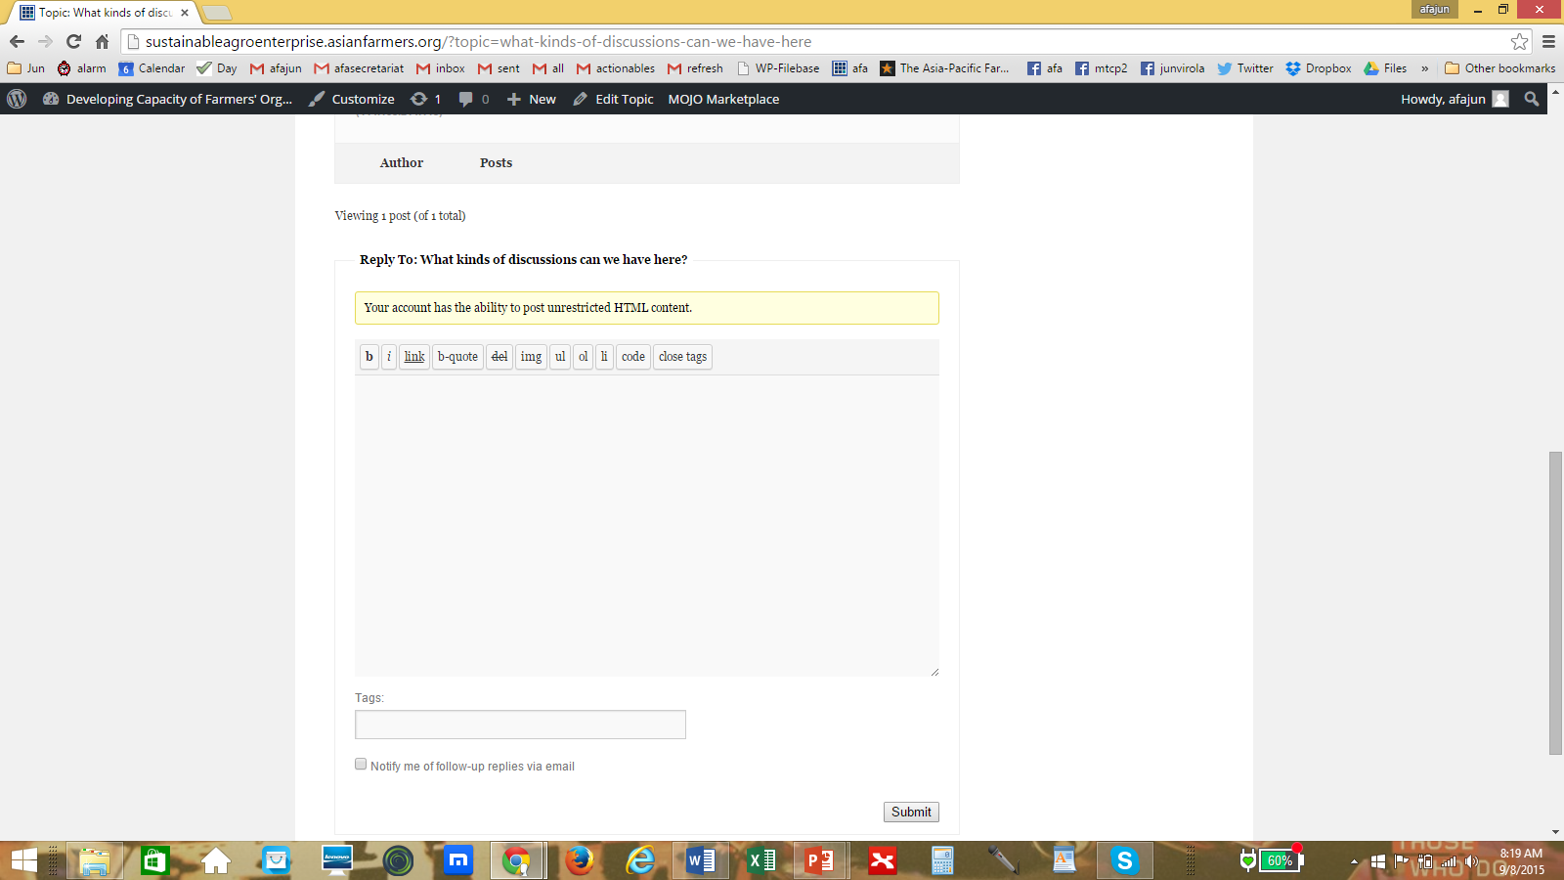

Slide 25
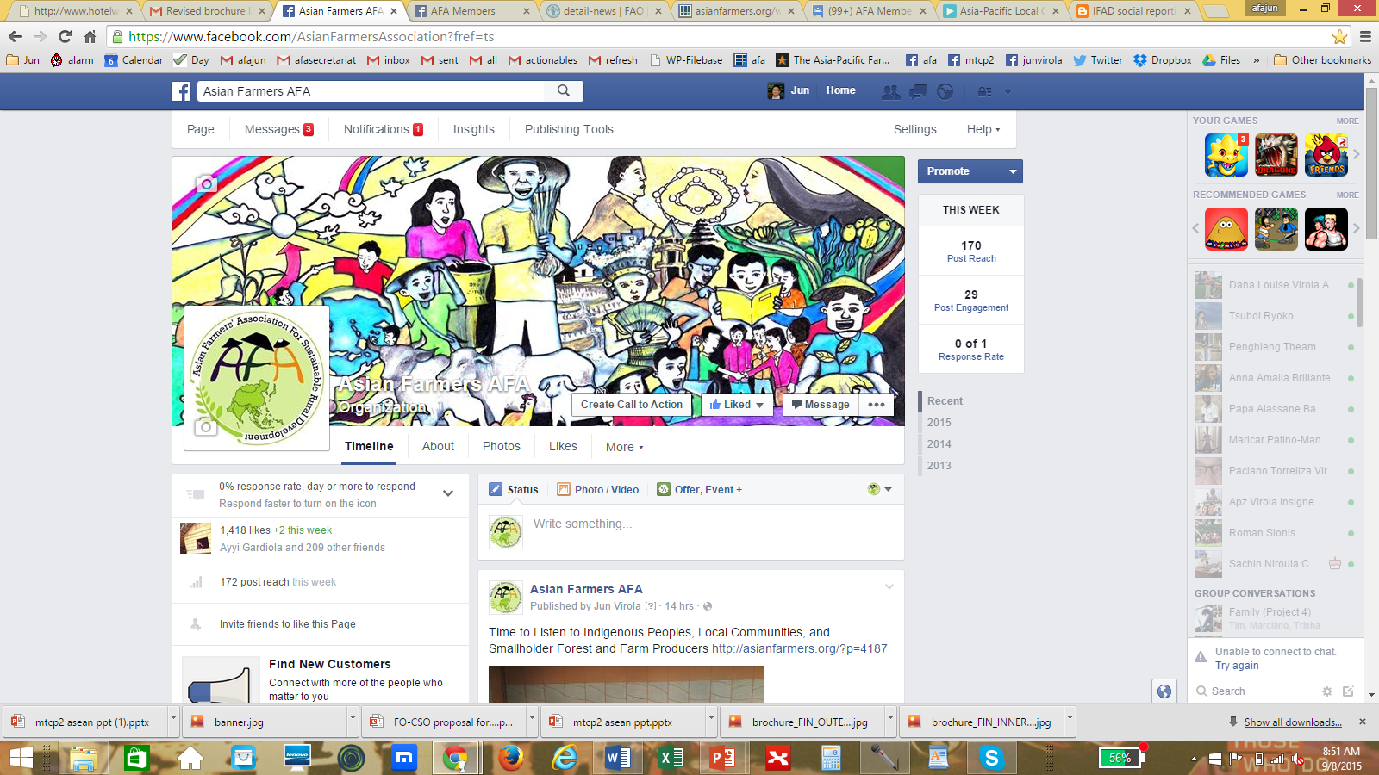
Facebook Page (Public)

Slide 26
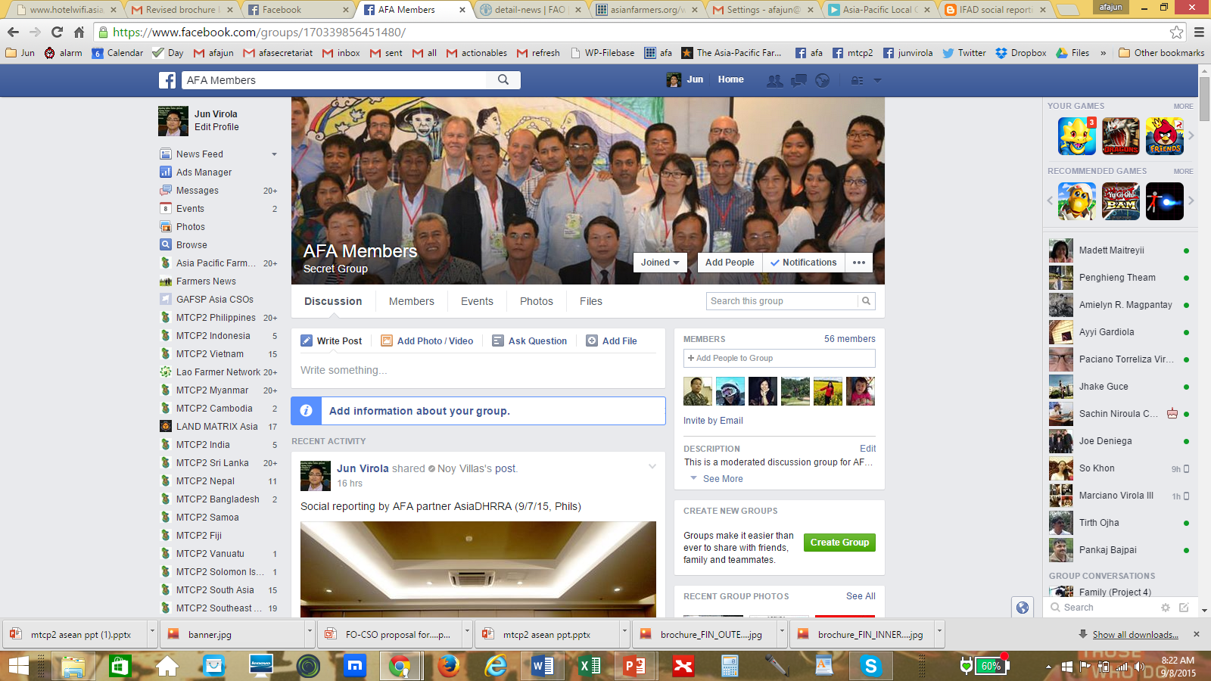
Facebook Group (Private)

Slide 27
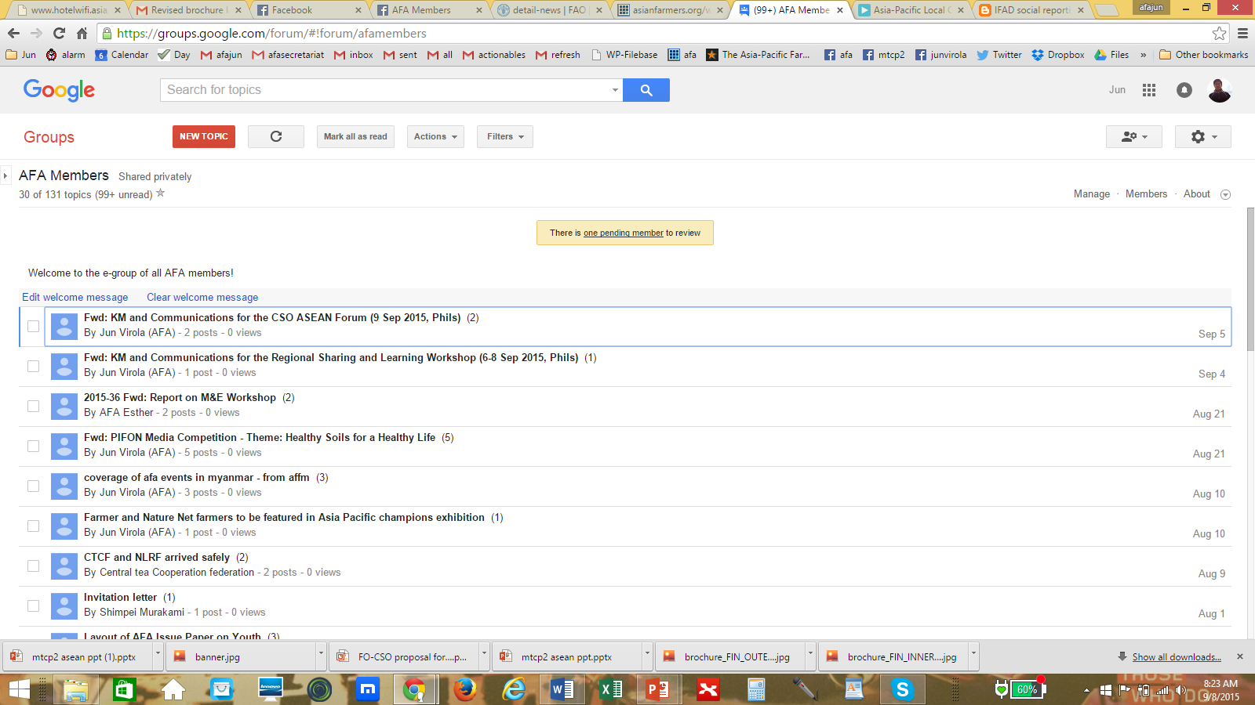
Google Group (Private)

Slide 28
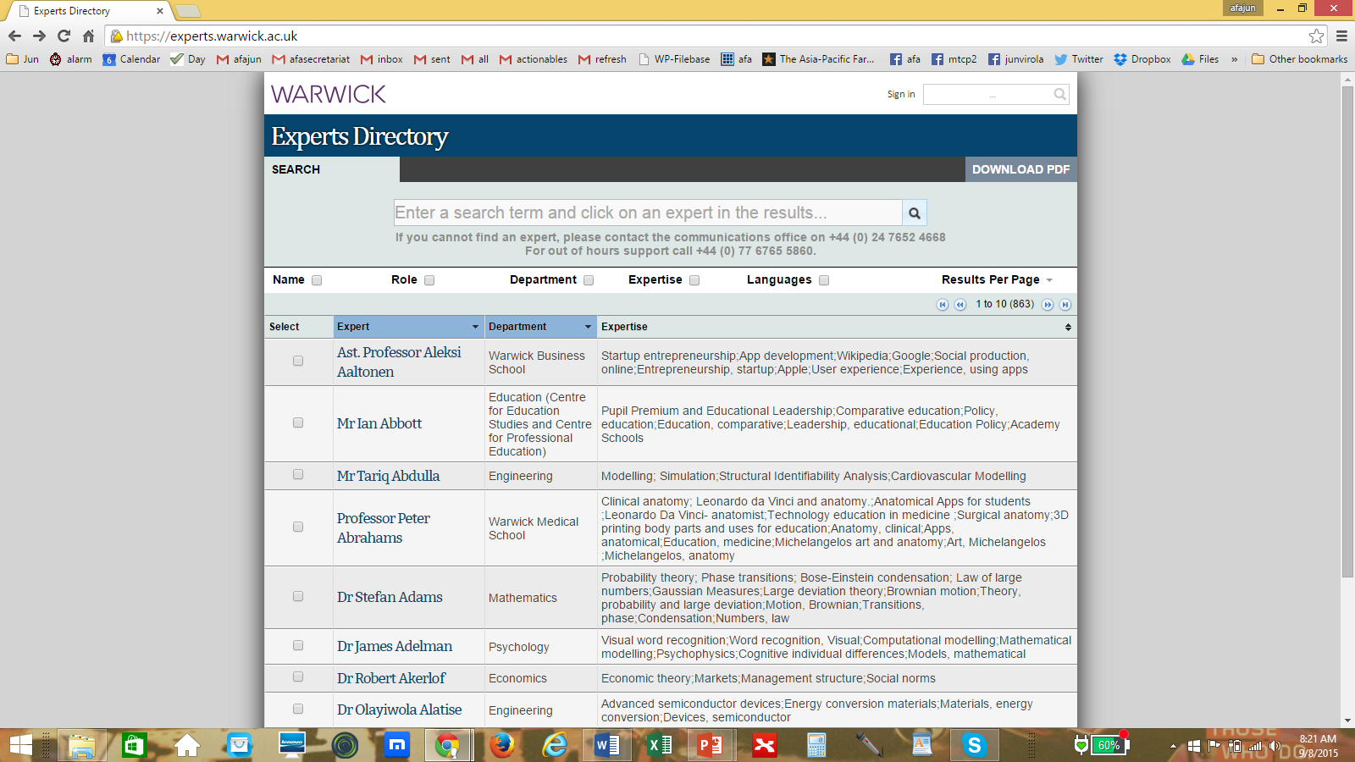
Experts Directory

Slide 29
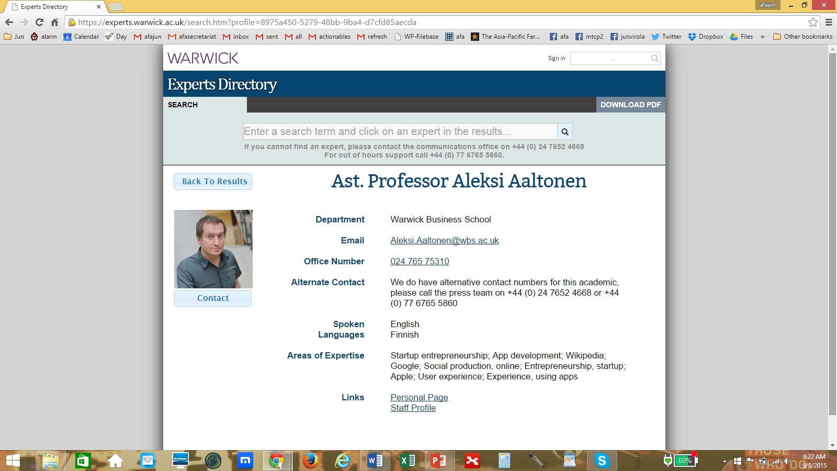

Slide 30
Suggestions to continue knowledge sharing
What to share?
Documentation of experiences, innovations, lessons learned
Sharing of case studies, manuals, videos
Infographics (e.g. how to produce coffee), tips on providing services (with visual aids for farmers)
Expert information, problems and difficulties of members
Successful agri enterprises from Japan, Korea, Taiwan (share more relevant knowledge)
How to share?
Website
Document management system
Online forum (general and specialized)
  Moderated forum on a specific topic per month (volunteer moderators: API, KAFF)
Facebook group, Egroup
Expert directory (ask an expert section)
  How to engage experts (member of org or retired professionals)

