Slide 1
NATIONAL ASSOCIATION OF MONGOLIAN AGRICULTURAL COOPERATIVES
/NAMAC/

Slide 2
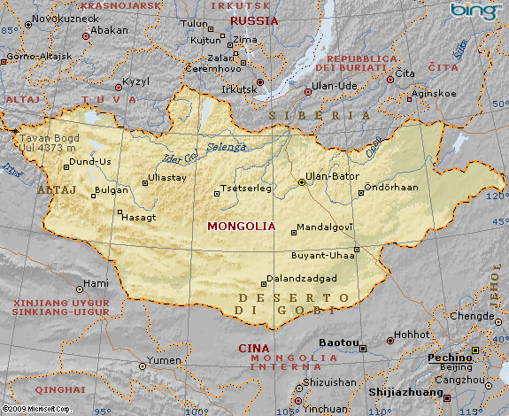
COUNTRY PROFILE
Located Northern Asia, between China and Russia, landlocked Territory: 1.566.500 sq.km. (17th largest land in the world)
Population: 3 million (as of 2014)
Capital : Ulaanbaatar
GDP: $21.84 billion Per capita $4,096 (as of 2014)

Slide 3
MONGOLIAN AGRICULTURAL SECTOR
Agricultural sector produces 20,6 % of total GDP.
80% livestock and 20% crop sector.
Provides job for 41 percent of entire population or 1,1 ml employees
Generates 7,0 percent of export revenue
Main agricultural export product: Leather, cashmere, meat, sheep and camel wool

Slide 4
Main Components of Agriculture Mongolia
AGRICULTURE:
20,6 % of GDP,
41% of Labor force
CROP PRODUCTION:
1% of total territory,
15% of total agriculture labor force
Cereals /wheat, rye, oat/
Potato, vegetables and fruits
ANIMAL HUSBANDRY:
80% of total territory,
85% of total agriculture labor force
Cattle, Horse, Sheep, Goat and Camel

Slide 5
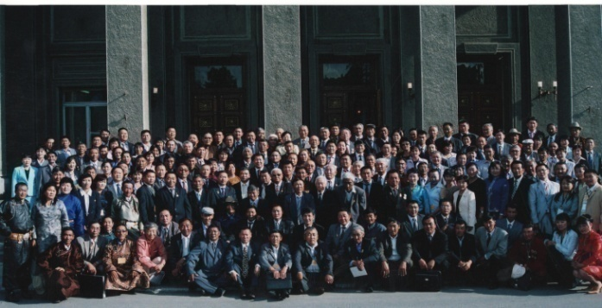
National association of Mongolian agricultural cooperatives
The National Association of Mongolian Agricultural Cooperatives /NAMAC/ is a non-governmental organization which was re-organized by its First General Assembly in January 1992. The Supreme Council of Agricultural Cooperatives the precursor of NAMAC was founded in 1967.

Slide 6
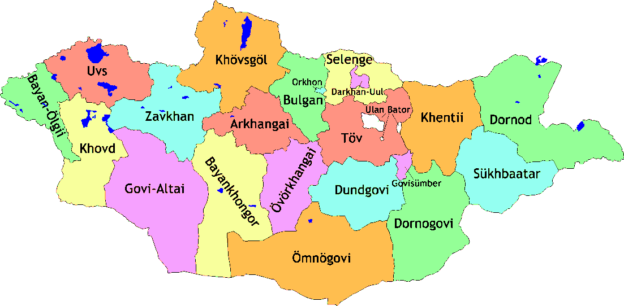
Current status
22 branch offices in every province and capital city
640 primary cooperatives
10 secondary cooperatives
Agricultural cooperative training center
130000 individual members and
over 300000 people
indirectly benefits from
our activities

Slide 7
Organization structure

Slide 8
ROLE OF NAMAC IN COOPERATIVE DEVELOPMENT
Play significant role in the formation and strengthening cooperatives and raises awareness of agricultural cooperatives at national and international level
Advocacy for the favorable legal and business
environment for cooperative development
Lobbying and policy advocacy
Protecting interests of cooperative members
Capacity building of cooperatives and their
members
Design and implement project and programs
Training and consultation service to the members and supply them with the latest information
Technical assistance
Development manuals and handouts for cooperatives

Slide 9
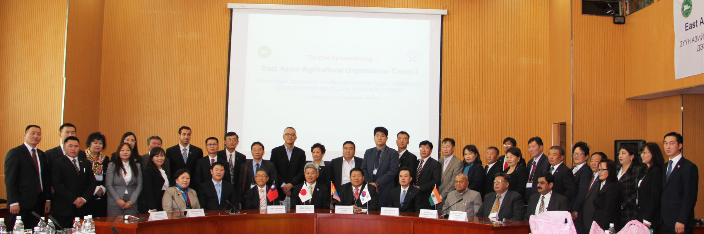
REPRESENTATION AT INTERNATIONAL LEVEL
1997 – member of East Asian Agricultural Organizations’ Council
1998 – member of International Cooperative Alliance Agriculture Organization
2009 – member of International Cooperative Alliance
2013 – member of Asian Farmers Association

Slide 10
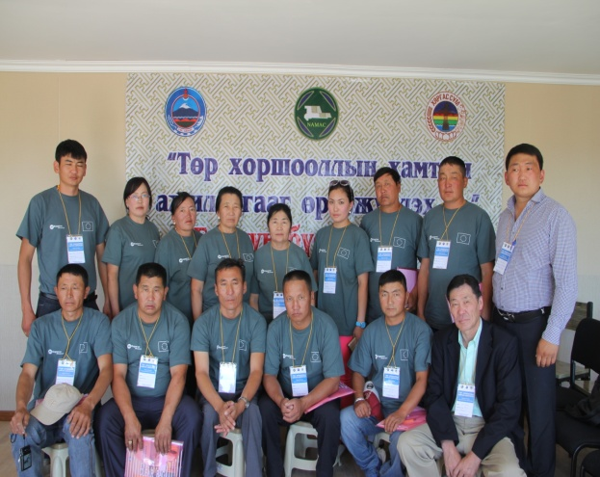
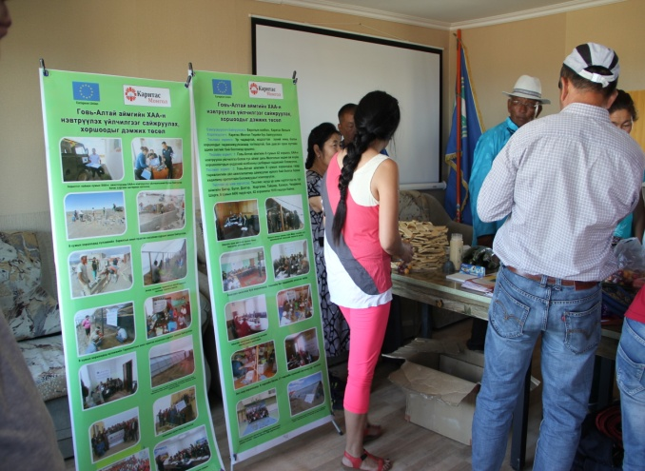
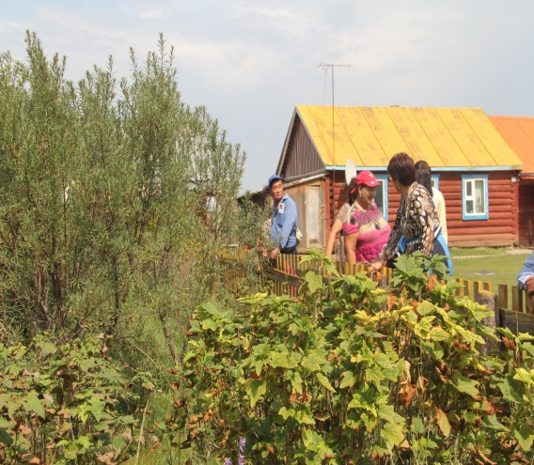
NAMAC - GOBI-ALTAI
Established in 21st October, 1997
More than 32 primary members cooperatives
90% out of total members run agricultural activities
Annual profit is 2 billion MNT, and 40 million MNT dividends has been distributed to the members

Slide 11
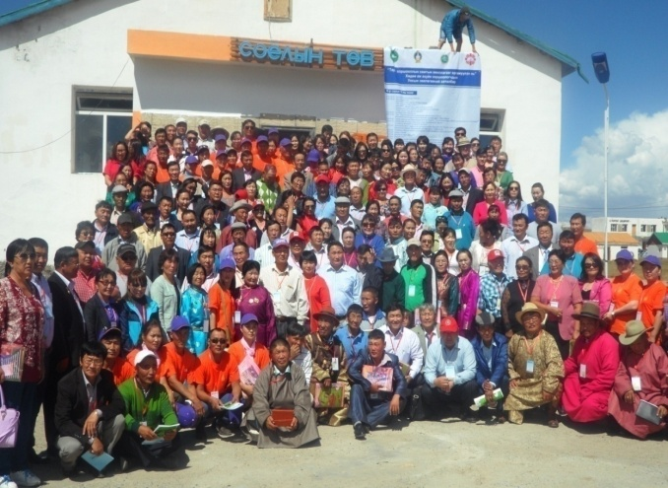
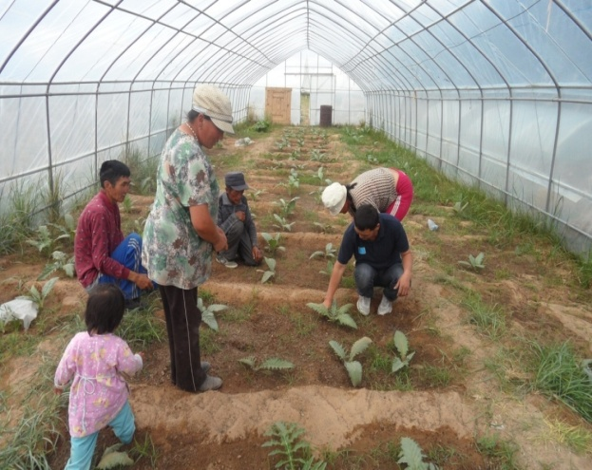
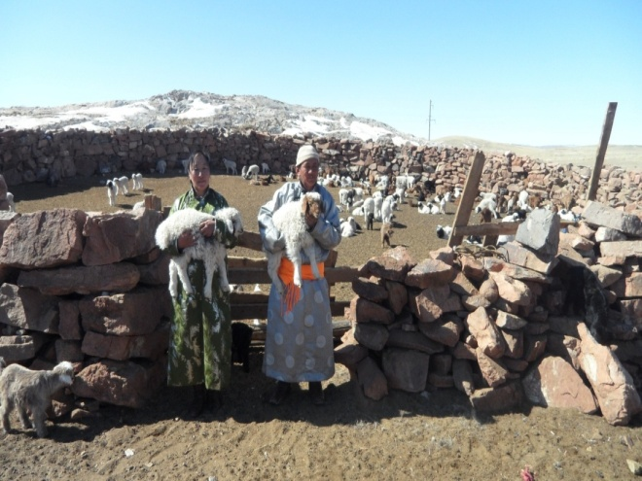
NAMAC – KHOVD
Established in 18th May, 1994
31 primary member cooperatives
Annual profit is 1,6 billion MNT, and 19 million MNT dividends has been distributed to the members

Slide 12
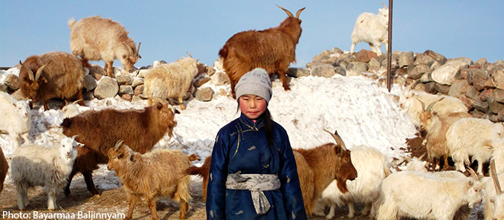
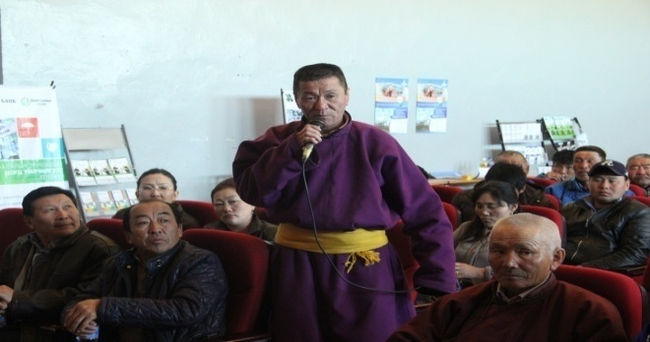
Main issues faced by our members
Natural disaster and climate changes
Pasture degradation
Lack of infrastructure development in rural
Insufficient financial support to the cooperative
Lack of supplying and marketing chain
Aging of farmers and herders
Lack of Agricultural products logistic system
Limited access to Agricultural commodity exchange
Deficit of skilled workers
Lack of social welfare

Slide 13
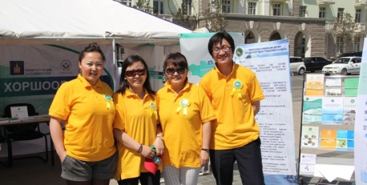
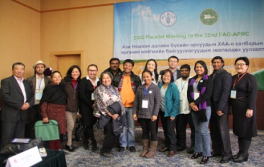
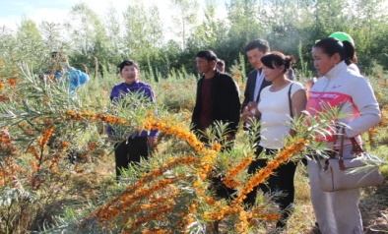
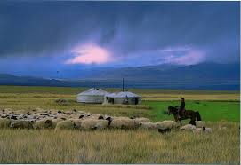
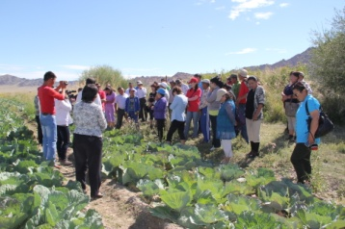
NAMAC’s participation to solve the issues
To support the cooperative management development and its financial viability
To intermediate members with domestic and international businesses, projects and programs
To organize trainings for members
Implement and support programs for youth in agriculture
Advocacy for Agricultural policies
Constructive engagement in policy implementation of agriculture sector
Support the increase market power of farmers
Approach the investments in sustainable agriculture

Slide 14
THANK YOU

