Slide 1
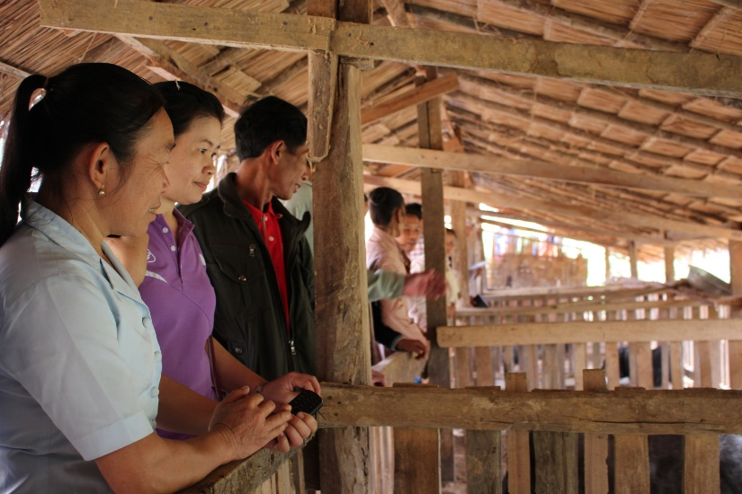
Lao Farmer Network
LFN is a national level network of farmer organizations established in 2014 with the objective to strengthening farmer cooperation in information sharing, learning, improve marketing, access to funds and engage in policy dialogues. Currently, the network has 16 member oganizations in 10 provinces including more than 4,000 farmers.

Slide 2
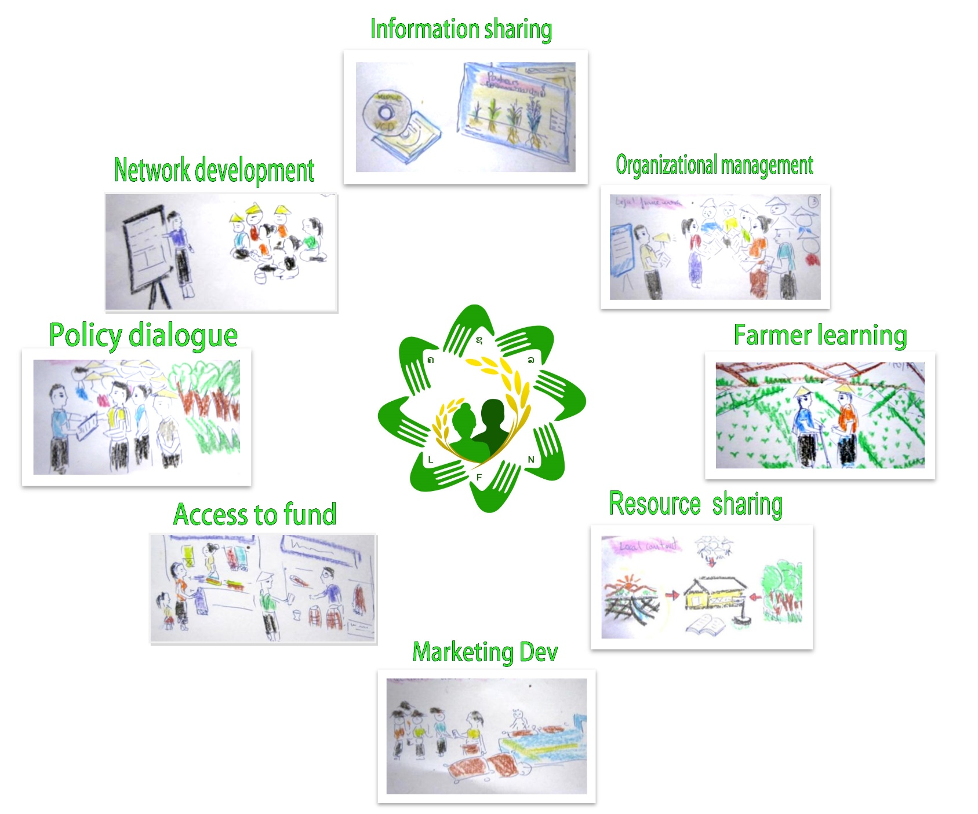
Lao Farmer Network- Objectives

Slide 3
Strategic Support for Food Security and Nutrition Project (SSFSNP)
The project has 4 components: a) strengthening public services, b) Community-driven agriculture-based nutrition interventions and c) Sustainable and inclusive market-driven partnerships
The project will work in in 12 districts in 4 Northern provinces, Laos
The total budget is 30 million USD supervised by IFAD and WFP, implemented by Lao government (MAF)

Slide 4
LFN engagement in SSFSNP
LFN hosted the national consultation workshop of the program in May 2015, later in the year, they provide inputs to the design process of the SSFSNP. As result, LFN is considered as implementing partners of the project especially on farmer to farmer learning, farmer organization development and small scale agri-business.
Consultation
Design
Partners

Slide 5
How to engage with the program
AFA introduced the program to LFN
Within the GAFSP framework, it requires the program to organize consultation workshop at national level- AFA supported LFN to co-host the event
IFAD country program aware about LFN because LFN in the National Implementing Agency of MTCPII- a IFAD-funded project as well. LFN asked IFAD to continue engage LFN in design phase of the SSFSNP.

Slide 6
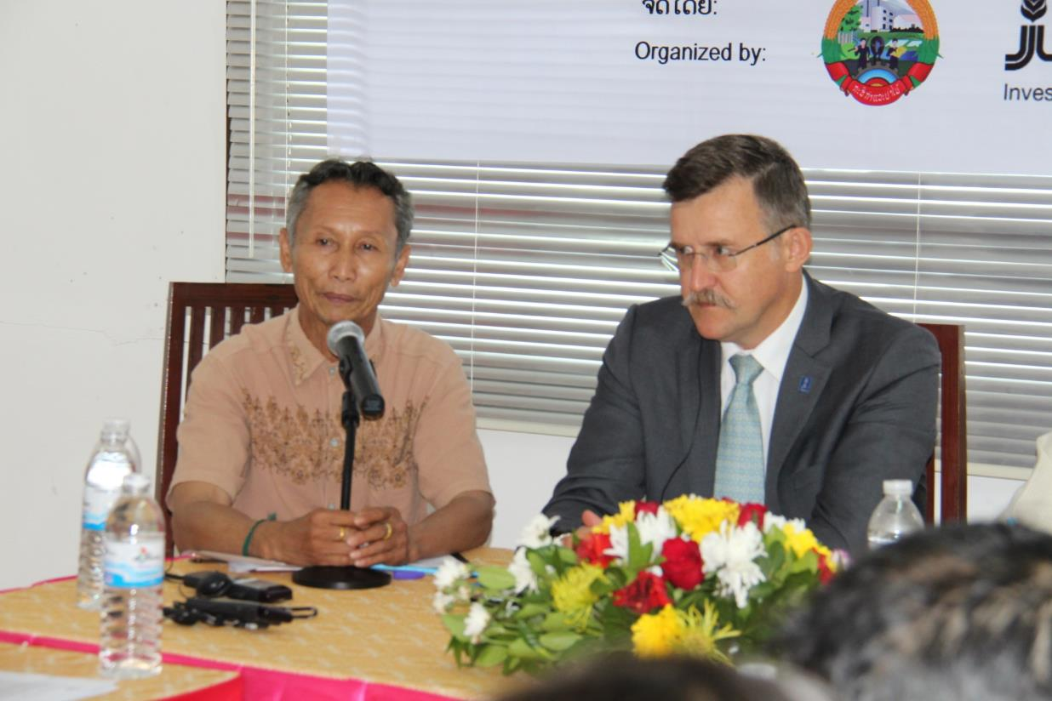
Example
Co-host a national consultation workshop on Global Agriculture and Food Security Program . 6 May 2015, Vientiane capital

Slide 7
LFN initiative in GFSAP-MMI program to ensure engagement with SSFSNP
Under the GFSAP scheme, LFN have been working together with IFAD, FAO and the government to develop a new project to support small holder farmers in doing better agri-business. The project is closely linked to the much bigger program- SSFSNP.
The MMI will focus on building internal capacity for LFN in the first 2 years before engaging with SSFSNP target groups in the 3rd year.
MMI
SSFSNP

Slide 8
Success factor
Knowing the mechanism in places are every important. LFN can engage because of AFA introduction.
Knowing your government is necessary. LFN together with the Department of Planning, MAF organized the consultation workshop established the relationship.
Knowing IFAD program also important because they can help to provide spaces for engagement.
Knowing ourselves is a must. Without understanding what LFN is capable of, it is impossible to offer opportunity for engagement.

Slide 9
Difficulties
LFN is a young organization with limited capacity for service delivery. It is necessary to build internal capacity first before delivering services to SSFSNP
SSFSNP target area is not the same where members of LFN are. It is difficult to get direct support from SSFSNP, but LFN can deliver services to them.
It is difficult to engage with public project if you are not included in the plan. So, engaging with them at the early stage is very important in order to make sure that you are in the their plan.

