Slide 1



AFA Regional Workshop:
Building our Agenda for Farmers in Forested Landscapes
Scaling Up Community Forestry
Reymondo A. Caraan
Senior Program Officer, Securing Community Forestry
RECOFTC, The Center for People and Forests
August 2-3, 2015, Yangon, Myanmar

Slide 2
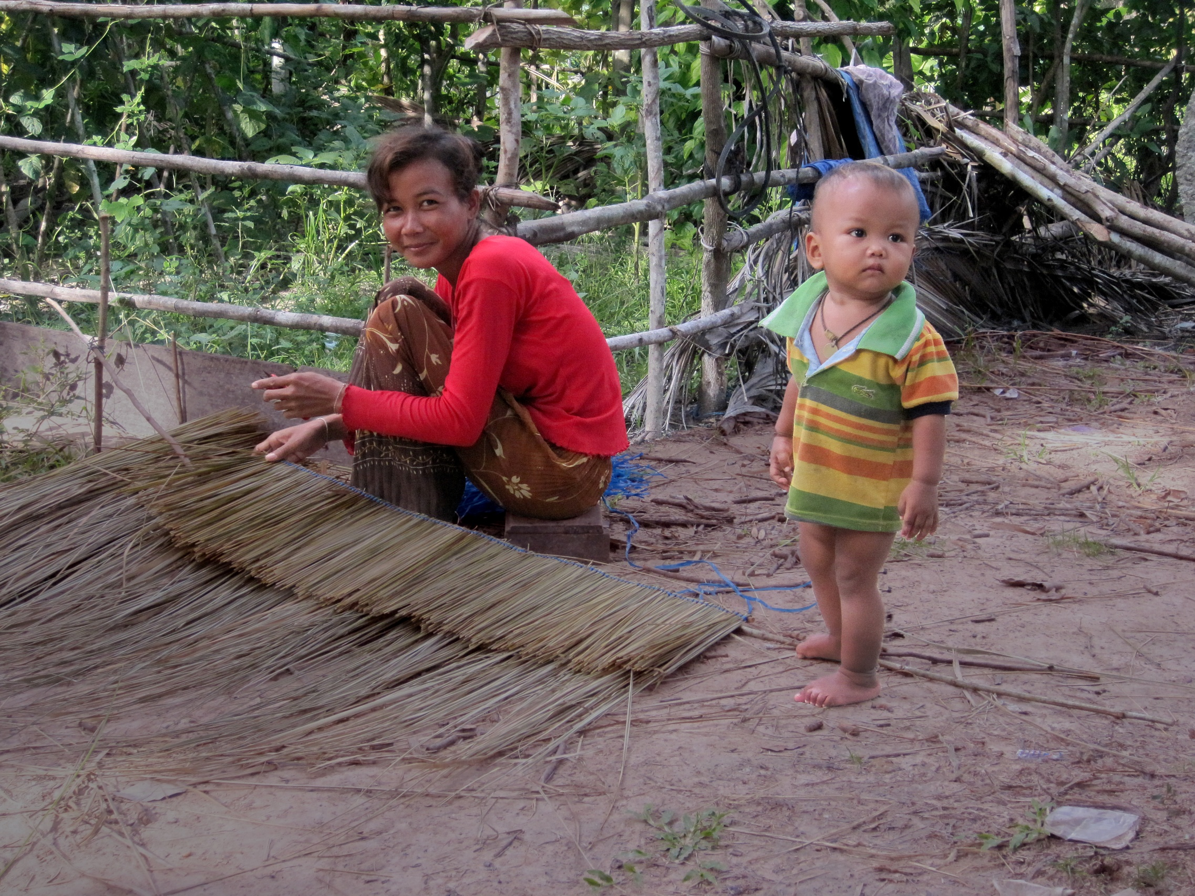
Notes:
At RECOFTC we embrace a broad definition of ‘community forestry’ that includes all aspects, initiatives, science, policies, institutions, and processes that increase the role of all local peoples—including women, youth and disadvantaged groups—in governing and managing forest resources. It consists of informal, customary and indigenous, and formal or government-led initiatives.
Community forestry includes a variety of institutional arrangements such as indigenous management of sacred sites of cultural importance, direct community control or management of forest areas, small-scale forest-based enterprises, forest out-grower schemes, company-community partnerships, and other forms of decentralized and devolved forest management.

Slide 3
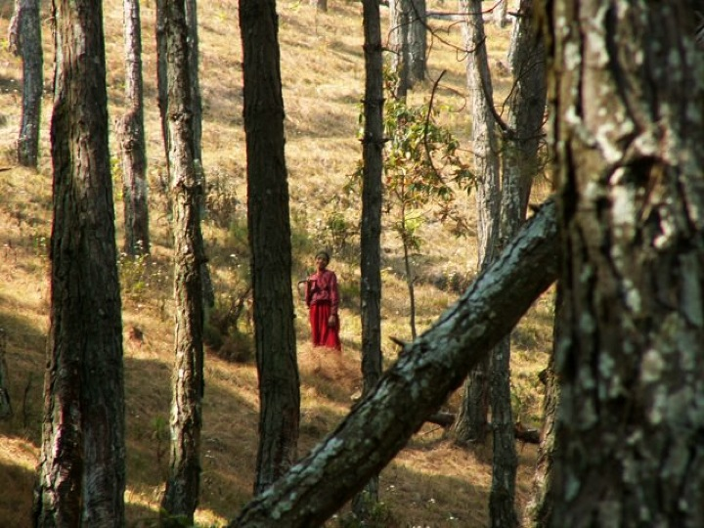
=
Seeing people through the trees
Notes:
Since its very inception, the concept of ‘Community Forestry’ has added new dimensions to forest management and governance. It has helped to make the forest sector a more dynamic and interesting field of work.
More concretely, over the years Community Forestry has proved itself to be one of the most appropriate and effective strategies for working towards achieving sustainable forest management.
It calls for a fundamental “change” in the way forest resources are used - that they be managed and governed by local and indigenous people for their own direct benefit.
3

Slide 4
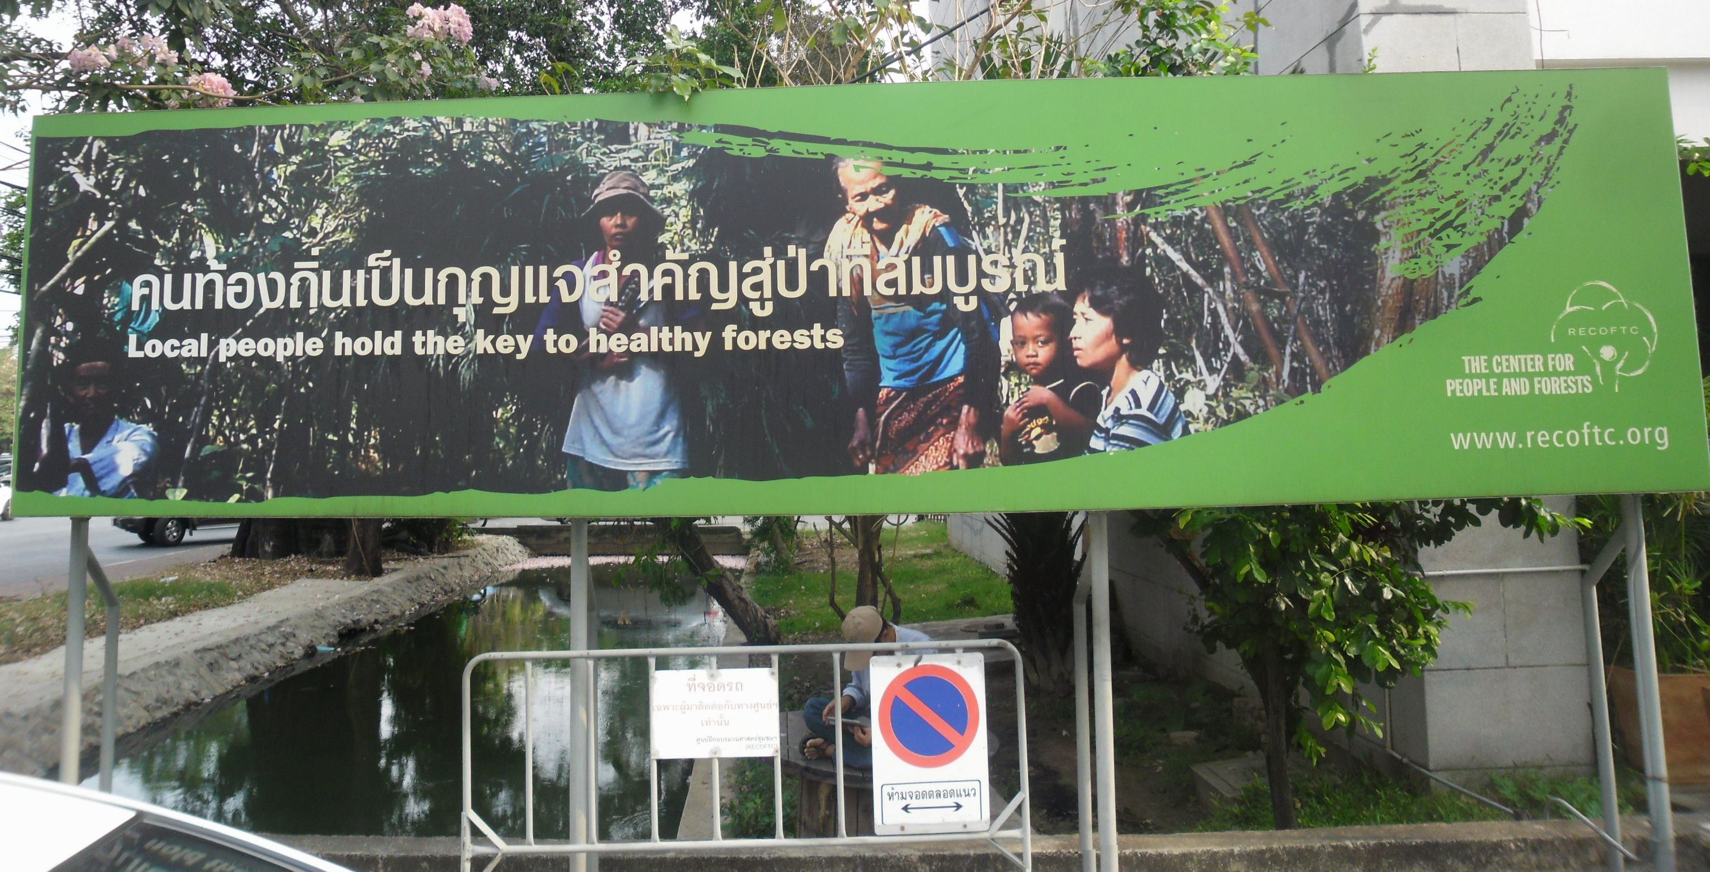
The ‘Bundle of Rights’
Project Southeast Asia
Southeast Asian Studies Symposium 2014
“Southeast Asia in Transition”
22 – 23 March 2014,
Keble College, University of Oxford
Community forestry =
all aspects, initiatives, science, policies, institutions, and processes that increase the role of all local peoples—including women, youth and disadvantaged groups—in governing and managing forest resources

Slide 5
Why Community Forestry?
Notes:
There is ample evidence that community forestry can contribute to local livelihoods, reducing deforestation and improving forest condition, and strengthening good governance.
i.e. community forestry contributes to all 3 pillars of sustainable development – the economic, the environmental and the social.
By putting local people at the heart of forest decision-making and management, community forestry can make sustainable forest management a reality.

Slide 6
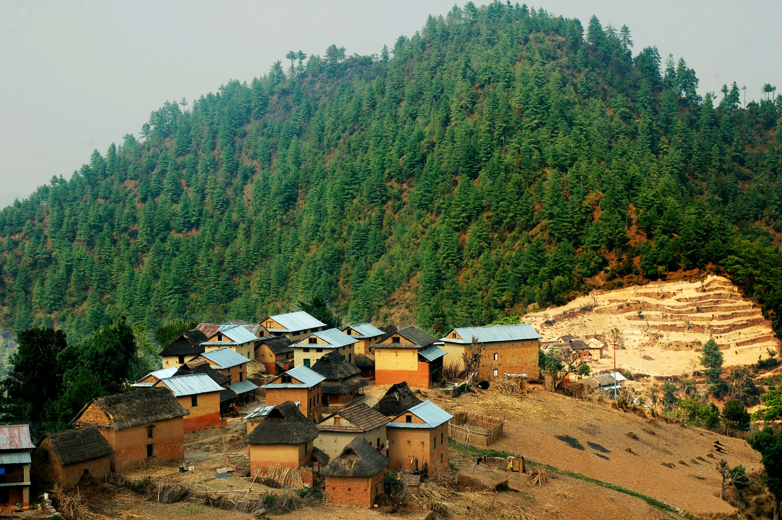
WHAT IS THE CURRENT STATUS OF COMMUNITY FORESTRY IN ASIA ?

Slide 7
BUNDLE OF RIGHTS

Slide 8

‘Bundle of Rights’ in ASEAN ‘Social Forestry’
(data from RECOFTC 2014)

Slide 9
BUNDLE OF RIGHTS
Y
E
S
Y
E
S
BUT
LIMI-
TED
Y
E
S
YES,
SOME NOT CLEAR
LAOS NO
NO
EXCEPT MYANMAR

Slide 10
Current CF Status v Targets
(from RECOFTC 2014)

Slide 11
Current CF Status v Targets
(from RECOFTC 2014)

Slide 12
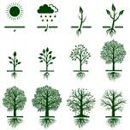
CF Target – Myanmar, 2001-2030
% Achieved: 4%
% Achieved: 100%

Slide 13
CF Target – Indonesia, 2011-2016
% Achieved: 5%
% Achieved: 100%

Slide 14
CF Target – Cambodia, 2010-2019
% Achieved: 9%
% Achieved: 100%

Slide 15
CF Target – Philippines, 1997-2008
% Achieved: 45%
% Achieved: 100%

Slide 16
CF Target – Vietnam, 2006-2020
% Achieved: 95%
% Achieved: 100%

Slide 17

Current CF Status v Targets
(from RECOFTC 2014)

Slide 18
Targets v Forest Area v CF
(from Bampton 2015 [in press])

Slide 19
CF in ASEAN
Total Land Area = 435,405,300 = 100%
Forest Land Area = 252,535,074ha = 58%
Forest Area = 199,975,262ha = 46%
Official Community Forest
8,806,470ha
2%
(data from RECOFTC 2014)
Notes:
2%CF of total land area, 3.5% of Forest land area

Slide 20
CF Development v Deforestation
Notes:
Defo is 6X faster the CF expansion

Slide 21
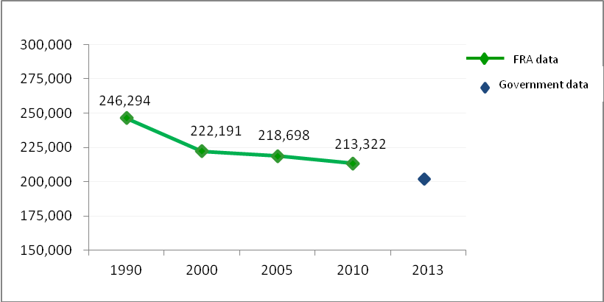
Forest in ASEAN
(thousands of hectares, from RECOFTC 2014)

Slide 22
Why is community forestry developing slowly?

Slide 23
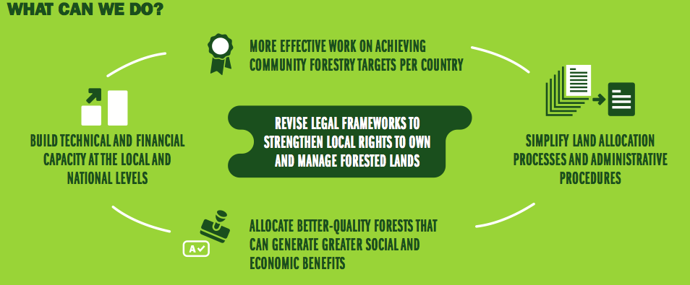

What can we do?

Slide 25
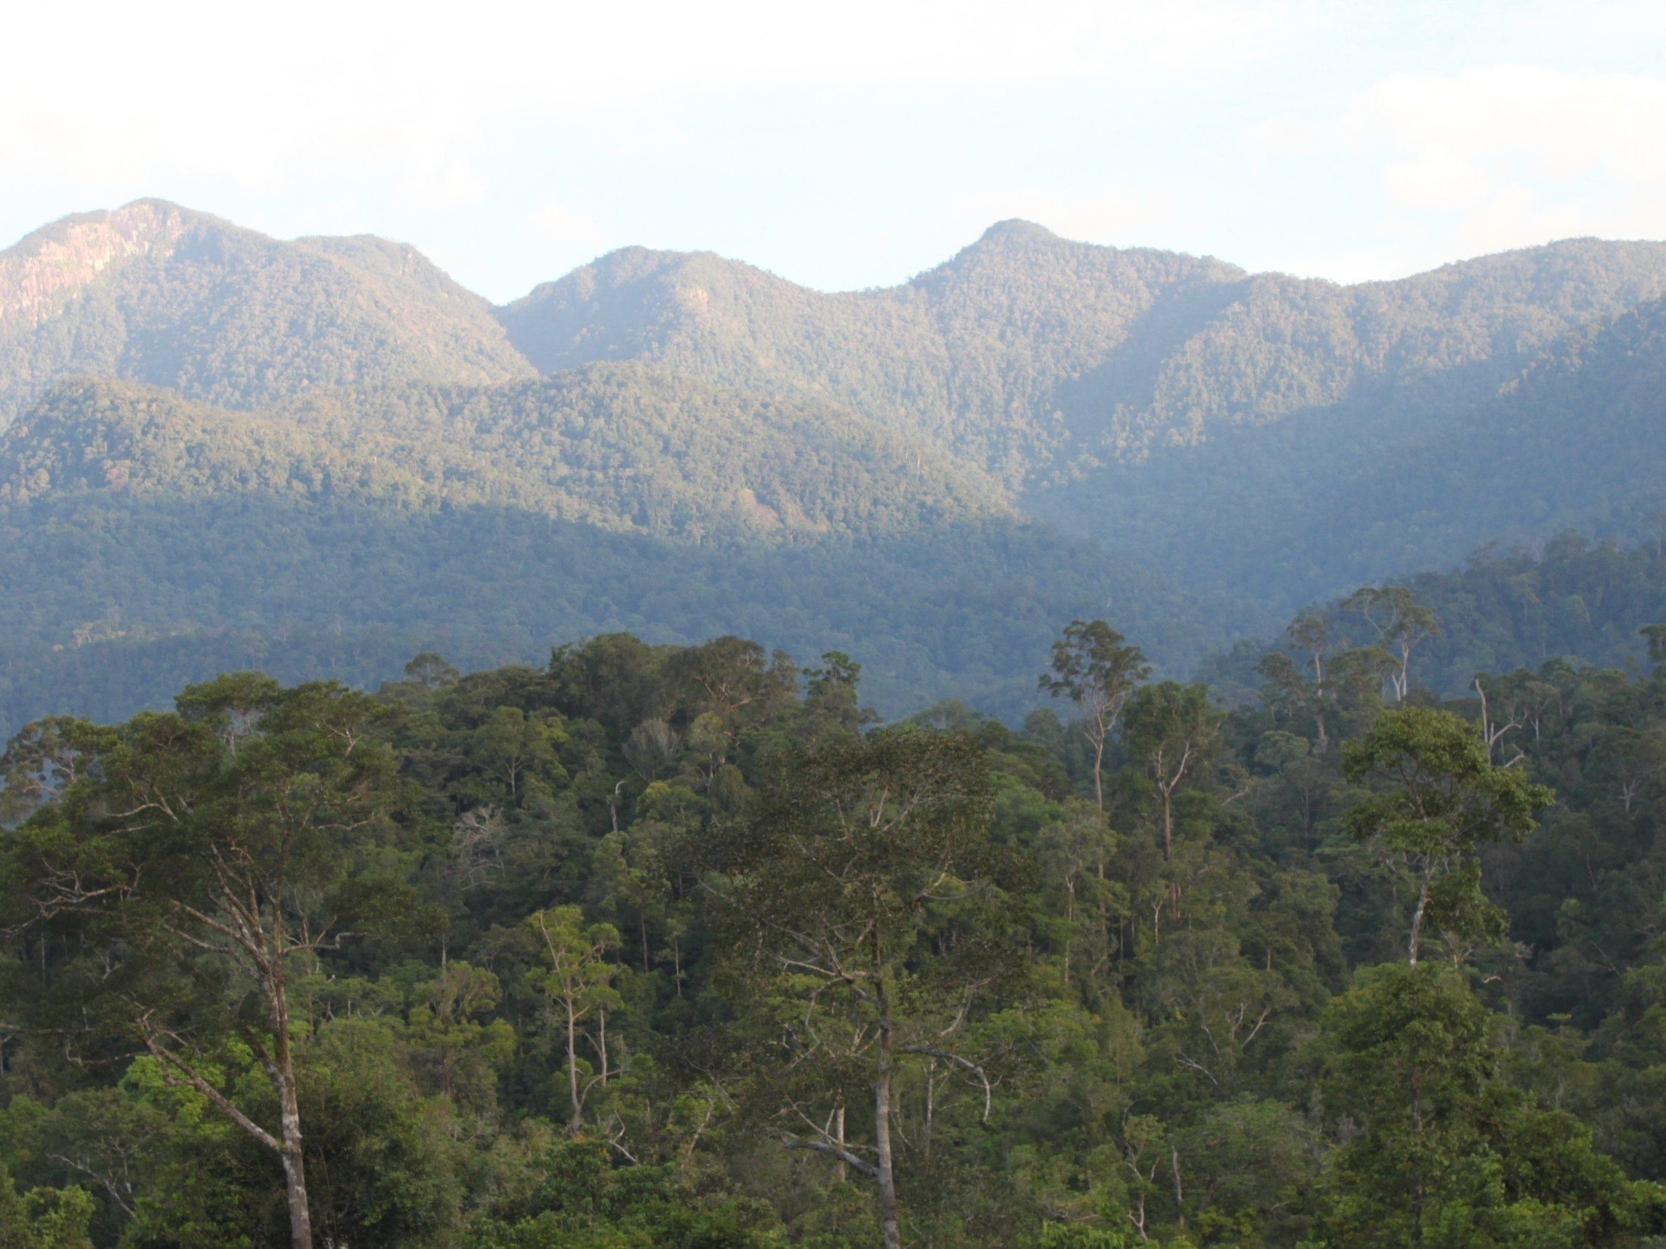

Thank you
Wealthy rural communities & healthy forests……
Community Forestry can make it happen
www.recoftc.org

